Slide 1

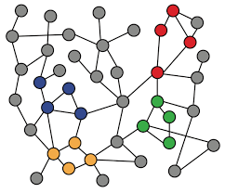
6-4. Kronecker Graph Model
Machine Learning with Graphs
Kronecker Product
Stochastic Kronecker Graphs Generation
ref: Jure Leskovec – Stanford CS224W: Machine Learning with Graphs
周遠同 (Chou Yuan-Tung), ton731@gmail.com
Notes:
Kronecker Product是这一个模型中一种重要的运算方式
Stochastic随机的

Slide 2
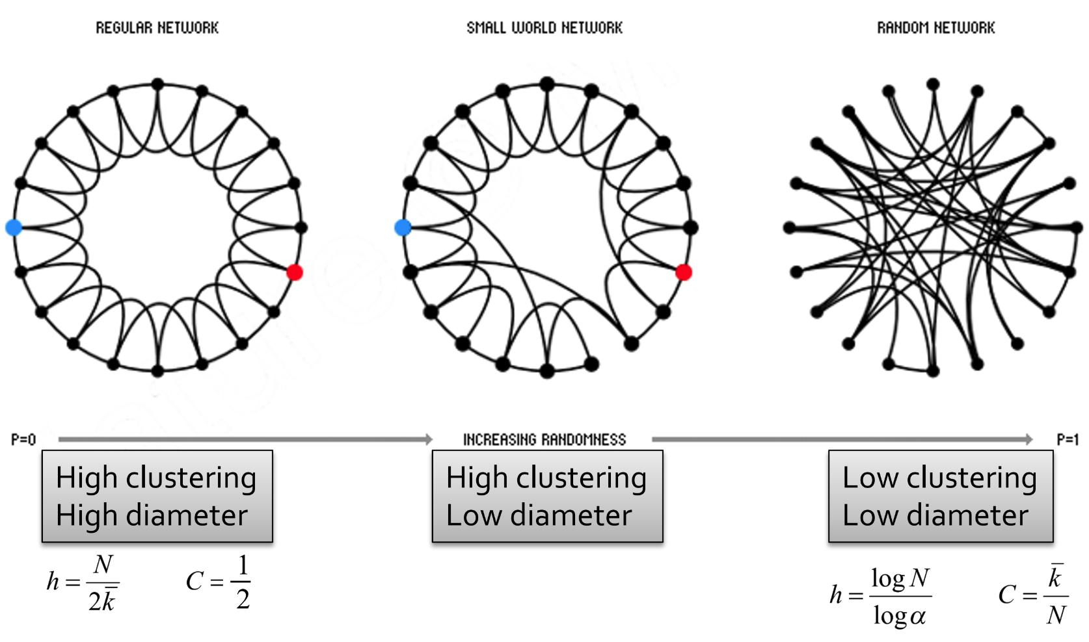
Recap: The Small World Model
It has high clustering and low diameter, but the degree distribution is still far from real world graph…
Notes:
but the degree distribution is still far from real world graph…

Slide 3
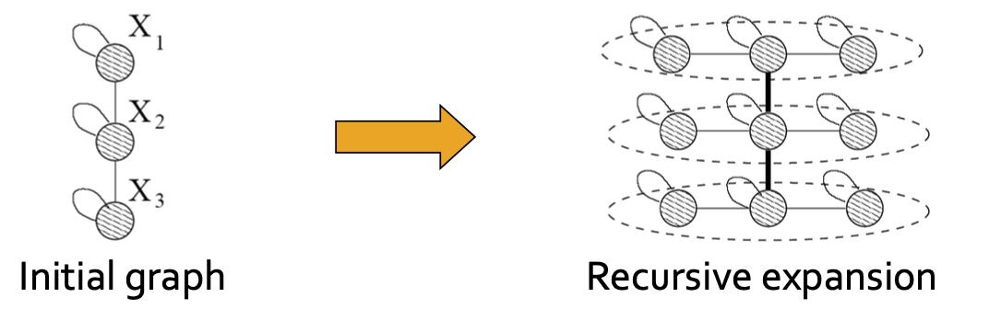
Recursive Graph Generation
How can we design network structure recursively?
  Object is similar to a part of itself
Kronecker product is a way of generating self-similar matrices
paper: Kronecker Graphs: An Approach to Modeling Networks
Notes:
self-similar matrices自相似矩阵

Slide 4
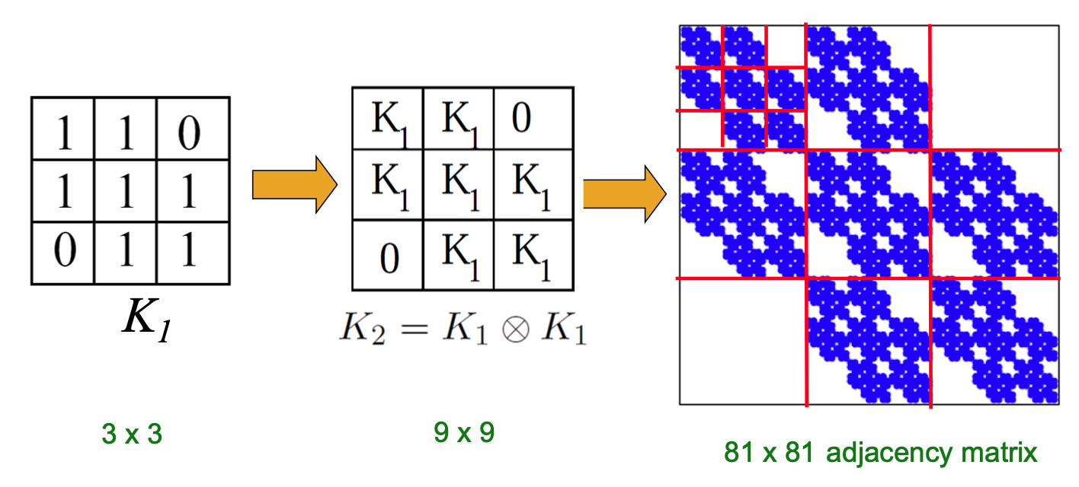
Kronecker Graph
Kronecker graphs: A recursive model of network structure
  graphs are represented as adjacency matrices

Slide 5
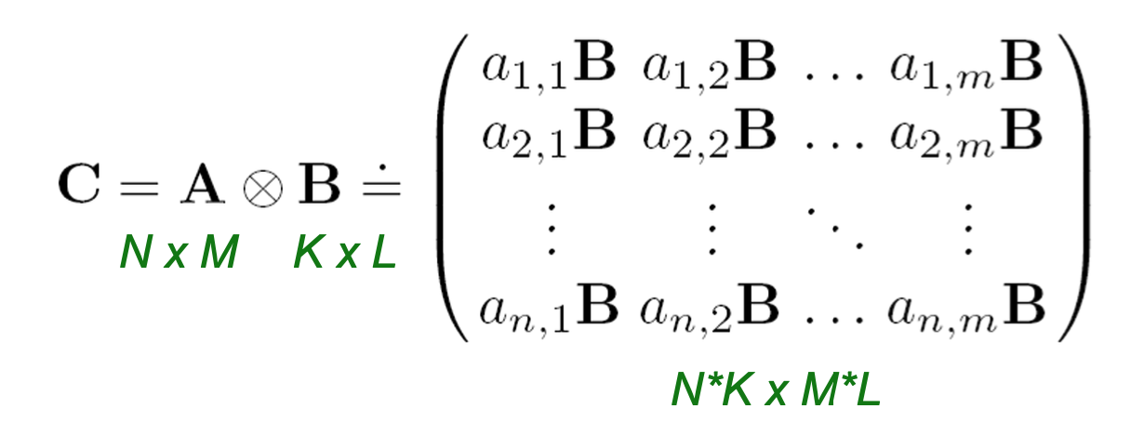
Kronecker Product
Kronecker product of matrices A and B is given as follows, where both A and B are graphs.
Notes:
两个矩阵可以是不同的形状，宽高也不要求相等

Slide 6
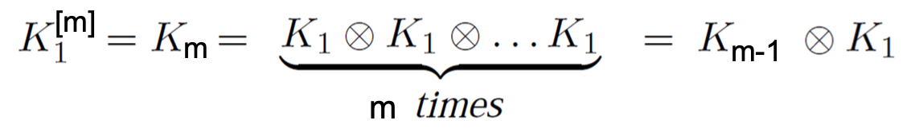
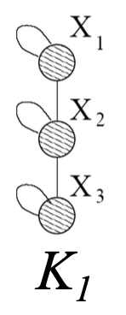
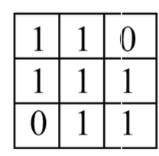
Kronecker Graphs
By iterating the Kronecker product over the initiator matrix K1, we can get the final Kronecker graph.

Slide 7
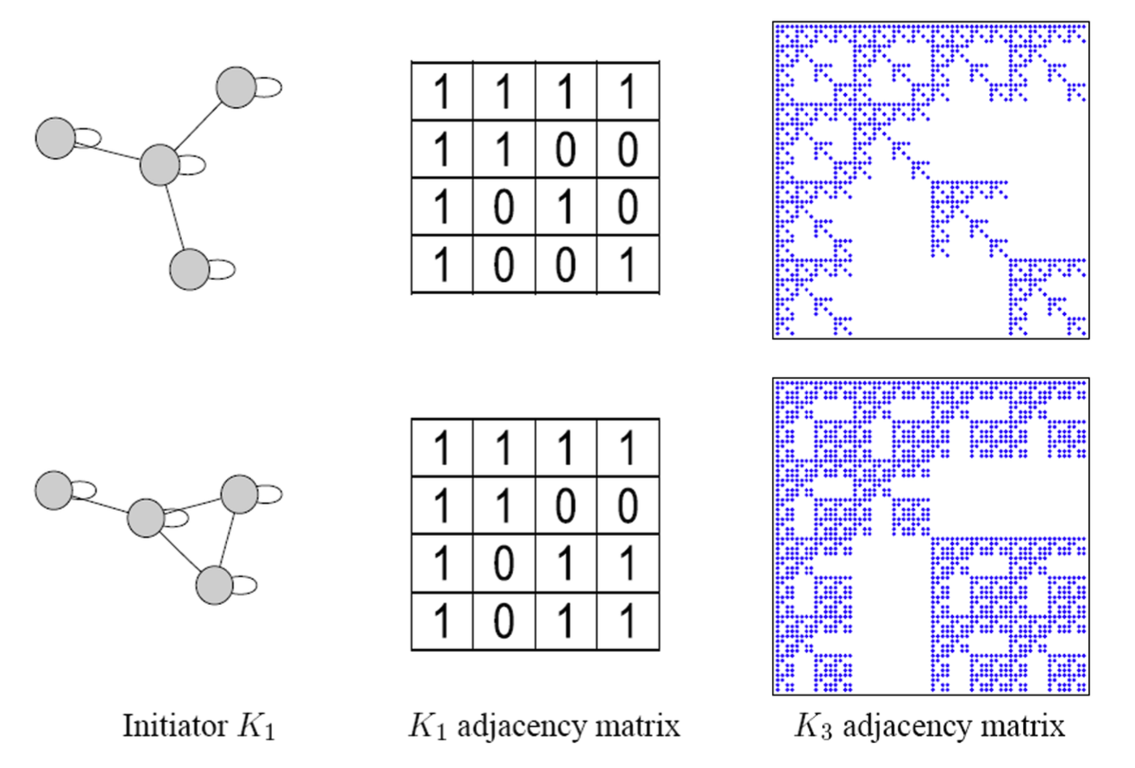
Kronecker Initiator Matrices
The final generated graphs are determined by the Kronecker initiators.

Slide 8
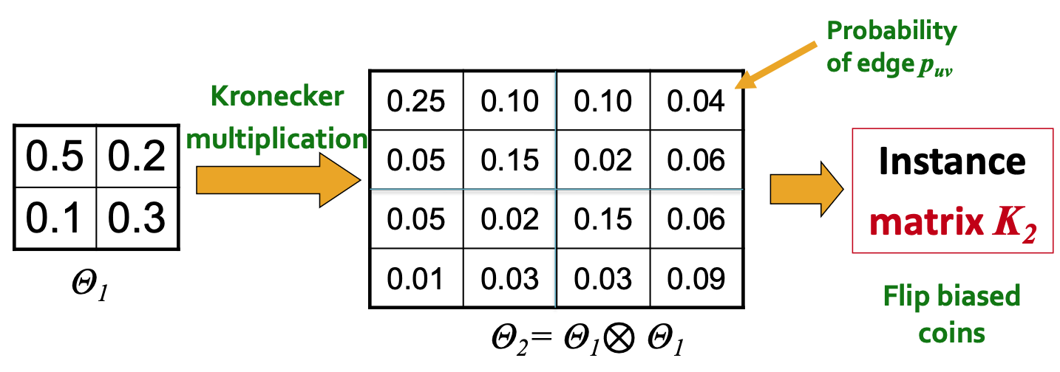
Stochastic Kronecker Graphs
We don’t have to set the adjacency matrices as 0 and 1, since it would make the graphs deterministic.
We can use a probability matrix as the initiator, and flip a coin to decide if there’s an edge.
Notes:
怎样通过生成的几率矩阵生成10矩阵呢，就是按照这个概率掷一次硬币，这样就会多很多随机性

Slide 9
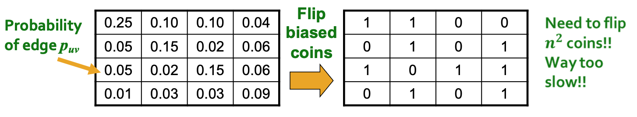
Generation of Stochastic Kronecker Graphs
Stochastic Kronecker graph instances are generated by flipping coins.
Idea of faster way: Exploit the recursive structure of Kronecker graph
  “Drop” edges one by one
Notes:
但是如果点太多了的话，就譬如facebook有20亿个点，都掷一次硬币的话太费事了

Slide 10
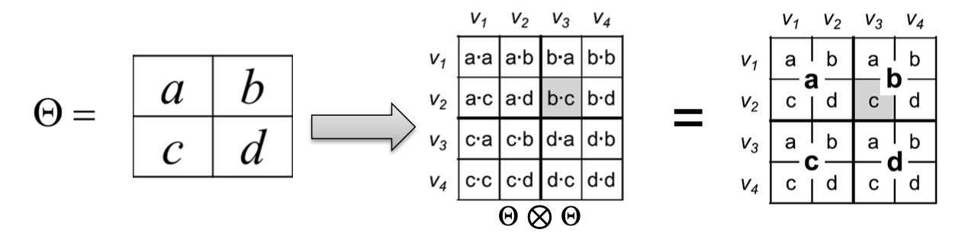
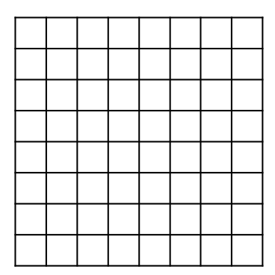
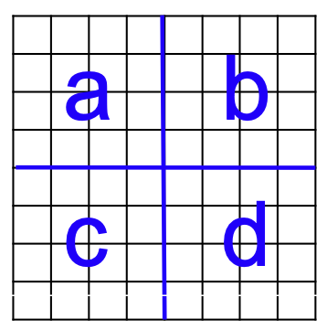
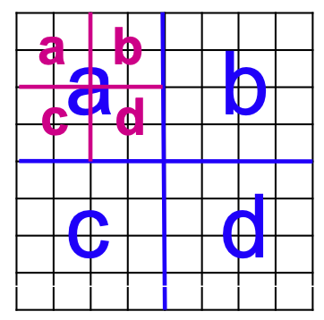
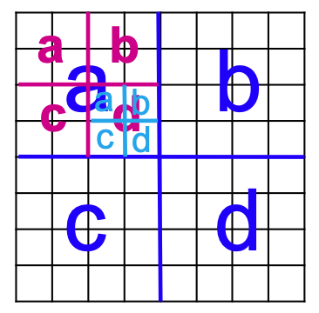
Generation of Stochastic Kronecker Graphs
Faster way: Drop edges into a graph one by one

Slide 11
Generation of Stochastic Kronecker Graphs
Real-world graph: 15,000 nodes, 20,000 edges
2*2 initiator → 13 times of Kronecker product → 16,384 nodes
Original complexity: 16384 * 16384 = 268M
Drop edge one by one:
  Each edge: (2*2) * 13 = 52
  Total complexity: 52 * 20000 = 1.04M
Notes:
举个现实的例子来对比一样两种产生方式

Slide 12
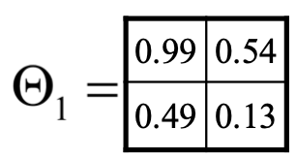
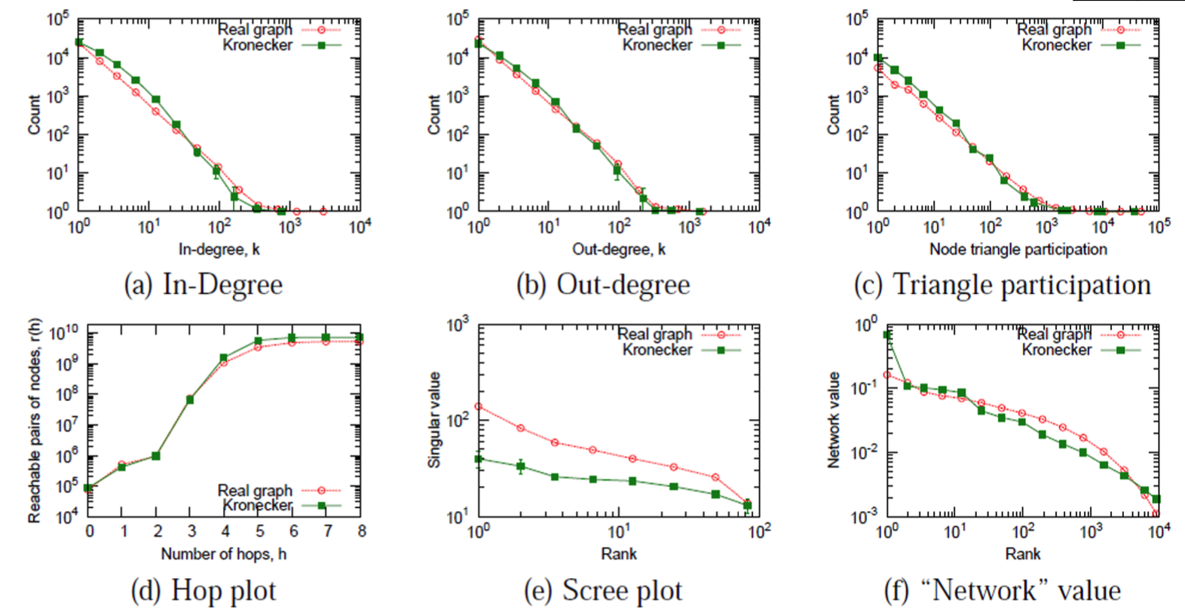
Properties of the Generated Graphs
Real graph: Epinions (node=76k, edge=510k)
Real and Kronecker are very close!

Slide 13
Summary of Graph Models
Traditional graph generative models
  Erdös-Renyi graphs
  Small-wrold graphs
  Kronecker graphs
  These graph models have some prior assumption of the graph generation process
Next: Deep graph generative models
  Learn the graph generation process from raw data
Notes:
These graph models have some prior assumption of the graph generation process这些图模型对图的生成过程有一定的先验假设
下一步骤要研究的：
Next: Deep graph generative models
Learn the graph generation process from raw data

