Slide 1

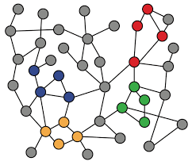
5-5. Data Splitting for Graphs
Machine Learning with Graphs
Transductive Settings
Inductive Settings
ref: Jure Leskovec – Stanford CS224W: Machine Learning with Graphs
周遠同 (Chou Yuan-Tung), ton731@gmail.com
Notes:
Data Splitting for Graphs数据分割
怎么把graph切成训练集（Training Set）、验证集（Validation Set）、测试集（Test Set）
训练跟验证集用来训模型，测试集在模型训练完成后进行测试
Transductive Settings：指的是推断（传导）设置，通常是指学习模型旨在对训练期间已经见过的数据进行预测。在图数据中，这可能意味着在数据分割时，所有的节点都在同一个图中，模型需要在看到部分节点标签的情况下推断其余节点的标签。
Inductive Settings：指的是归纳设置，模型需要在训练时未见过的数据上进行预测。对于图数据，这通常意味着模型被训练来推广到全新的图或图中的节点，这些是在训练过程中未被观察到的。

Slide 2
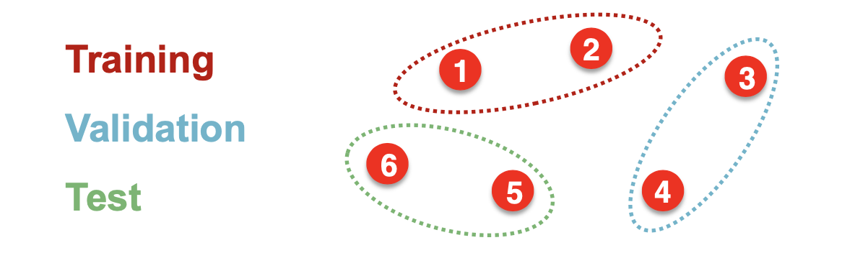
Why Splitting Graphs is Special?
When training deep learning models, we split data into:
Training set: used for optimizing model parameters
Validation set: used for selecting model/hyperparameters
Test set: held out for final peformance
For image data, we can simply split into groups of images…
data points are independent!
Notes:
For image data举例对比

Slide 3
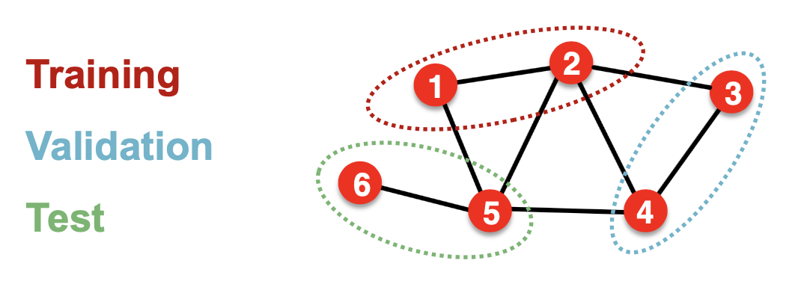
Why Splitting Graphs is Special?
Splitting a graph dataset is different!
In node-level tasks, data points are not independent!
Prediction of Node 1 will be influenced by Node 5 and Node 3
Notes:
类比于上一节，那为什么我们今天要把graph拿出来讨论呢？
In node-level tasks, data points are not independent!

Slide 4
Splitting Solution 1
Solution 1: Transductive setting
The input graph can be observed in all the dataset splits.
Only the node labels are splitted.
At training time, we compute embeddings using the entire graph, and train the model with node 1 & 2’s labels
At validation time, we compute embeddings using the entire graph, and evaluate on node 3 & 4’s labels
Notes:
假设只有一个graph
使用Transductive setting不会改变图原有的信息，区分只是计算label时算不算分数

Slide 5
Splitting Solution 2
Solution 2: Inductive setting
Edges are broken and graph is splitted to multiple graphs.
Now we have 3 graphs.
At training time, we compute embeddings using the graph over node 1 & 2, and train the model with node 1 & 2’s labels
At validation time, we compute embeddings using the graph over node 3 & 4, and evaluate on node 3 & 4’s labels
Notes:
Edges are broken and graph is splitted to multiple graphs.

Slide 6
Transductive / Inductive Settings
Transductive setting: training / validation / test sets are on the same graph
Usually performed on single-graph dataset
Only labels are splitted
Applicable to node / edge prediction tasks
Inductive setting: training / validation / test sets are on different graphs
Usually performed on multiple-graph dataset
Nodes / edges / labels are splitted
Applicable to node / edge / graph tasks
Notes:
那么这两种方法真正的idea是什么
传导设置：在这种设置下，训练集、验证集和测试集都来自于同一个图。这通常在单一图数据集上进行，也就是说，你有一个大的图，并且将这个图的一部分用于训练，另一部分用于验证，最后一部分用于测试。在这种设置中，图结构是完全可见的，但是标签是分开的。传导设置适用于节点预测和边预测任务。
归纳设置：与传导设置不同，在归纳设置中，训练、验证和测试集位于不同的图上。这通常在多图数据集上进行。这意味着模型需要学会从一个图中学习到的模式，并将这些模式应用到之前未见过的另一个图上。在这种设置中，节点、边和标签都可能是分开的。归纳设置适用于更广泛的任务，如节点预测、边预测和整个图的任务。
后面会有详细介绍

Slide 7
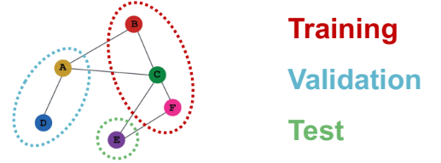
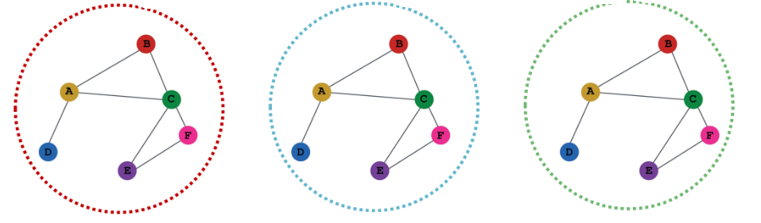
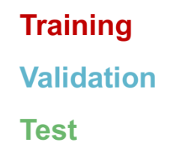
Example: Node Classification
Transductive node classification
Inductive node classification

Slide 8
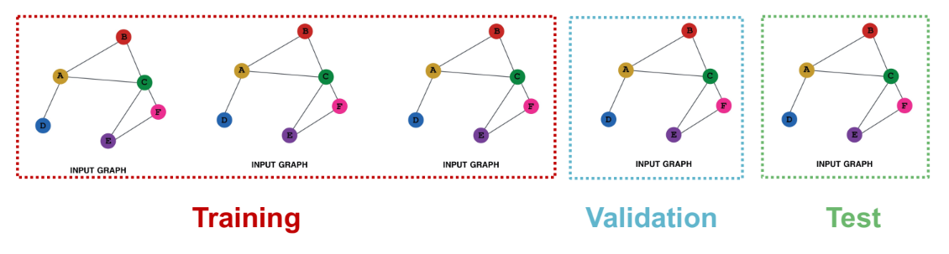
Example: Graph Classification
Graph classification is inherently used with inductive setting, since we have to test on unseen graphs.

Slide 9
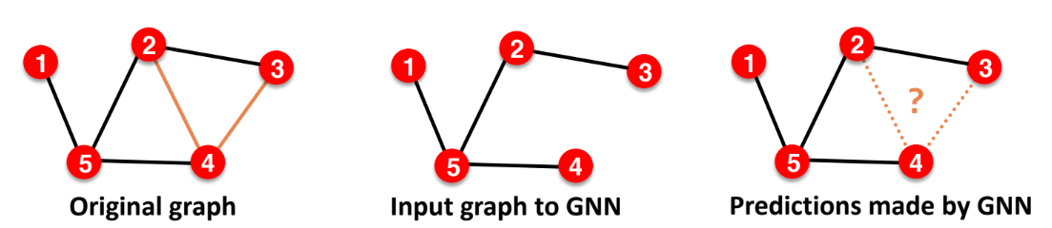
Example: Link Prediction
Goal of link prediction: predict missing edges
Link prediction is an unsupervised / self-supervised task
We have to hide some edges from the GNN and let the GNN predict if the edges exist.

Slide 10
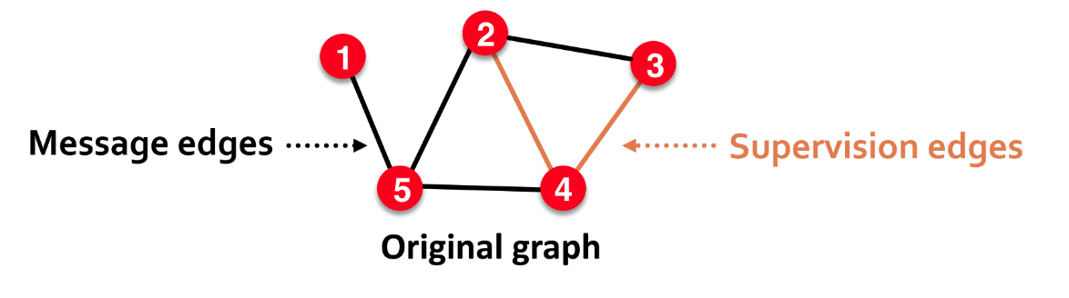
Link Prediction Setup
In link prediction, edges are splitted into two types.
Message edges: Used for GNN message passing
Supervision edges: Used for prediction and loss calculation
Only message edges will be fed into GNN

Slide 11
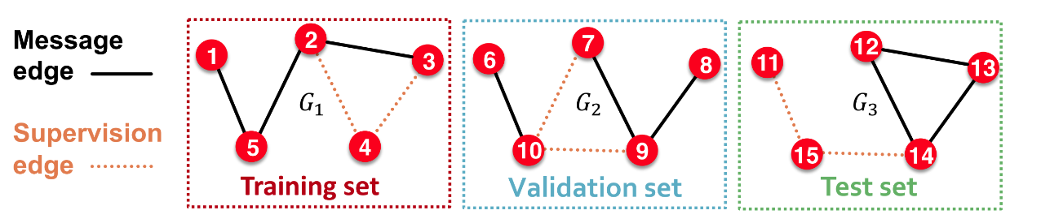
Inductive Link Prediction
Inductive link prediction
In each graph, some edges have to be hidden
In train/valid/test set, each graph will have to types of edges: message edges + supervision edges

Slide 12
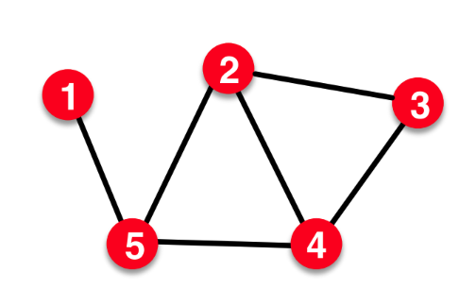
Transductive Link Prediction
Transductive link prediction
This is the default setting when people talk about link prediction.
For example, friend recommendation in social network
We only have one graph and the all of the nodes can be observed in each splits.

Slide 13
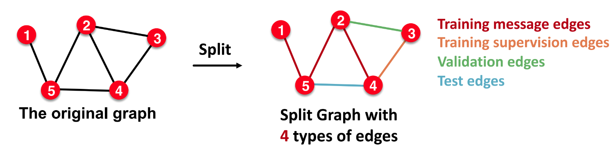
Transductive Link Prediction
Transductive link prediction task splits edges into four types:

Slide 14
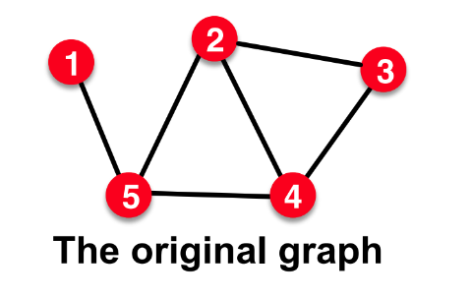
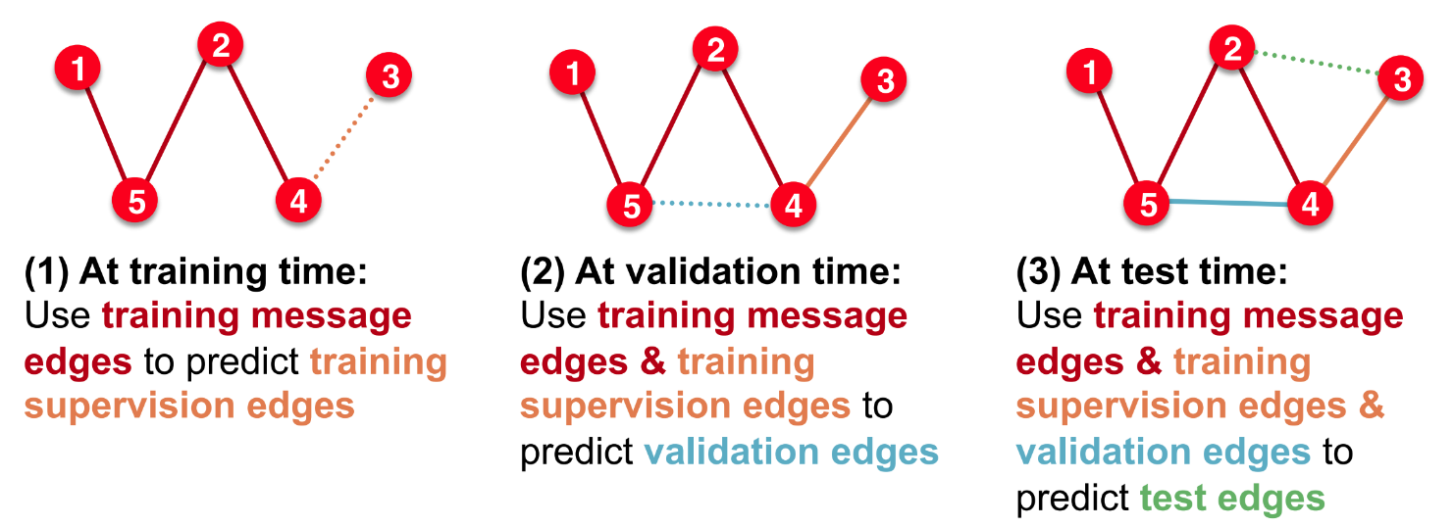
Transductive Link Prediction
Then we have to hold out supervision edges for train/valid/test sets

Slide 15
Summary
Node-level task
Inductive/transductive settings
Graph-level task
Inductive settings
Edge-level task
Inductive/transductive settings

