Slide 1

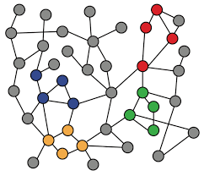
5-4. Graph Augmentation for GNNs
Machine Learning with Graphs
Graph Feature Augmentation
Graph Structure Augmentation
ref: Jure Leskovec – Stanford CS224W: Machine Learning with Graphs
周遠同 (Chou Yuan-Tung), ton731@gmail.com
Notes:
“Graph Augmentation for GNNs”（图增强技术在图神经网络中的应用）
概述了两种提升图神经网络性能的策略

Slide 2
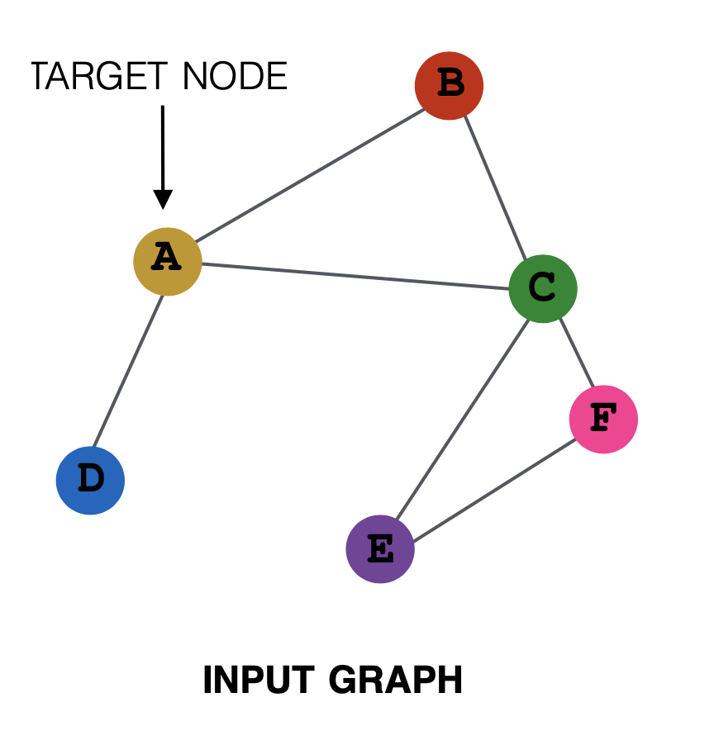
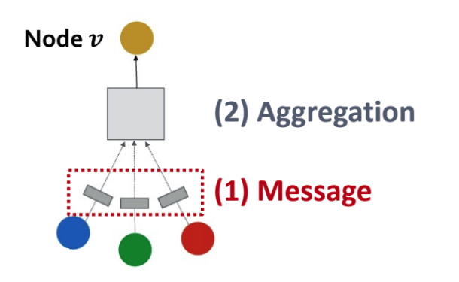
Why Augmenting Graphs?

Slide 3
Why Augmenting Graphs?
Graph feature augmentation
  The graph input lacks features
Graph structure augmentation
  The graph is too sparse → inefficient message passing
  The graph is too dense → message passing is to costly
  The graph is too large → cannot fit into memory
Notes:
Sparse稀松的
Dense密集的

Slide 4
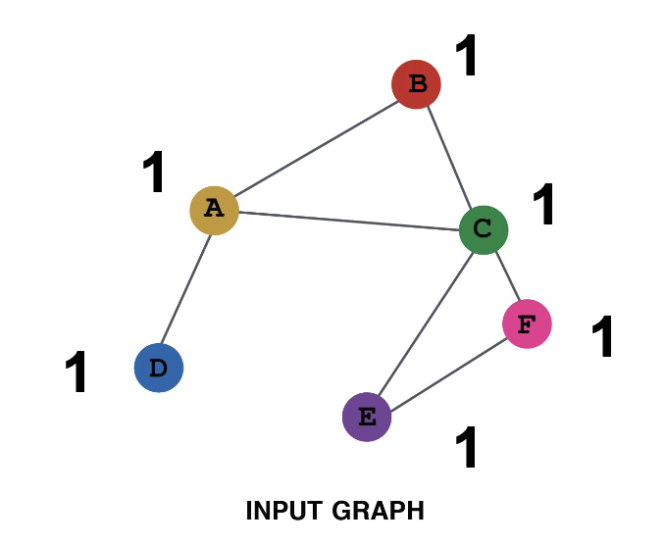
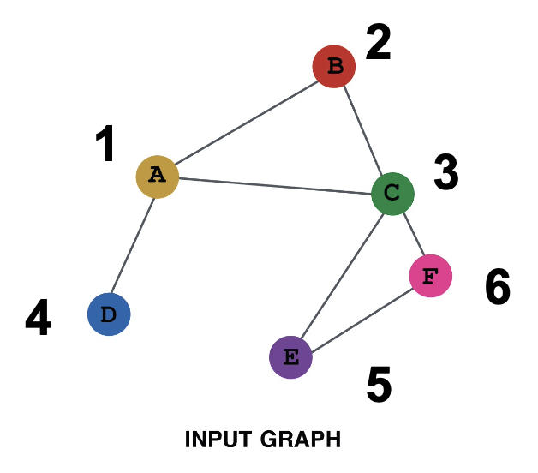
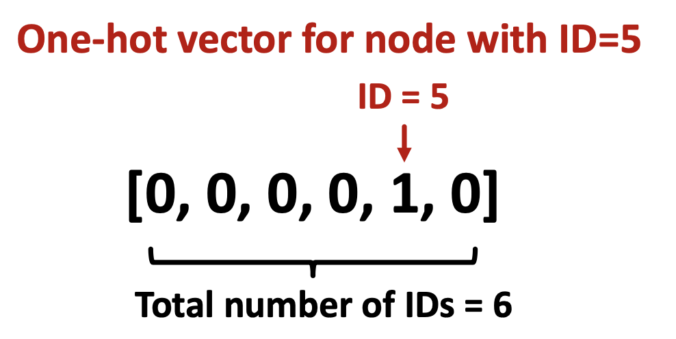
Feature Augmentation
Situation: Input graph does not have node features
Approach:
  Assign constant values to nodes
  Assign unique IDs to nodes

Slide 5
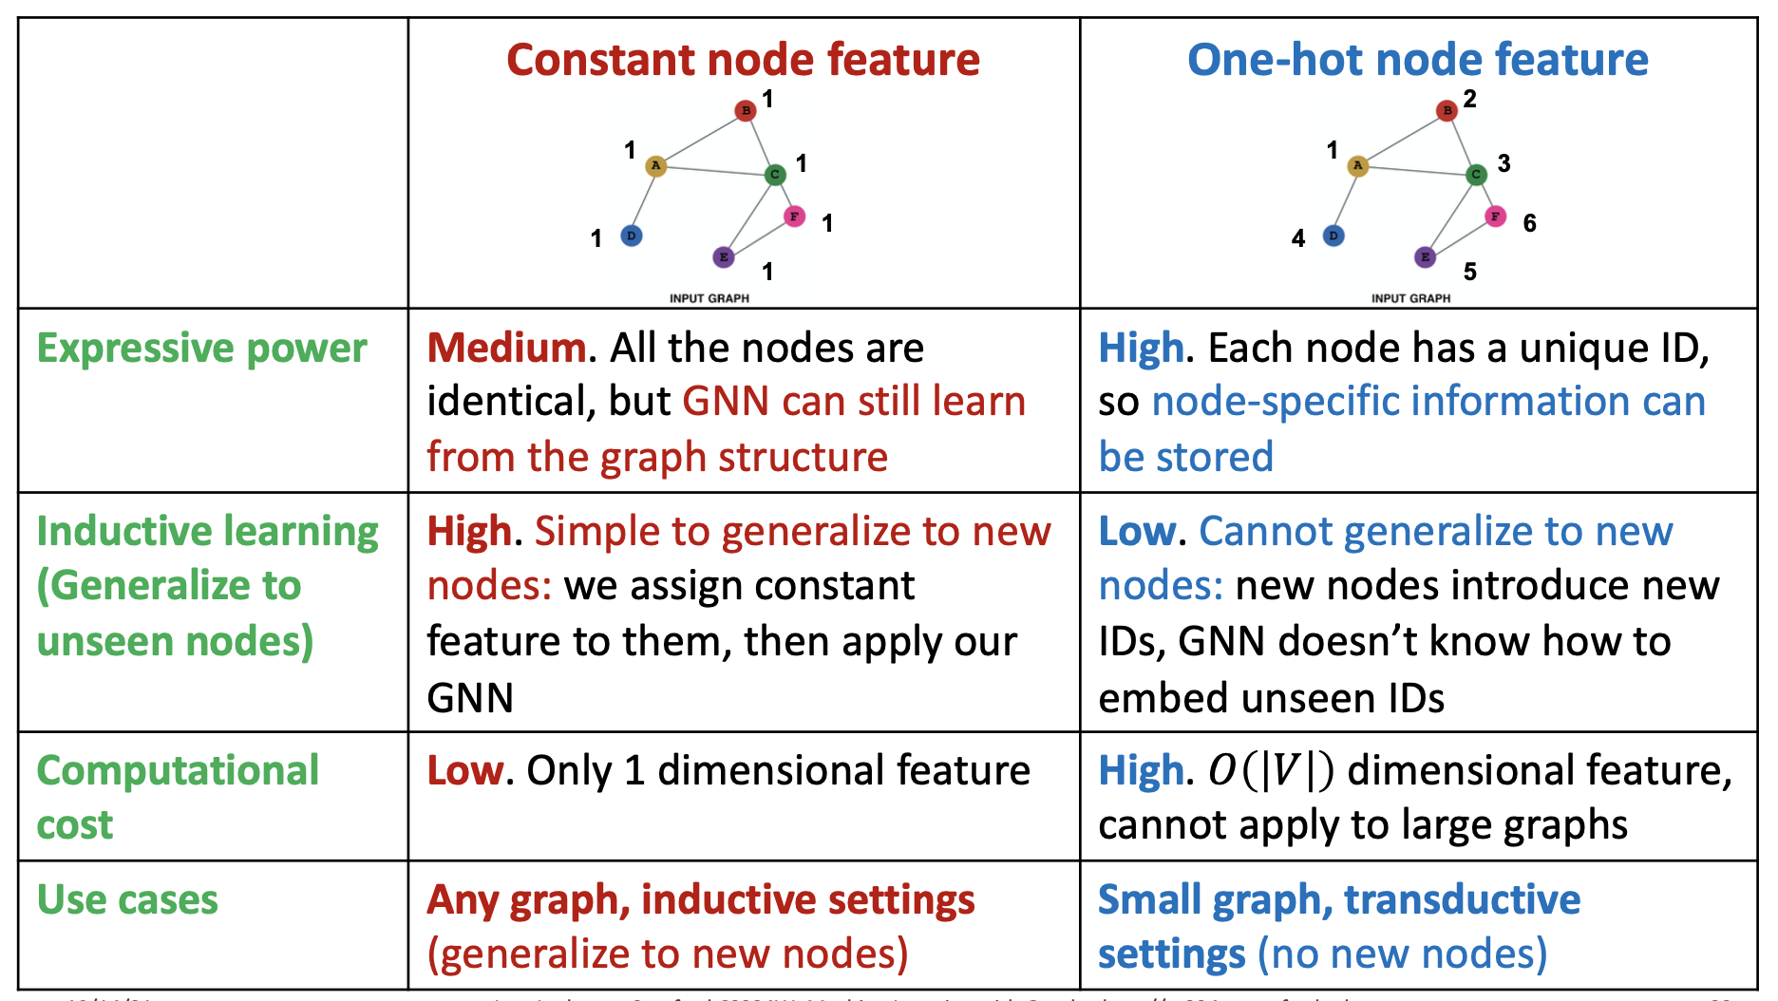
Feature Augmentation
Constant vs. One-hot
Notes:
恒定节点特征（Constant node feature）：
所有节点都有相同的特征值，这里是1。
表达能力：中等。所有节点都相同，但GNN仍然可以从图结构中学习。
归纳学习能力：高。对新节点进行归纳学习很简单，我们只需要给它们分配恒定的特征，然后应用GNN。
计算成本：低。只需要处理一维特征。
使用情况：任何图，特别适合归纳设置（推广到新节点）。
单热节点特征（One-hot node feature）：
每个节点都有一个唯一的标识符（ID），即单热编码。
表达能力：高。每个节点具有独特的ID，因此可以存储特定于节点的信息。
归纳学习能力：低。不能推广到新节点，因为新节点引入了新的ID，而GNN不知道如何嵌入看不见的ID。
计算成本：高。特征的维度与节点数（|V|）一致，不适合大规模图。
使用情况：适用于小图，传导设置（无新节点）。

Slide 6
Feature Augmentation
Node features we talked previously can also be used!
  Importance-based features
    Node degree
    Node centrality (Eigenvector, Betweenness, Closeness Centrality)
  Structure-based features
    Clustering coefficients
    Graphlets

Slide 7
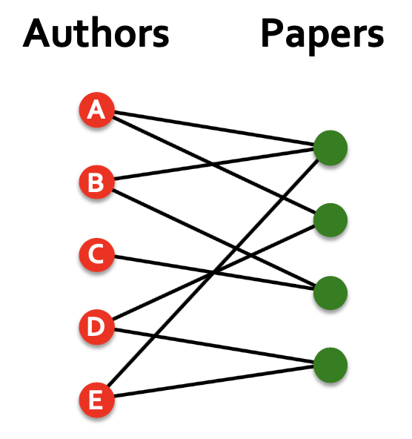
2. Virtual Nodes / Edges
Situation: the graphs are sparse
(1) Add virtual edges
  common approach: Connect 2-hop neighbors via virtual edges
  Intuition: Instead of adj. matrix A, use A + A^2
Use cases: Bipartite graphs
  Author-to-papers
  2-hop virtual edges
→ author-author collaboration graph
Notes:
接下来看到的这些方法都是通过改变graph的一些原有的特征

Slide 8
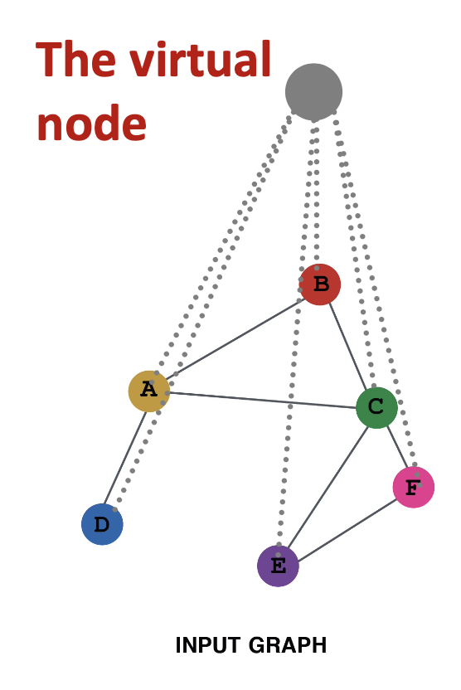
2. Virtual Nodes / Edges
Situation: the graphs are sparse
(2) Add virtual nodes
  After adding the virtual node, all the nodes will have a distance of two
  Benefits: Greatly improves message passing in sparse graphs

Slide 9
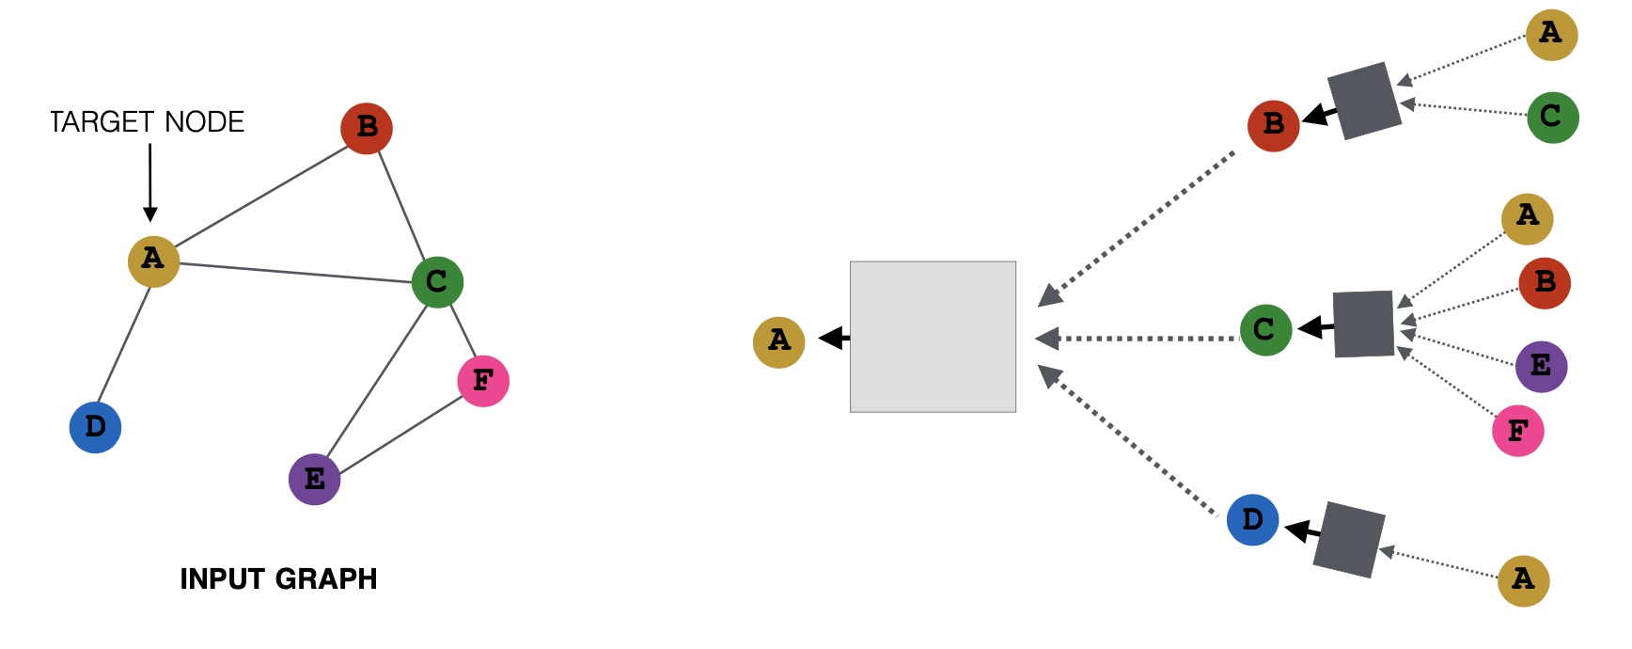
3. Neighborhood Sampling
Situation: the graphs are dense
Originally, all the nodes are used in the message passing process.
New idea: Randomly sample a node’s neighbor for message passing
Notes:
Sampling抽样

Slide 10
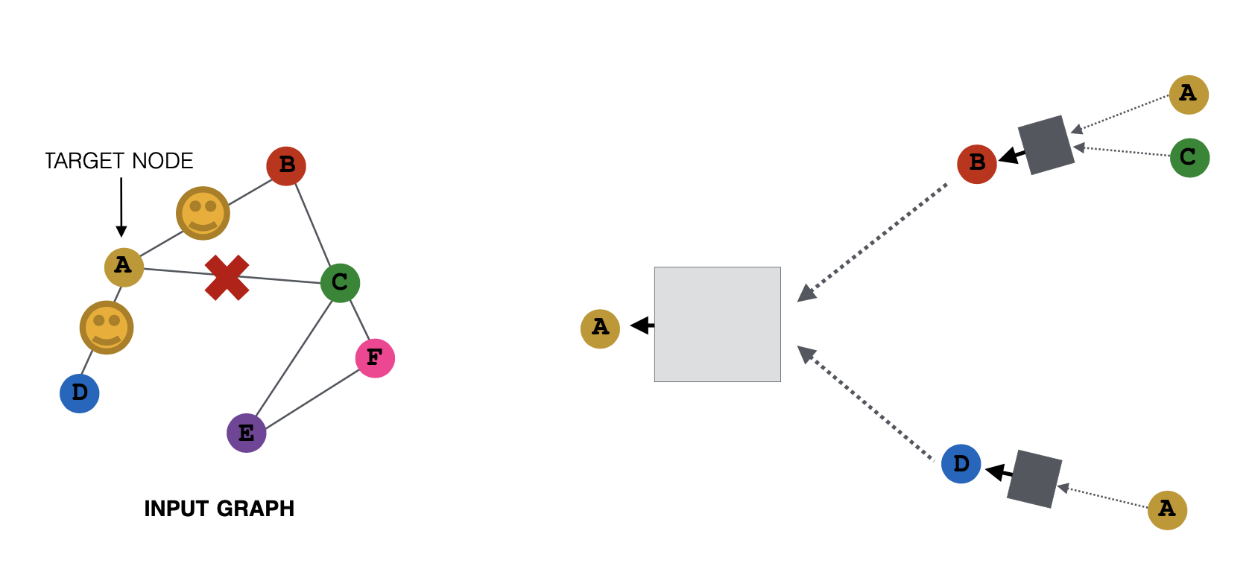
3. Neighborhood Sampling
In the first iteration, randomly sample 2 neighbors for message passing.

Slide 11
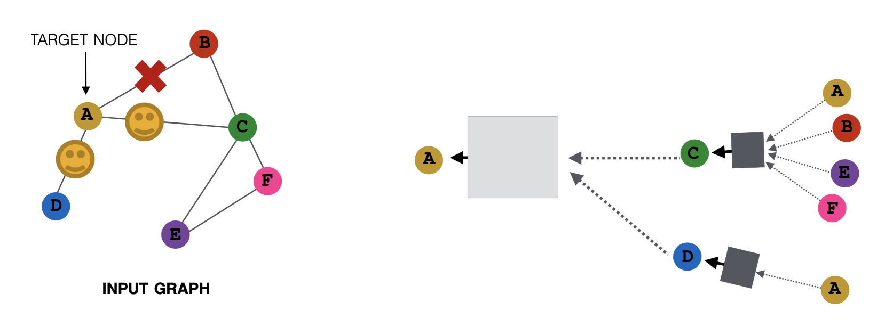
3. Neighborhood Sampling
In the next iteration, re-sample 2 neighbors for message passing.

Slide 12
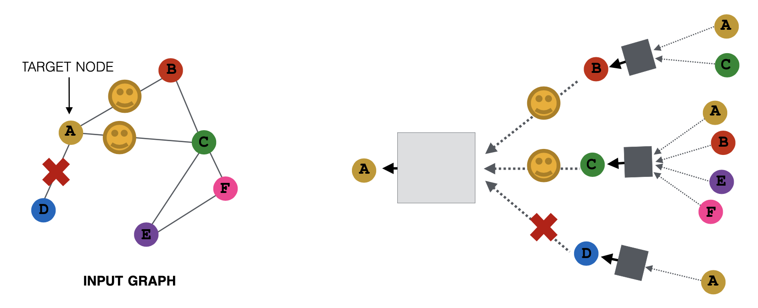
3. Neighborhood Sampling
After several iterations of sampling, we can get embeddings similar to those all neighbors are used in expectation.
Benefits: Reduces computation cost → Allows for scaling to large graphs

Slide 13
Summary
Input graph can be lacking of features, sparse, dense, large
Graph feature augmentation
  constant, IDs, importance-based and structure-based features
Graph structure augmentation
  Add virtual nodes / edges
  Sampling neighborhoods

