Slide 1
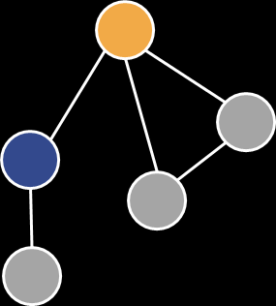
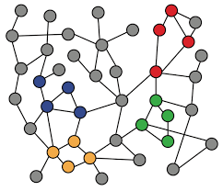
5-2. A General Perspective on Graph Neural Network
Machine Learning with Graphs
Convolution on Graphs
General GNN Framework
Inductive Capability
ref: Jure Leskovec – Stanford CS224W: Machine Learning with Graphs
周遠同 (Chou Yuan-Tung), ton731@gmail.com

Slide 2
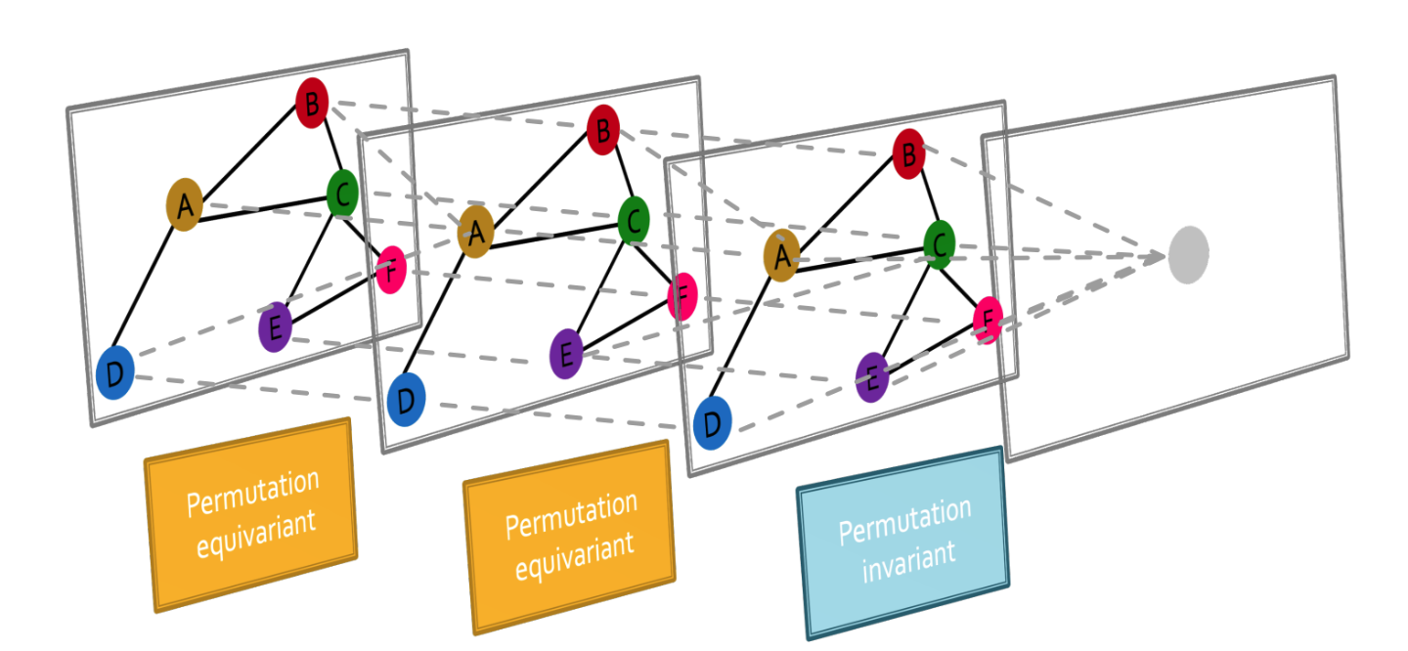
Recap: Graph Neural Network Overview
Graph neural networks consist of multiple permutation equivariant / invariant functions.
Notes:
NLP是自然语言处理（Natural Language Processing）的缩写

Slide 3
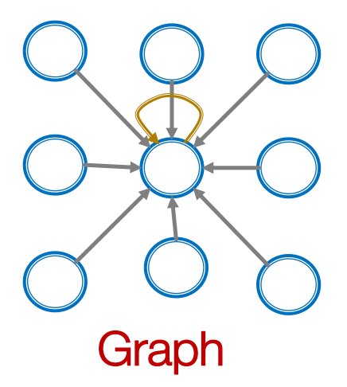
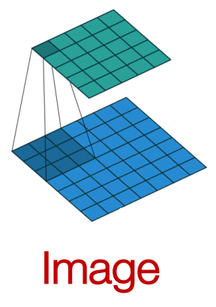
From Images to Graphs
Single convolutional neural network layer with 3x3 kernel:
Idea: transform information on neighbors and combine it.
Transform “messages” hi from neighbors: W * hi
Add them up: ∑ W * hi

Slide 4
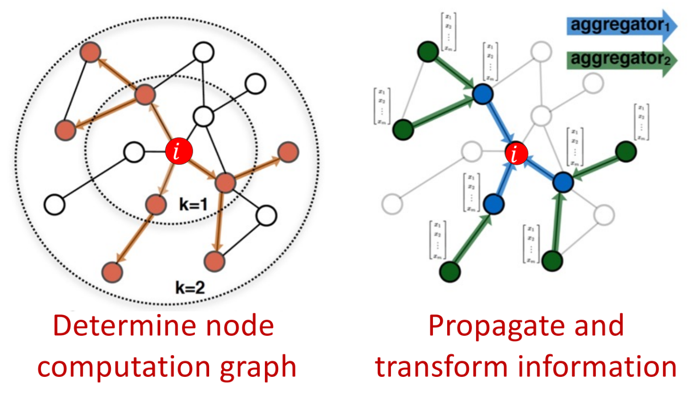
Graph Convolutional Networks
Idea: Node’s neighborhood defines a computation graph
→ Learn how to propagate information across the graph to compute node features

Slide 5
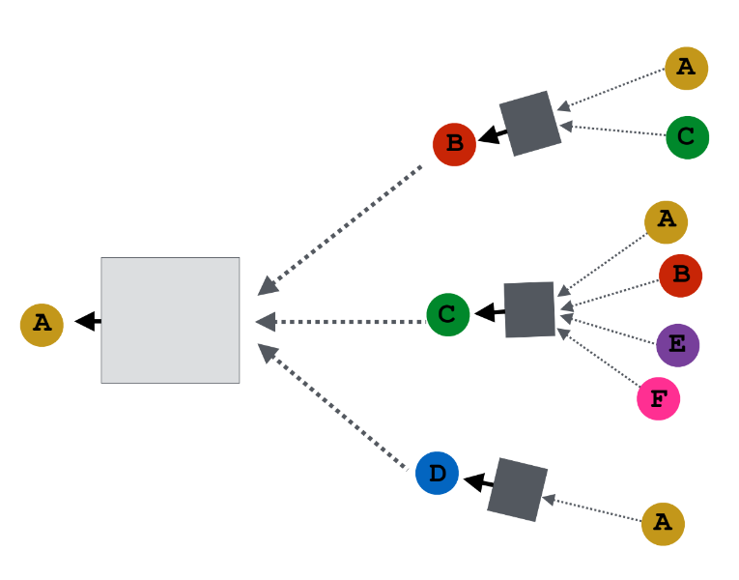
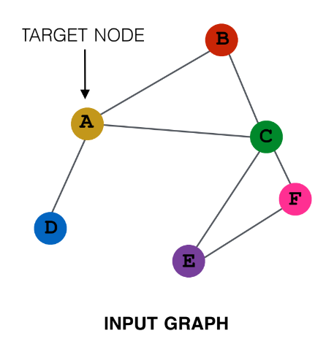
Idea: Aggregate Neighbors
Key idea: Generate node embeddings based on local network neighborhoods
Intuition: Neighboring information is aggregated using neural networks
NN
NN
NN
NN
Computational Graph
Notes:
Aggregate Neighbors 把邻居抓过来更新自己

Slide 6
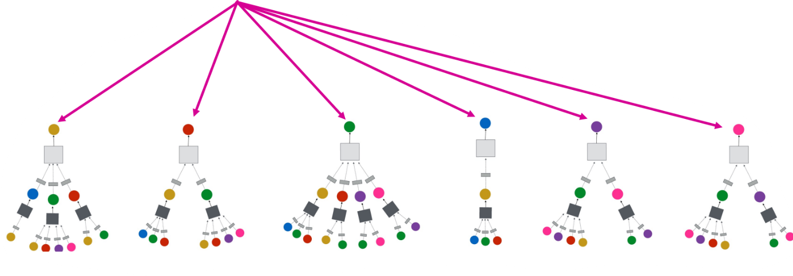
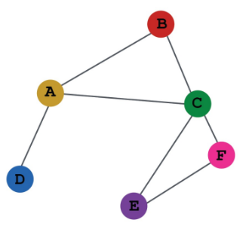
Idea: Aggregate Neighbors
Network neighborhood defines a computation graph
→ Every node defines a computation graph based on its neighboorhood.

Slide 7

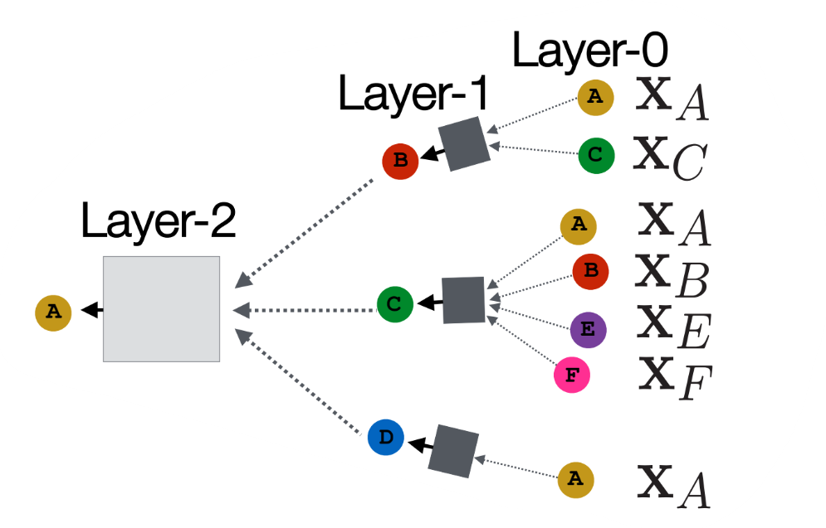
Receptive Field in GNN
Deeper model (more layers) can have bigger receptive field → Deep Encoder
Nodes have embedding at each layer
Layer-0 embedding of node v is it’s input feature,
Layer-k embedding gets information from nodes that are k hops away
average messages
?
?
(2) apply NN

Slide 8
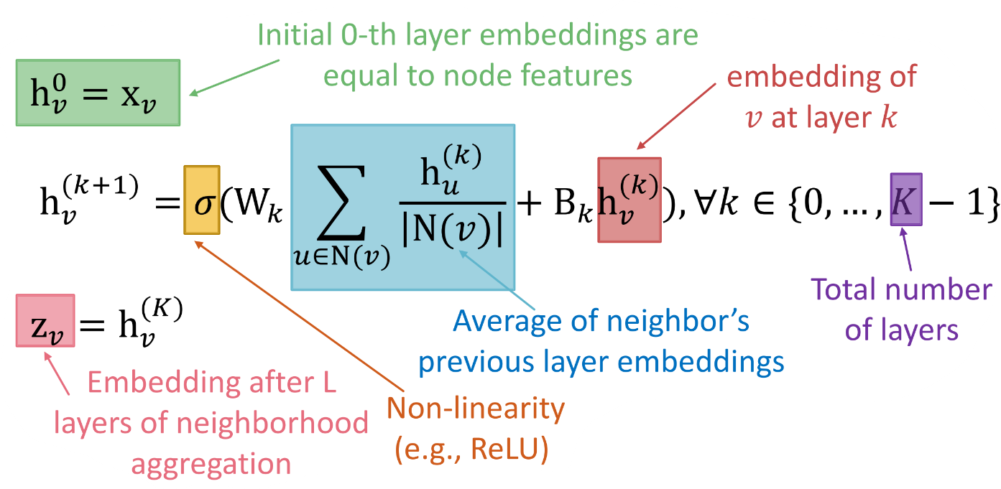
The Math of Graph Convolution
Basic approach: Average neighbor messages and apply a neural network.
Summation is a permutation invariant pooling/aggregation!
Wk and Bk are trainable weight → what we want to learn

Slide 9
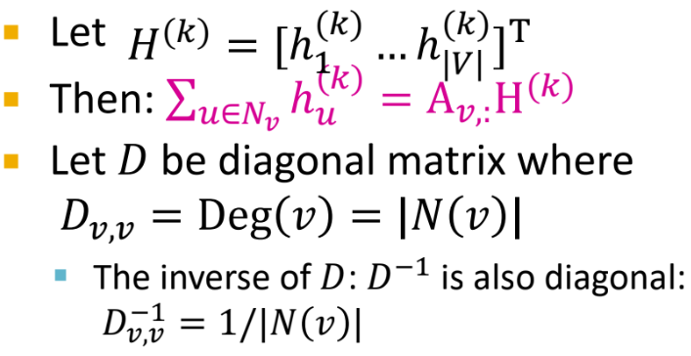
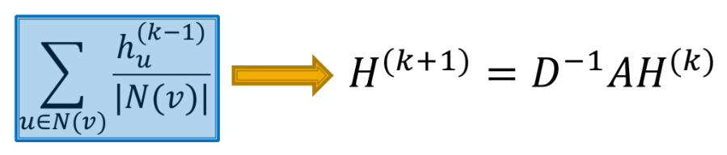
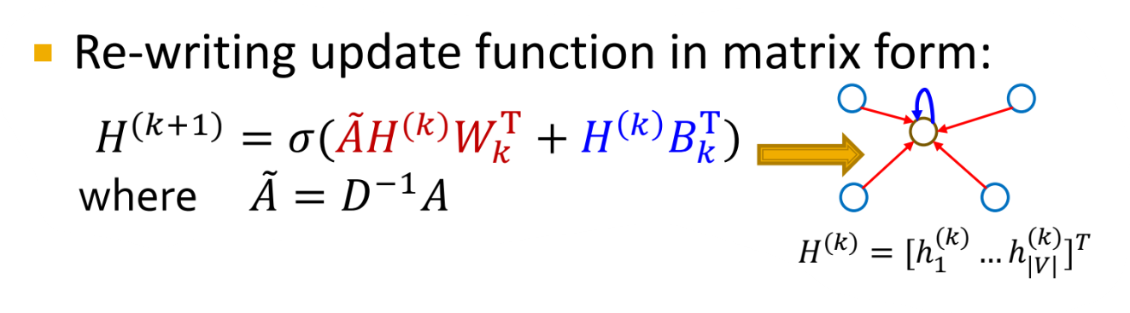
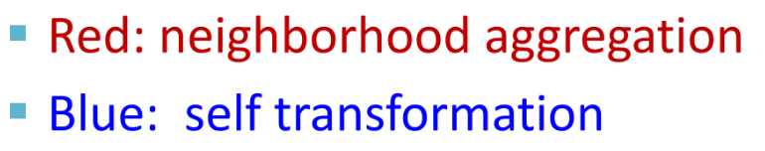
Matrix Formulation
Aggregations can be performed efficiently by matrix operations
Notes:
Diagonal 对角
乘以度的对角矩阵等于是在做平均

Slide 10
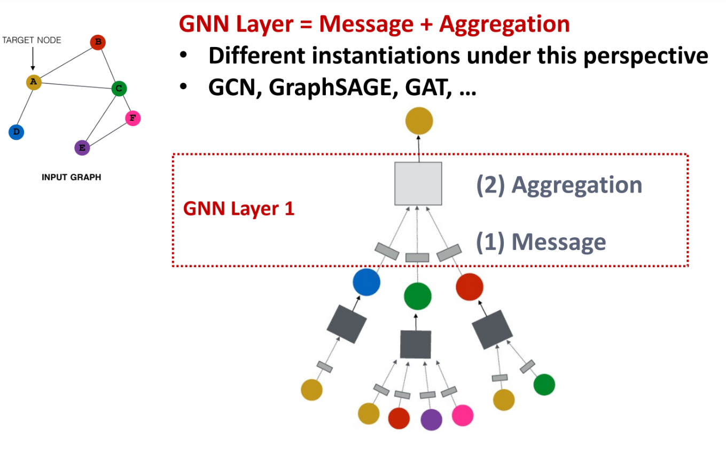
A General GNN Framework
Notes:
第一个问题就是怎样获取到信息
第二个问题是怎样将信息Aggregate（聚合）起来
第三个部分在下一页

Slide 11
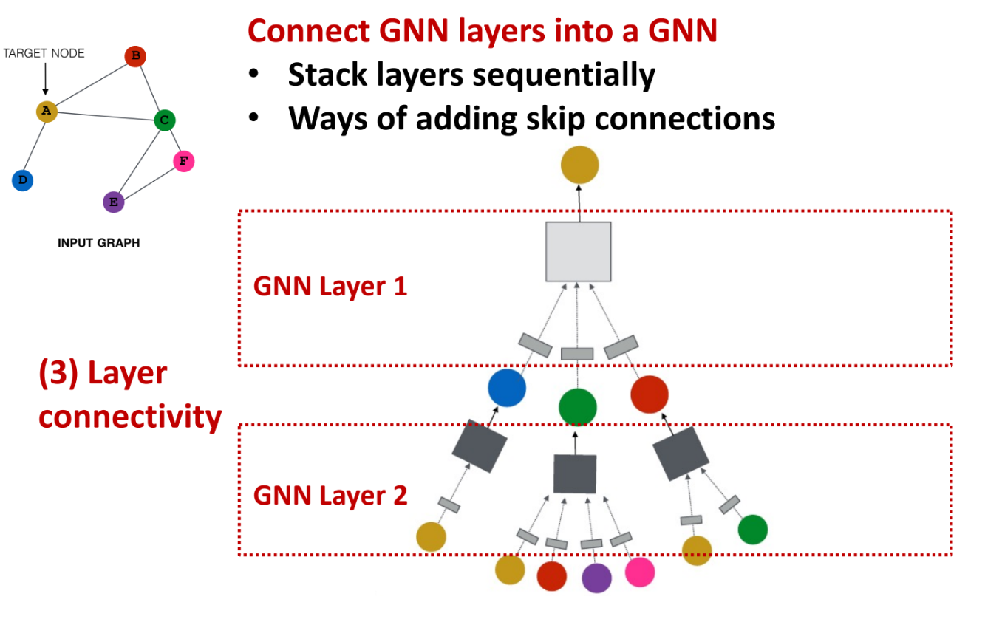
A General GNN Framework
Notes:
第三点提到的“Layer connectivity”指的是如何将一个GNN层与另一个层相连。这包括了如何将信息从一层传递到下一层，以及如何可能地跳过某些层（即skip connections，类似于残差网络中的概念）。Skip connections可以帮助解决梯度消失问题，并允许网络学习更深层次的特征表示。

Slide 12
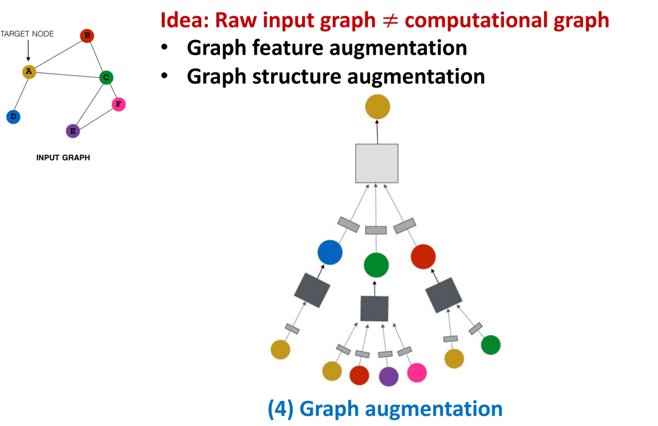
A General GNN Framework
Notes:
“Graph augmentation”在通用图神经网络（GNN）框架中的应用。图增强是指在对图数据进行预处理或处理过程中增加额外信息的技术，以便于改进机器学习模型的性能。在GNN中，图增强主要包含两个方面：
Graph feature augmentation: 这涉及到为图中的节点或边添加新的特征或修改现有的特征。这可以通过外部信息注入，或者根据现有的节点和边特征生成新的特征来实现。例如，如果原始输入图的节点仅有简单的标签信息，那么特征增强可能包括添加节点的统计属性、节点间的相似度度量或者其他域特定信息。
Graph structure augmentation: 这指的是改变图的结构本身，比如添加或删除边、节点，或者重新构建图的拓扑结构。结构增强可以用于模拟潜在的链接，或者为了训练更健壮的模型而进行的图扰动。例如，可以通过增加不存在的边来引入新的关系，或者删除一些边来减少噪声。

Slide 13
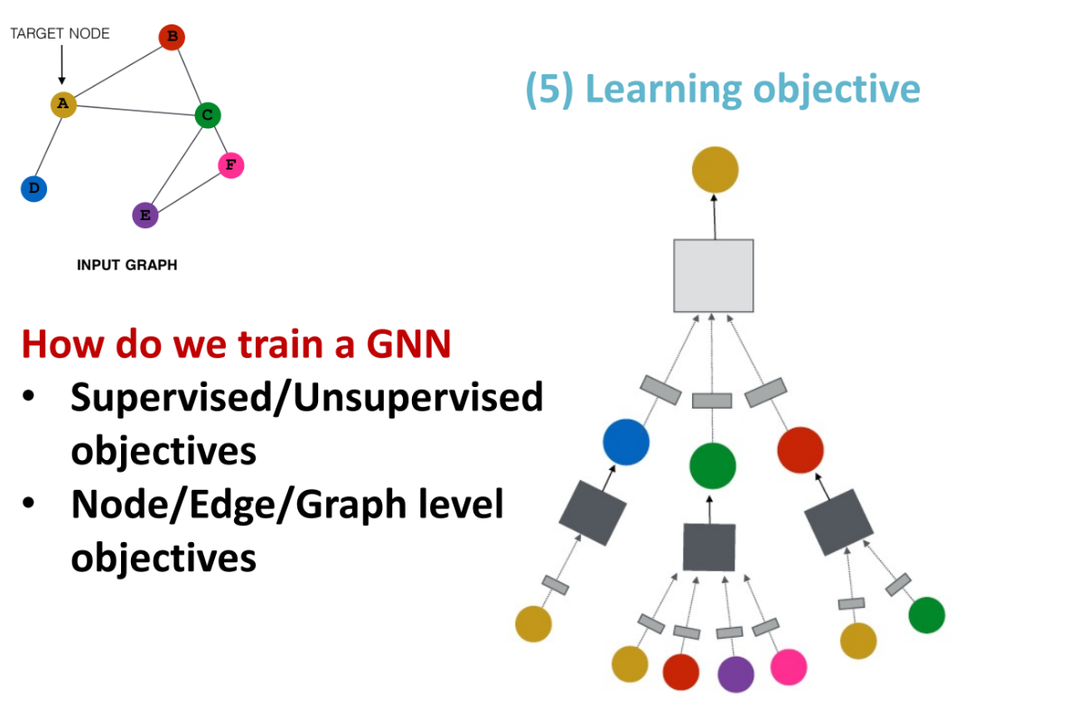
A General GNN Framework
Notes:
Supervised/Unsupervised监督/无监督

Slide 14
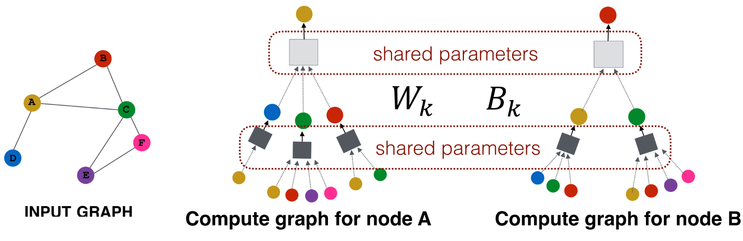
Inductive Capability
The same aggregation parameters are shared for all nodes:
The number of model parameters is not dependent on |V|.
Notes:
Inductive Capability区别于节点嵌入的客制化
我需要的参数并不会因为我的graph的变大而变多，在shallow encoding参数数量会成大小正比
但是当我们如果使用图卷积、message passing这样的方式的时候，参数量都可以是固定的不管图大小有多大

Slide 15
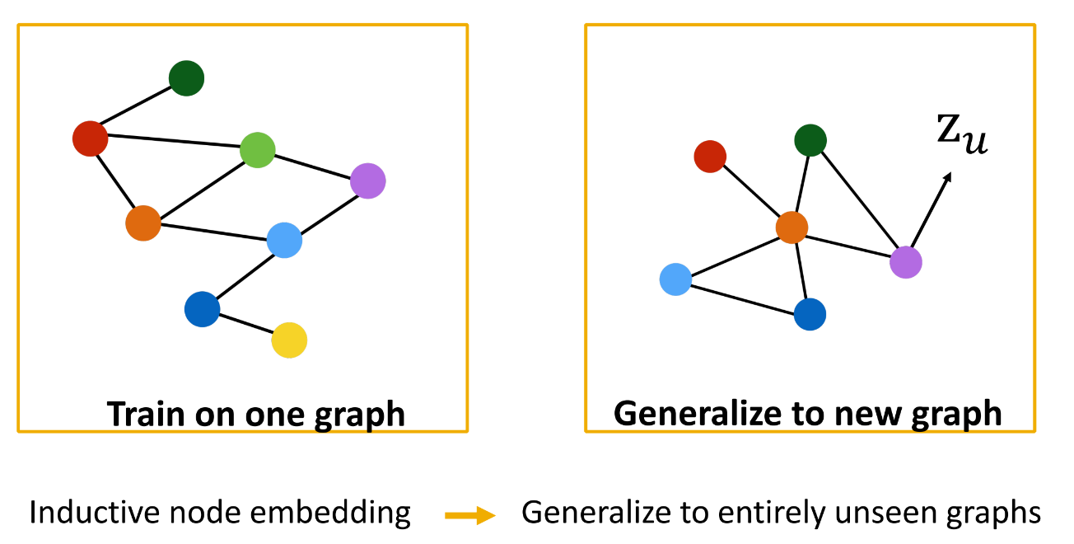
Inductive Capability: New Graphs
Train on a molecular A to predict certain property, then predict the property on a new molecular B.
Notes:
Molecular分子
训练一个分子模型，是完全可以应用在新的分子上面的

Slide 16
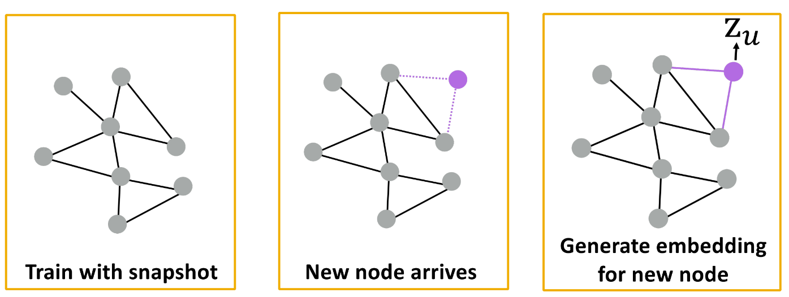
Inductive Capability: New Nodes
Many application settings constantly encounter previously unseed nodes:
E.g., Facebook, Google Scholar
Notes:
随时会产生新节点

Slide 17
Summary
Convolution on graphs
computation graph
permutation invariant
General GNN framework
Inductive capability
new graphs
new nodes
Notes:
computation graph计算图

Slide 18
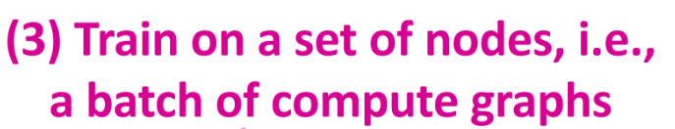
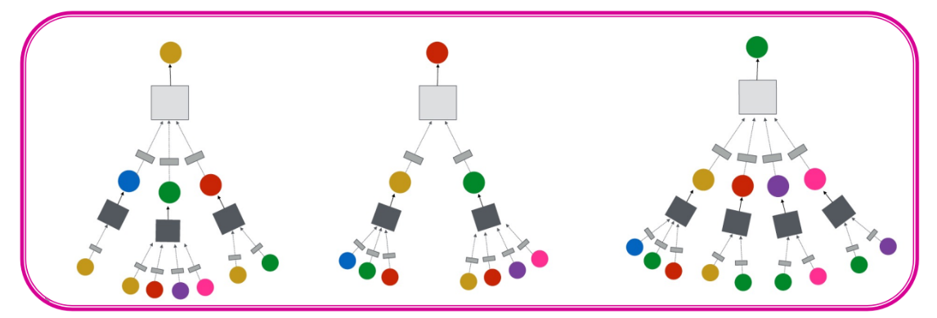
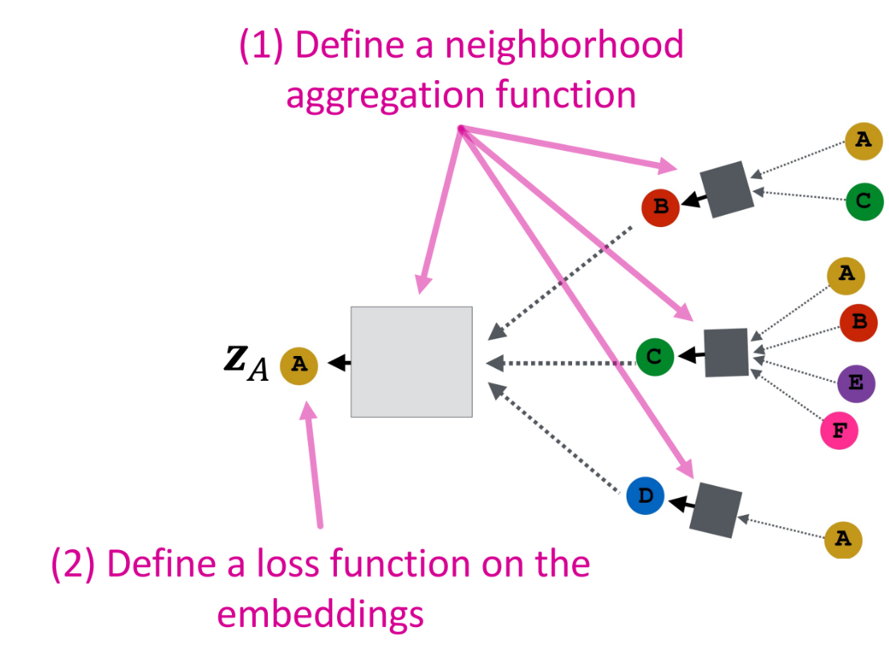
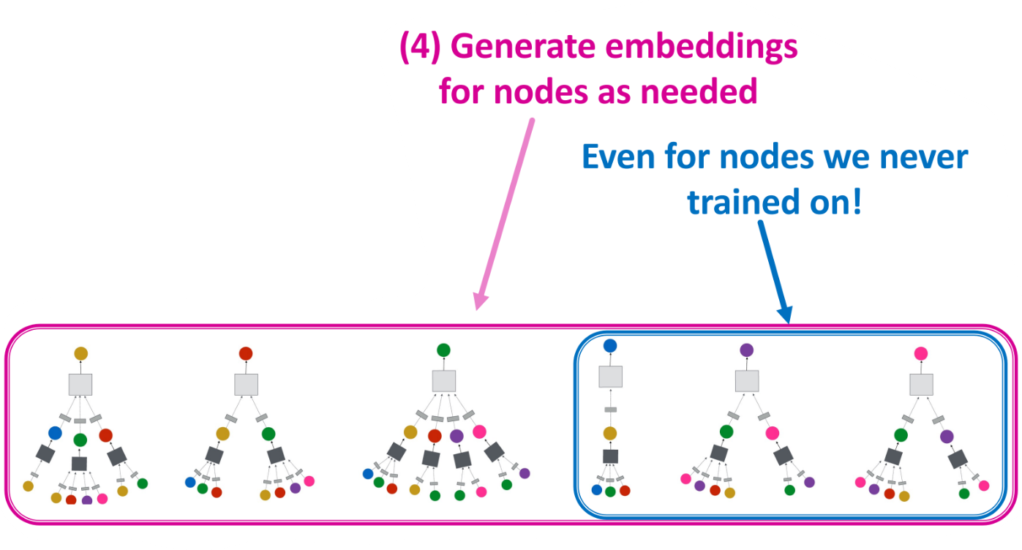

How to Train a GNN?
Supervised Training

Slide 19
How to Train a GNN?
Unsupervised Training
Use graph structures as the supervision!
Node centrality
Clustering coefficient
Node similarity (DeepWalk, node2vec)

