Slide 1

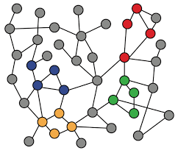
5-1. Deep Learning for Graphs
Machine Learning with Graphs
Modern DL Tools
Permutation Invariance / Equivariance
ref: Jure Leskovec – Stanford CS224W: Machine Learning with Graphs
周遠同 (Chou Yuan-Tung), ton731@gmail.com

Slide 2
Limitations of Shallow Encoders
Limitations of shallow embedding methods:
O(|V|) parameters are needed:
  Can we generate node embeddings with shared parameters?
Inherently “transductive”:
  Can the method be applied to unseen graphs?
Do not incorporate node features:
  Can we leverage node, edge features?
Notes:
Leverage 利用

Slide 3
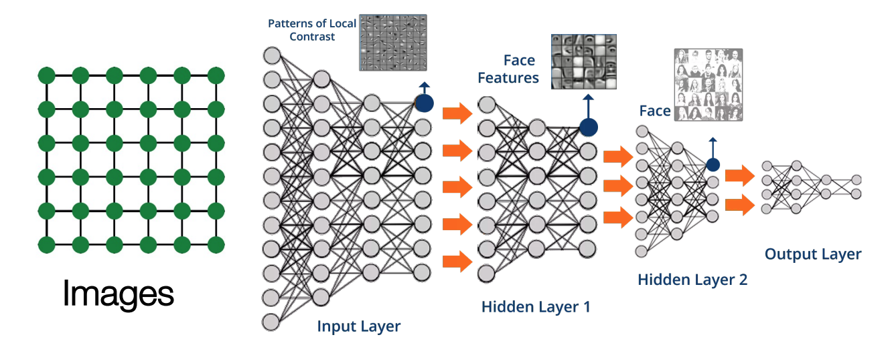
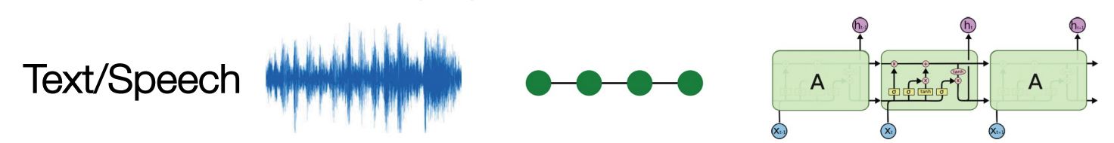
Modern DL Toolbox
Modern deep learning frameworks (CNN, RNN) are designed for simple sequences and grids
Notes:
CNN全称是Convolutional Neural Network，中文称作卷积神经网络。
RNN全称是Recurrent Neural Network，中文称作递归神经网络。有时也被译作循环神经网络。

Slide 4
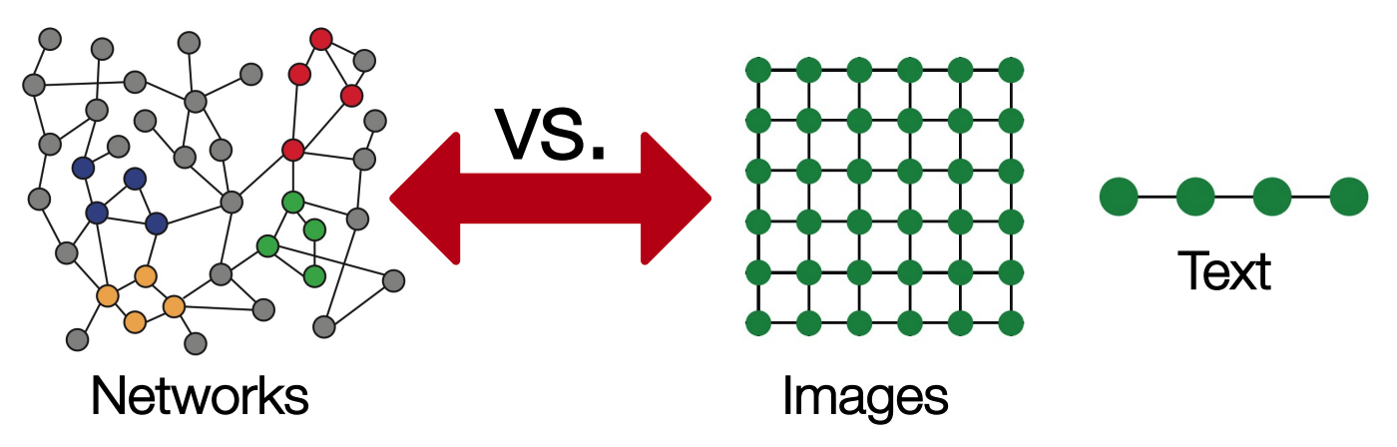
Why is it Hard?
Graph networks are far more complex!
  Arbitrary size and complex topological structure
  No fixed node ordering or reference point
  Often dynamic and have multimodal features

Slide 5
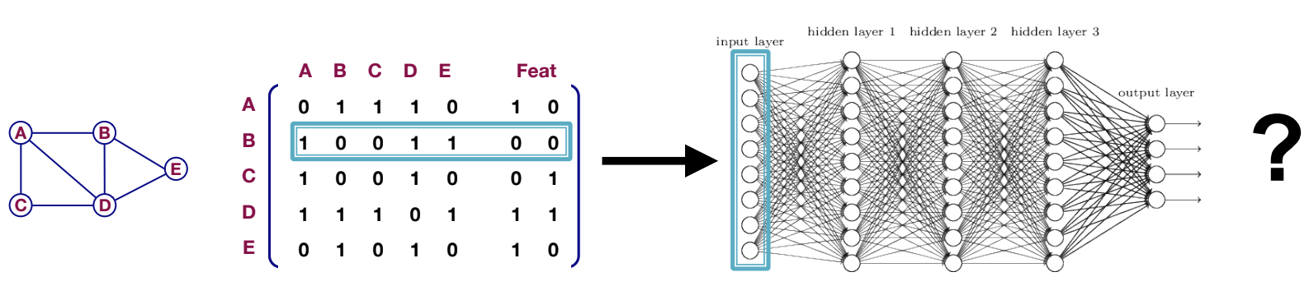
A Naive Approach
Combine adjacency matrix and node features
Feed them into a deep neural network:
Issues:
O(|V|) parameters
Not applicable to graphs of different sizes
Sensitive to node ordering
Notes:
Naïve 简单的

Slide 6
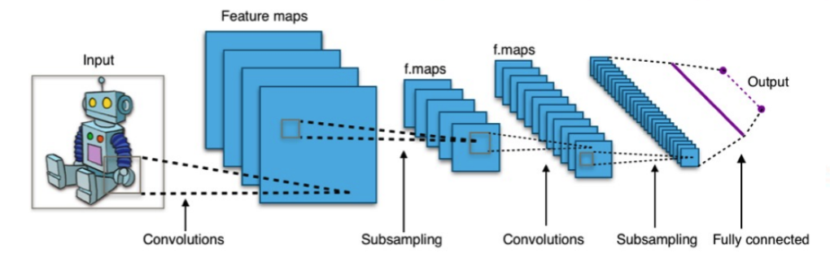
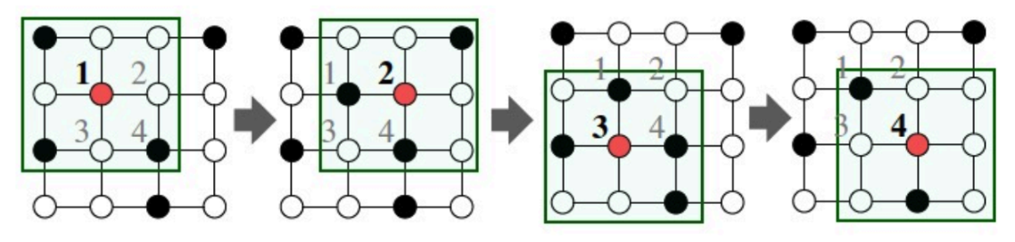
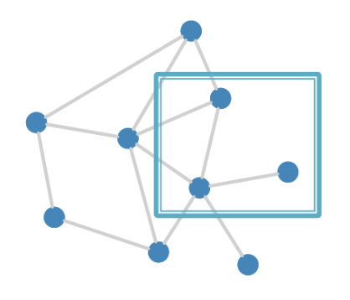
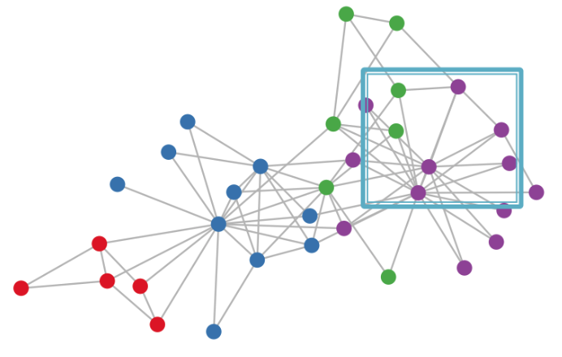
Idea: Convolutional Networks
CNN on an image
However, our graphs look like this:
  There’s no fixed notion of locality or sliding window on the graph
  Graph is permutation invariant
Notes:
1.图没有参考点
2.图中的future应该随卷积核的变化保持不变
"Permutation Invariance"（排列不变性）是一个在数学、计算机科学、特别是在机器学习和深度学习领域中常见的概念。 它指的是一个函数或模型对其输入数据的排列顺序不敏感的性质，即无论输入数据的顺序如何变化，函数或模型的输出保持不变。

Slide 7
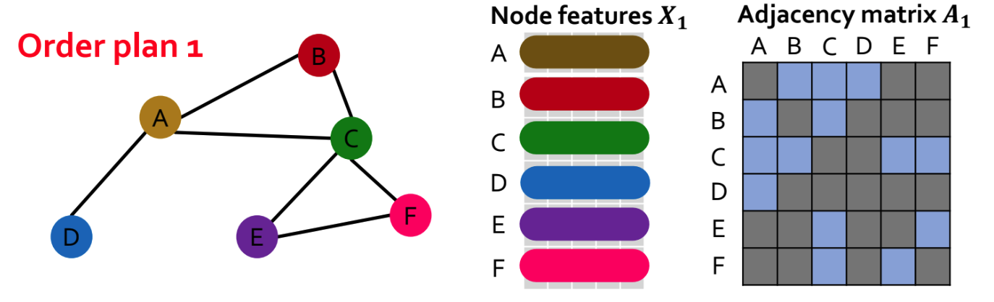
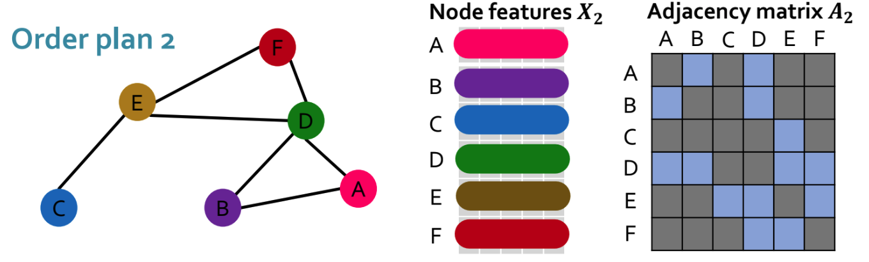
Permutation Invariance
Graph does not have a canonical order of the nodes!
Graph representations should be the same for Order plan 1 and Order plan 2
Notes:
"Permutation Invariance"（排列不变性）是一个在数学、计算机科学、特别是在机器学习和深度学习领域中常见的概念。 它指的是一个函数或模型对其输入数据的排列顺序不敏感的性质，即无论输入数据的顺序如何变化，函数或模型的输出保持不变。

Slide 8

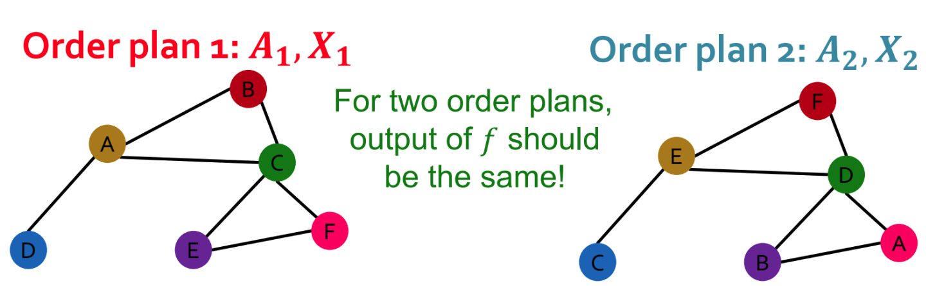
Permutation Invariance
What does it mean by “graph representation is same for two order plans”?
Consider we learn a function f that maps a graph G = (A, X) to a vector .
Then, if f(Ai, Xi) = f(Aj, Xj) for any order plan i and j, we formally say f is a permutation invariant function. (For a graph with m nodes, there are m! different order plans)

Slide 9

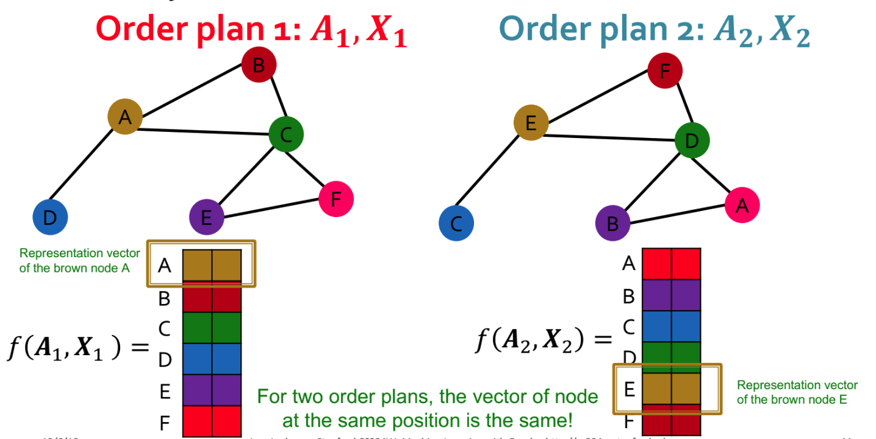
Permutation Equivariance
For node representation
Consider we learn a function f that maps a graph G = (A, X) to matrix
Similarly, if this property holds for any pair of order plan i and j, we say f is a permutation equivariant function.

Slide 10
Permutation Invariance vs. Equivariance
Permutation invariance:
  For graph embedding (representation)
  Ordering of the nodes will not change the graph representation
Permutation equivariance:
  For node embeddings
  Ordering of the nodes will result in the same ordering of the node representations
→ We want our deep learning approach on graphs is permutation invariant / equivariant!
→ Graph neural network (GNN)
Notes:
排列不变性（Permutation Invariance）和排列等变性（Permutation Equivariance）虽然听起来类似，但它们在图数据处理中的应用和含义是不同的：
排列不变性（Permutation Invariance）：
它涉及到对整个图的处理。
如果我们考虑整个图的嵌入（一个将整个图编码为单个向量的过程），排列不变性确保了无论我们如何交换节点的顺序，图的嵌入（或特征向量）保持不变。
这个概念是在处理诸如图分类或图回归任务时非常重要的，因为这些任务的目标是输出与图的整体结构相关的结果，而与节点的特定排序无关。
排列等变性（Permutation Equivariance）：
它涉及到对图中单个节点的处理。
对于节点嵌入，排列等变性意味着如果输入图的节点顺序改变，嵌入后的节点特征也会以相同的顺序改变。
这个概念对于保持节点特征与其原始图中的结构和语义相关性很重要。例如，在节点分类或节点预测任务中，即使输入顺序改变，我们也希望每个节点的表示反映其在图中的角色。
简单来说，排列不变性关注的是如何保持整体输出不受输入顺序的影响，而排列等变性关注的是如何保持输出特征的顺序与输入顺序的改变一致。排列不变性保证了图的整体表示不因节点顺序而改变，排列等变性保证了节点的表示与节点的顺序改变是一致的。

Slide 11
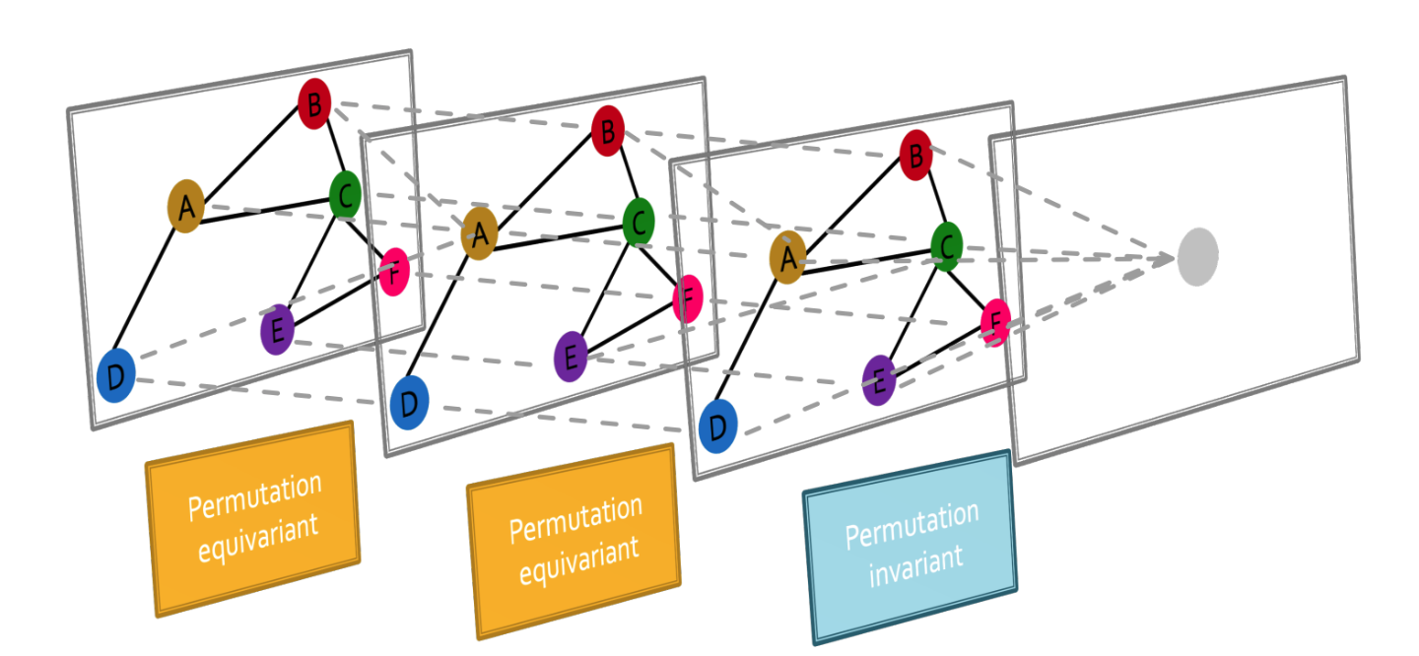
Graph Neural Network Overview
Graph neural networks consist of multiple permutation equivariant / invariant functions.

Slide 12
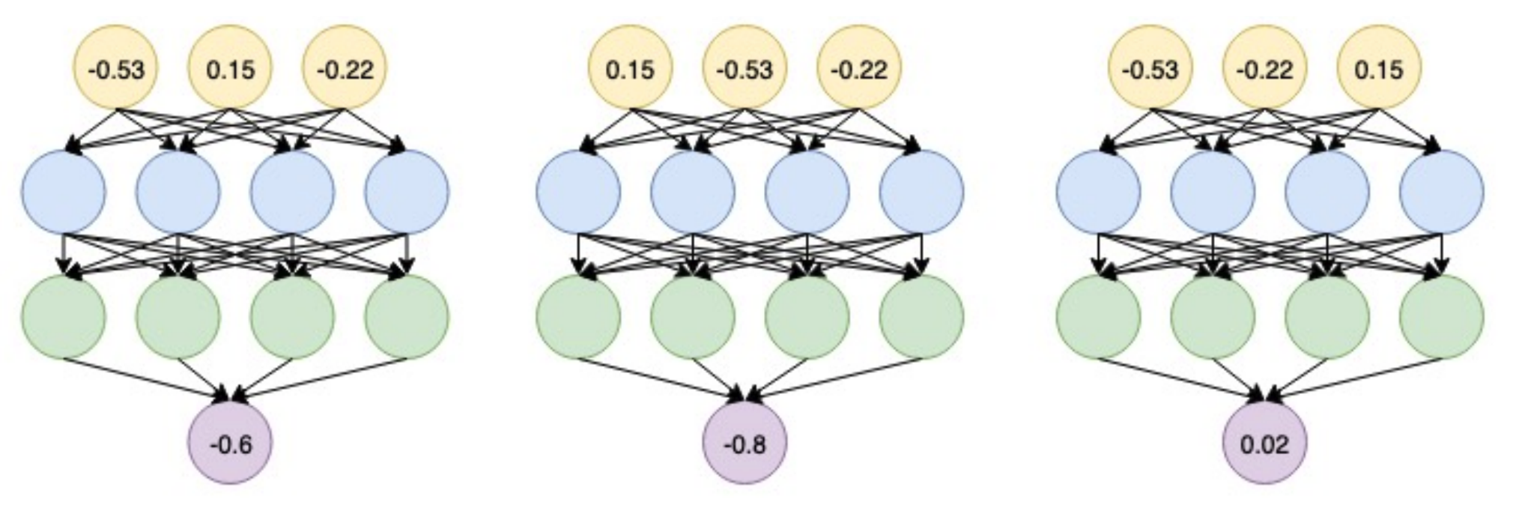
Graph Neural Network Overview
Are other neural network architectures like MLPs, permutation invariant / equivariant?
  No.
  Switching the order of the input leads to different outputs.
Notes:
MLP代表多层感知器（Multilayer Perceptron），它是一种前馈人工神经网络。MLP由至少三层的节点组成：一个输入层，一个或多个称为隐藏层的中间层，以及一个输出层。除了输入节点之外，每个节点（也称为神经元）都使用一个非线性激活函数。MLP是一个深度学习模型，可以通过使用称为反向传播的算法进行训练。

Slide 13
Graph Neural Network Overview
Are other neural network architectures like MLPs, permutation invariant / equivariant?
  No.
  Switching the order of the input leads to different outputs.
This explains why the naive MLP approach fails for graphs!

Slide 14
Summary
Common DL framework
  CNN, RNN, MLP
Permutation invariance / equivariance
  Graph neural network (GNN)
Next: Design graph neural networks that are permutation invariant / equivariant by passing and aggregating information fron neighbors!

