Slide 1

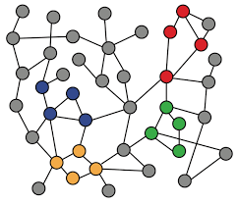
4. Message Passing and Node Classification
Machine Learning with Graphs
Relational Classification
Iterative Classification
Message Passing
ref: Jure Leskovec – Stanford CS224W: Machine Learning with Graphs
周遠同 (Chou Yuan-Tung), ton731@gmail.com

Slide 2
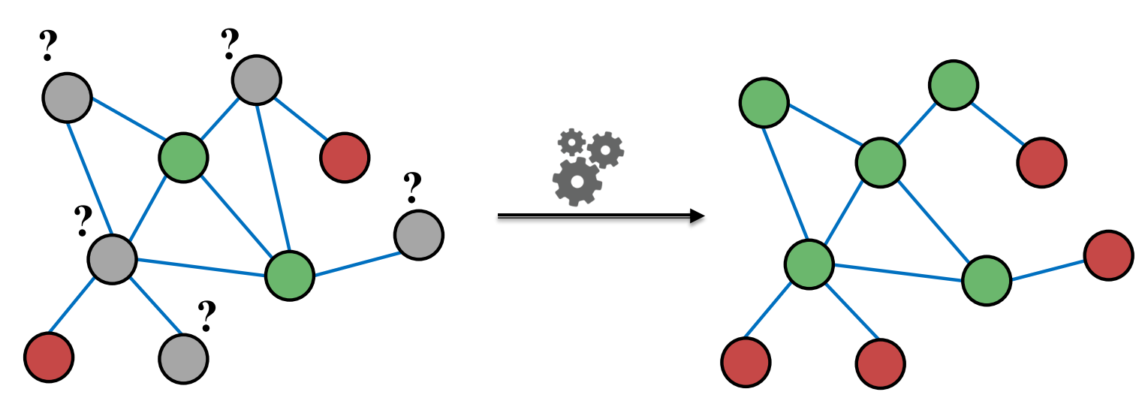
Main Question
Given a network with labels on some nodes, how do we assign labels to all other nodes in the network?
Node embedding (shallow encoding) is a method to solve this (獨善其身)
Message passing is an alternative framework (互通有無)

Slide 3
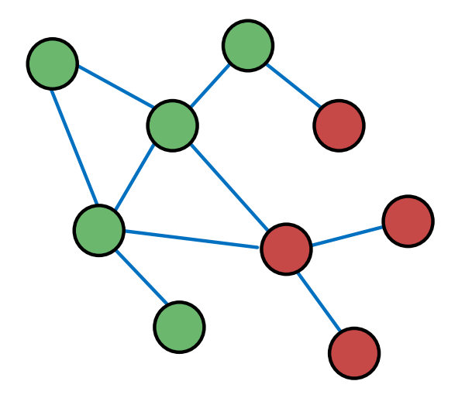
Message Passing Intuition
Intuition: Correlations (dependency) exist in network
Similar nodes are connected
Homophily: individual character → social connections
Influence: social connections → individual character
Key concept: collective classification, assign labels to all nodes in a network together
We will look at 2 techniques:
Relational classification
Iterative classification

Slide 4
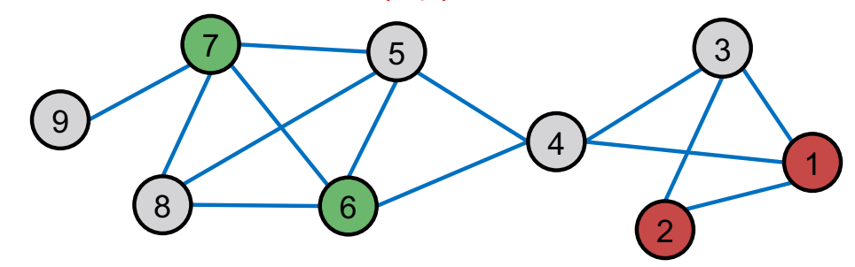

Classification with Network Data
How do we leverage node correlations in networks to help prediction?
Motivation 1: Similar nodes are typically close together or directly connected in the network
Motivation 2: Classification label of node v in network may depend on:
features of v
labels of the nodes in v ‘s neighborhood
features of the nodes in v ‘s neighborhood
Many applications are under the same setting

Slide 5
Relational Classification
Idea: Propagate node labels across the network
Class probability Yv of node v is a weighted average of class probabilities of its neighbors.
Labeled nodes: initialize Yv with ground-truth label Yv*
Unlabeled nodes: initialize Yv = 0.5
Update all nodes in a random order until convergence or until maximum number of iterations.
Yv = 1
Yv = 0.5
Yv = 0
Notes:
weighted average 加权平均

Slide 6
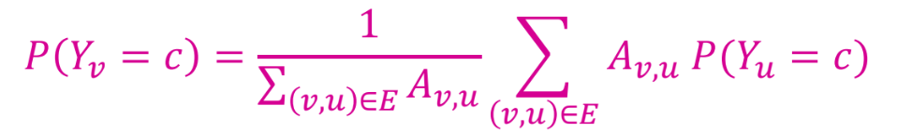
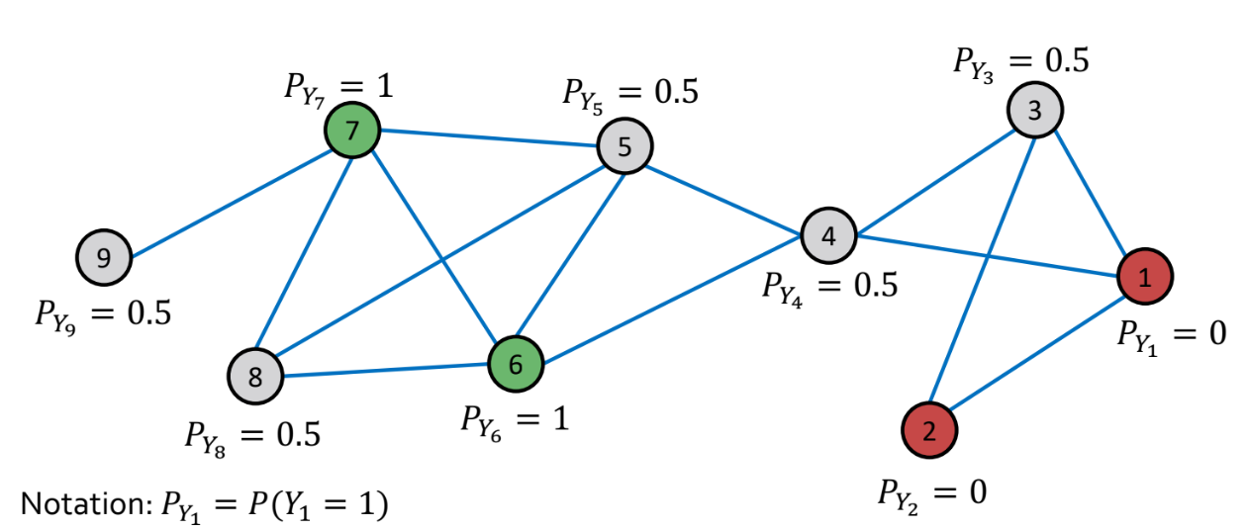
Update for Relational Classifier
Update for each node v and label c (0 or 1)
if edges have weight/strength, Avu can represent the edge weight
For example:

Slide 7
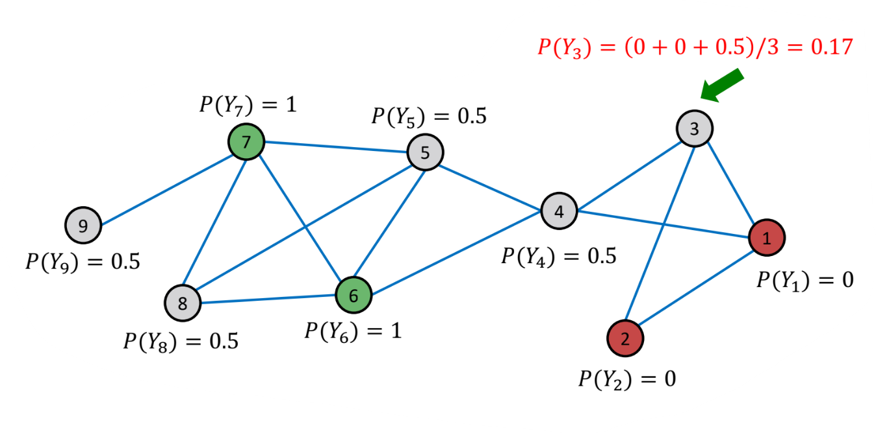
Example: 1st Iteration, Update Node 3
Update for the 1st iteration:
For node 3, N3 = {1, 2, 4}

Slide 8
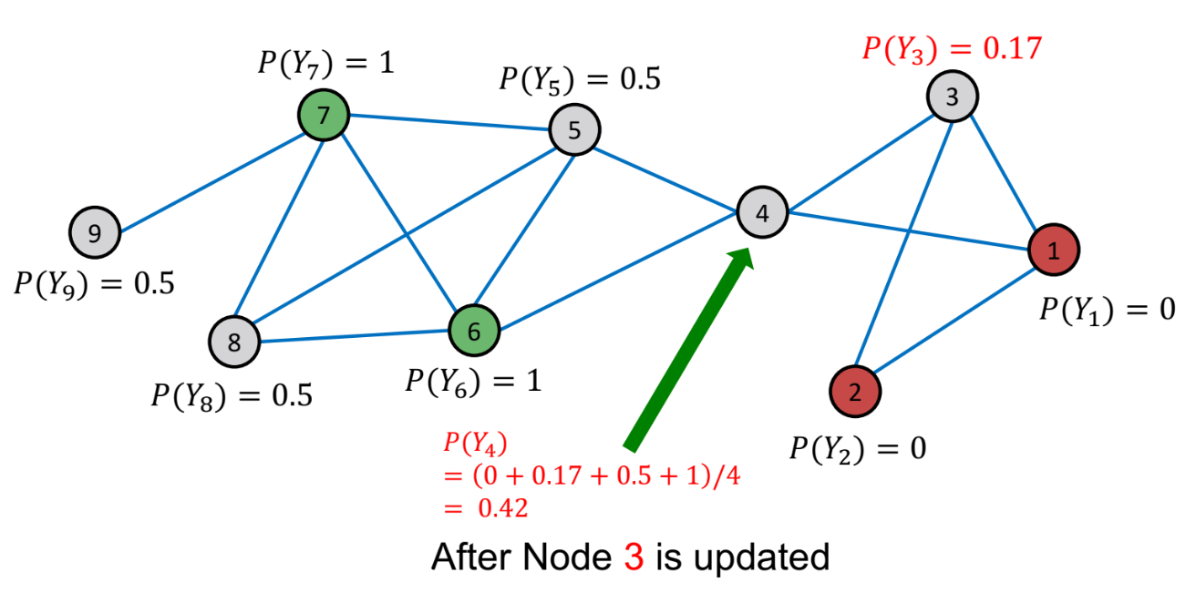
Example: 1st Iteration, Update Node 4
Update for the 1st iteration:
For node 4, N4 = {1, 3, 5, 6}

Slide 9
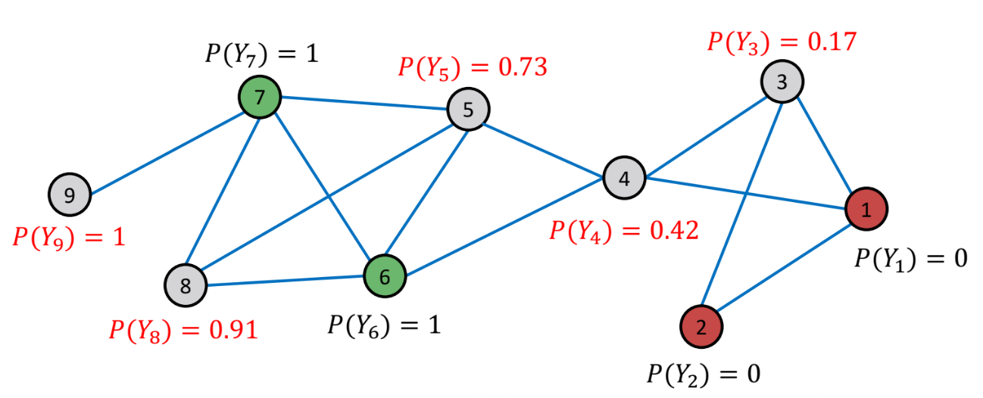
Example: After 1st Iteration
Then after update for node 5, 8, 9
1 iteration

Slide 10
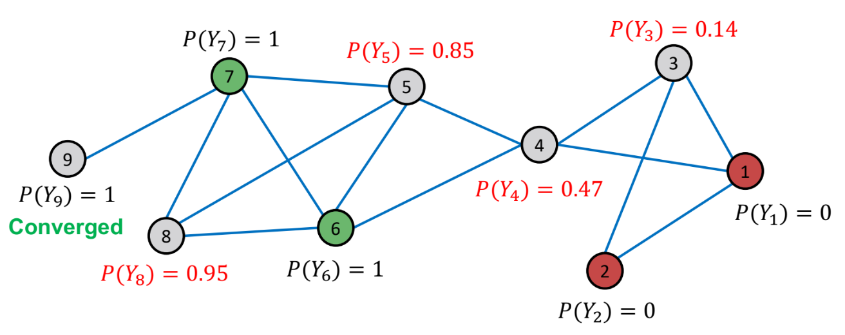
Example: After 2nd Iteration
Update nodes with another random order
After 2nd iteration:

Slide 11
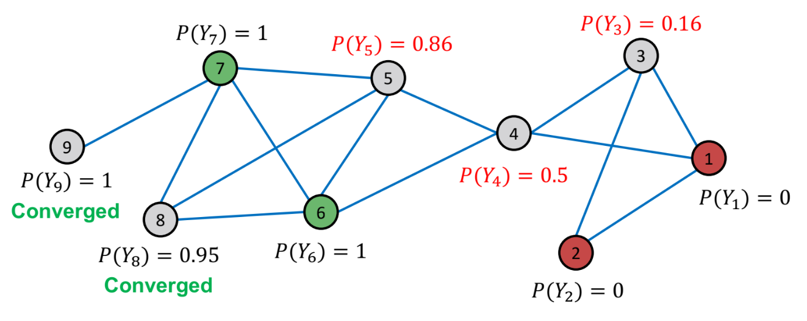
Example: After 3rd Iteration
Update nodes with another random order
After 3rd iteration:

Slide 12
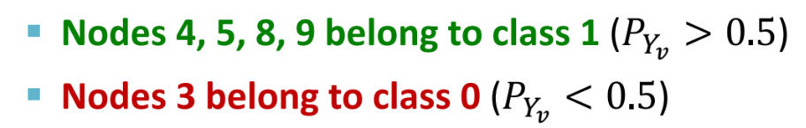
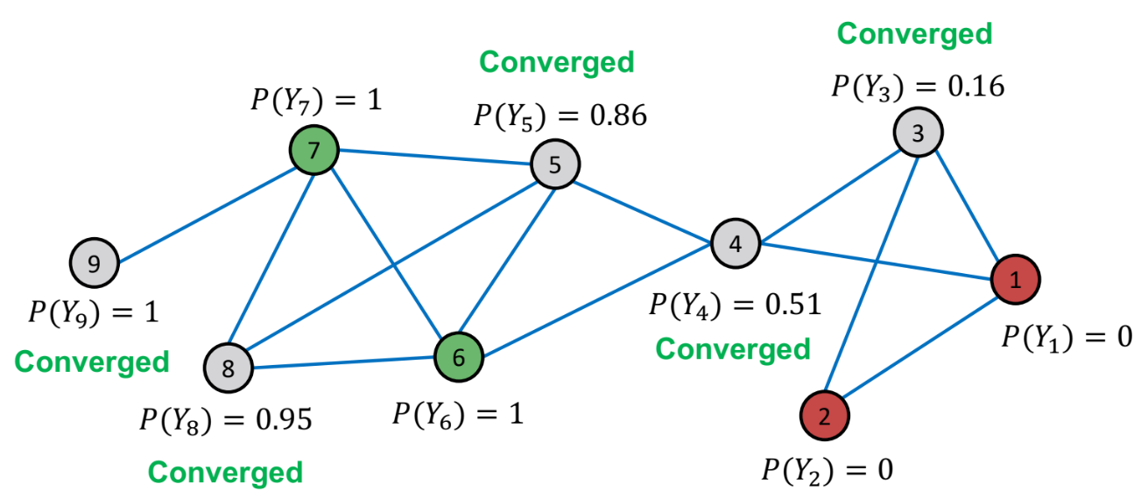
Example: Convergence
After 4th iteration, it converged, we therefore predict:
Challenges: (1) convergence not guaranteed, (2) cannot use node feature information

Slide 13
2. Iterative Classification
Relational classifier does not use node features.
How can we leverage node features?
Main idea of iterative classification: Classify node v based on its features fv and labels zv of neighbor set Nv.
Approach: Train two classifiers:
φ1(fv): Predict node label based on node feature fv → base classifier
φ2(fv, zv): Predict label based on node feature fv and summary zv of labels of v’s neighbors → relational classifier

Slide 14
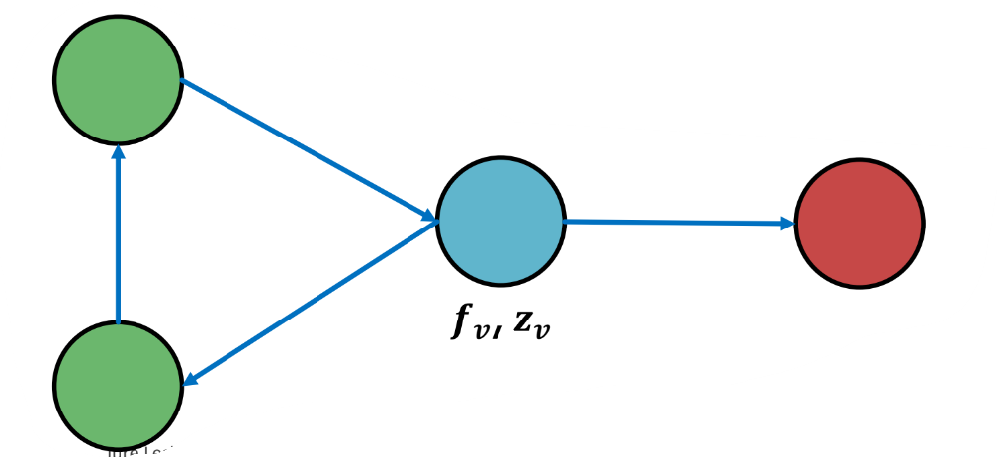
Computing the Summary zv
How do we compute summary zv of labels of v’s neighbors Nv?
zv = vector that captures labels around node v
Histogram of the number of each label in Nv
Most common label in Nv
Number of different labels in Nv

Slide 15
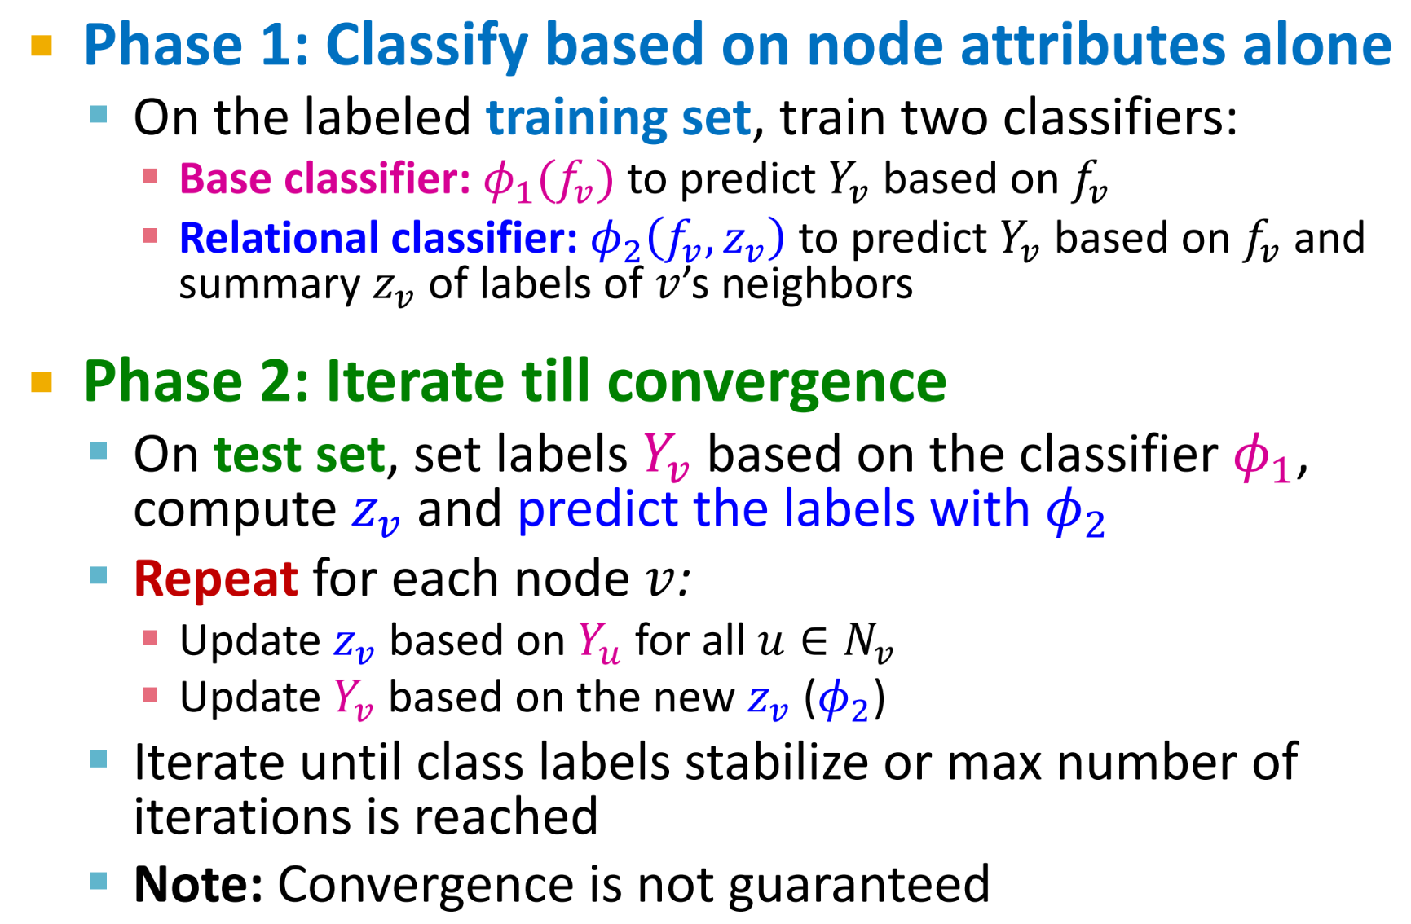
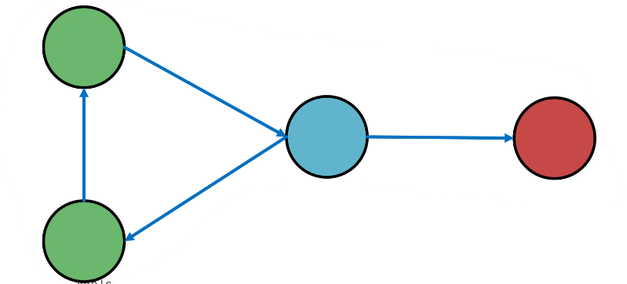
Algorithm of Iterative Classification

Slide 16
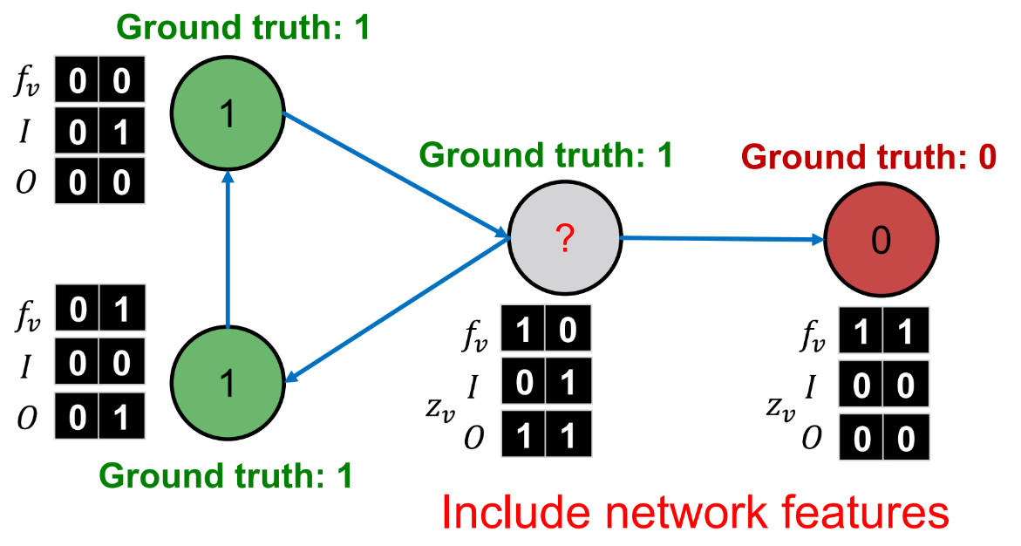
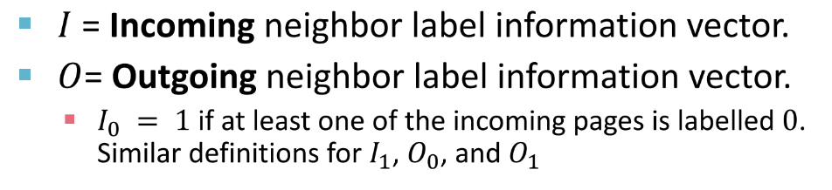
Example: Web Page Classification
Input: Graph of web pages (Node: web page, Edge: hyper-link, Node features: webpage description)
Task: Predict the topic of the webpage

Slide 17
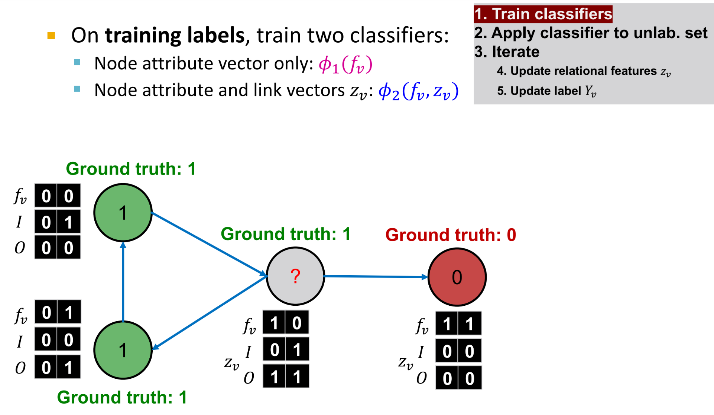
Iterative Classifier – Step 1

Slide 18
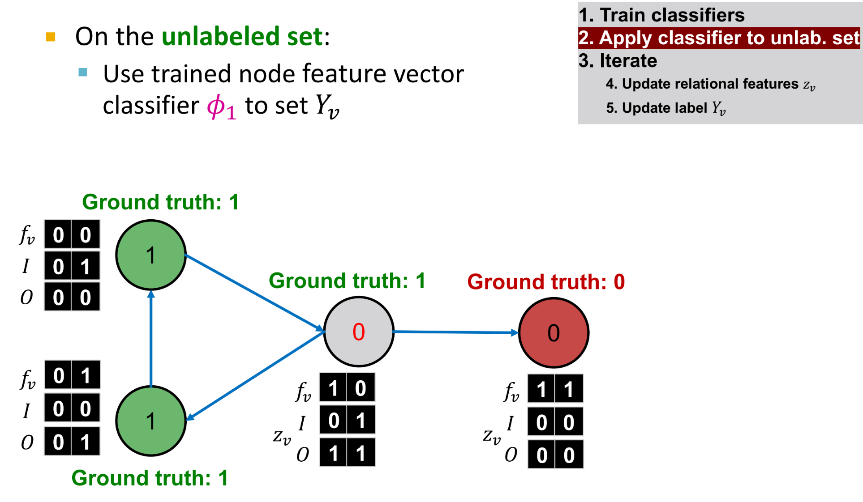
Iterative Classifier – Step 2

Slide 19
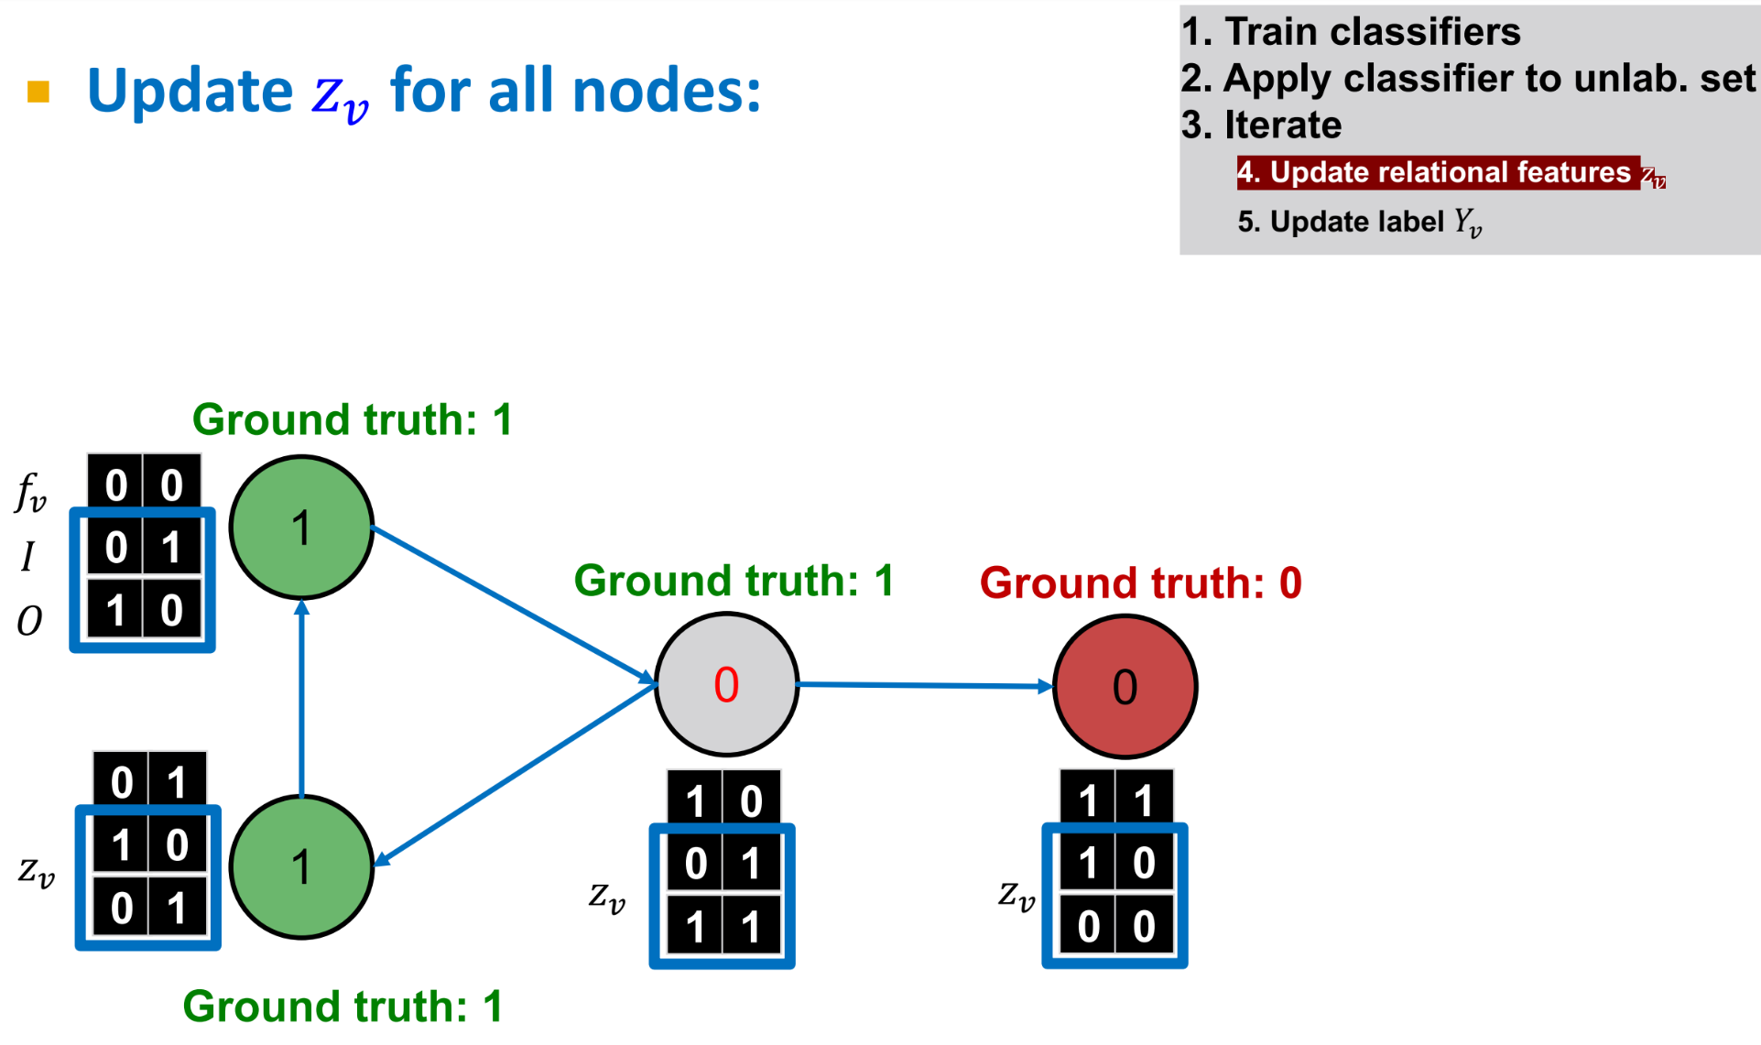
Iterative Classifier – Step 3.1

Slide 20
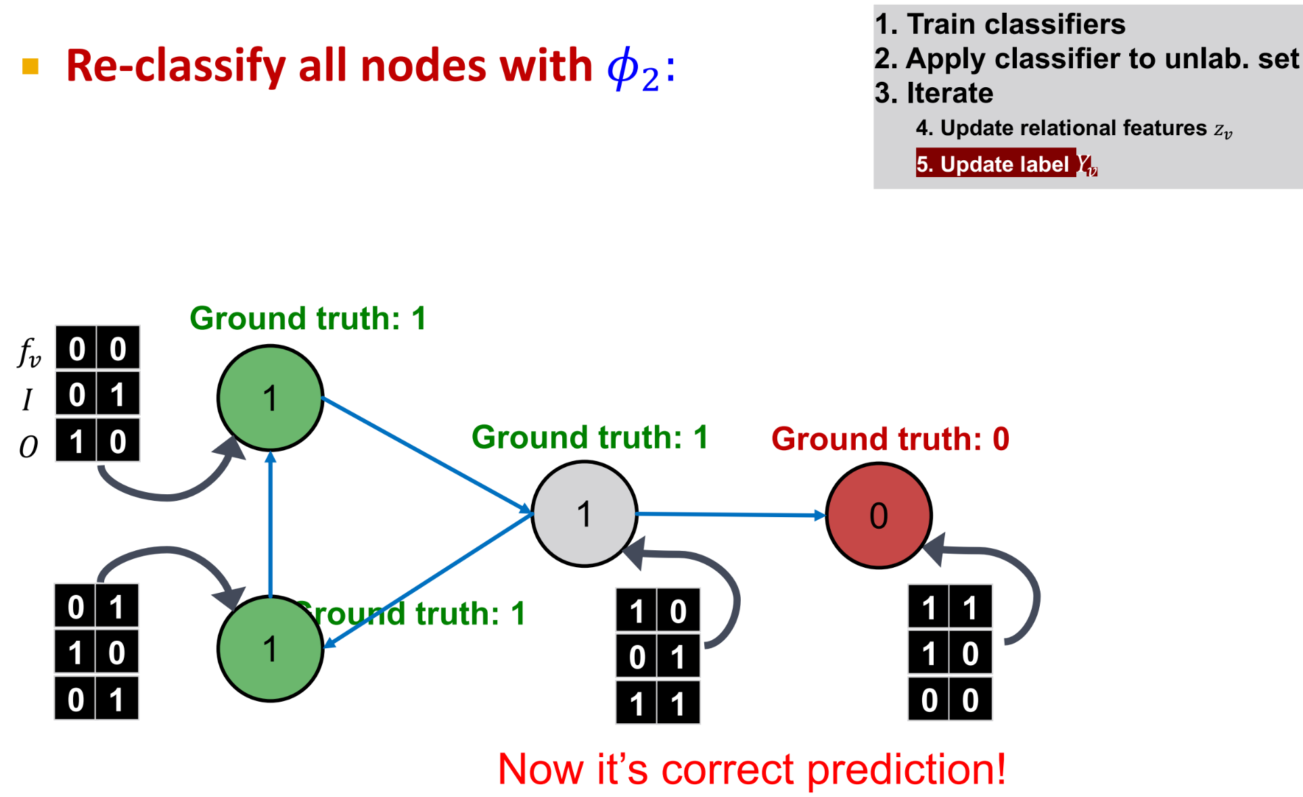
Iterative Classifier – Step 3.2
Notes:
分类器1在这个迭代分类过程的开始阶段使用一次，它仅仅基于节点的属性向量对未标记的节点进行初步的标签预测。这个步骤为整个迭代过程提供了一个起点。随后，整个迭代过程主要依赖于分类器2，它不仅使用节点的属性向量，还使用链接向量，这包括了节点之间的关系信息。在每次迭代中，基于当前的标签预测更新链接向量 ，然后使用分类器2进行重新分类，直到标签预测收敛或达到最大迭代次数。因此，分类器1用于提供初步的标签预测，为迭代过程设置基线，而分类器2则用于在迭代中不断地细化这些预测。

Slide 21
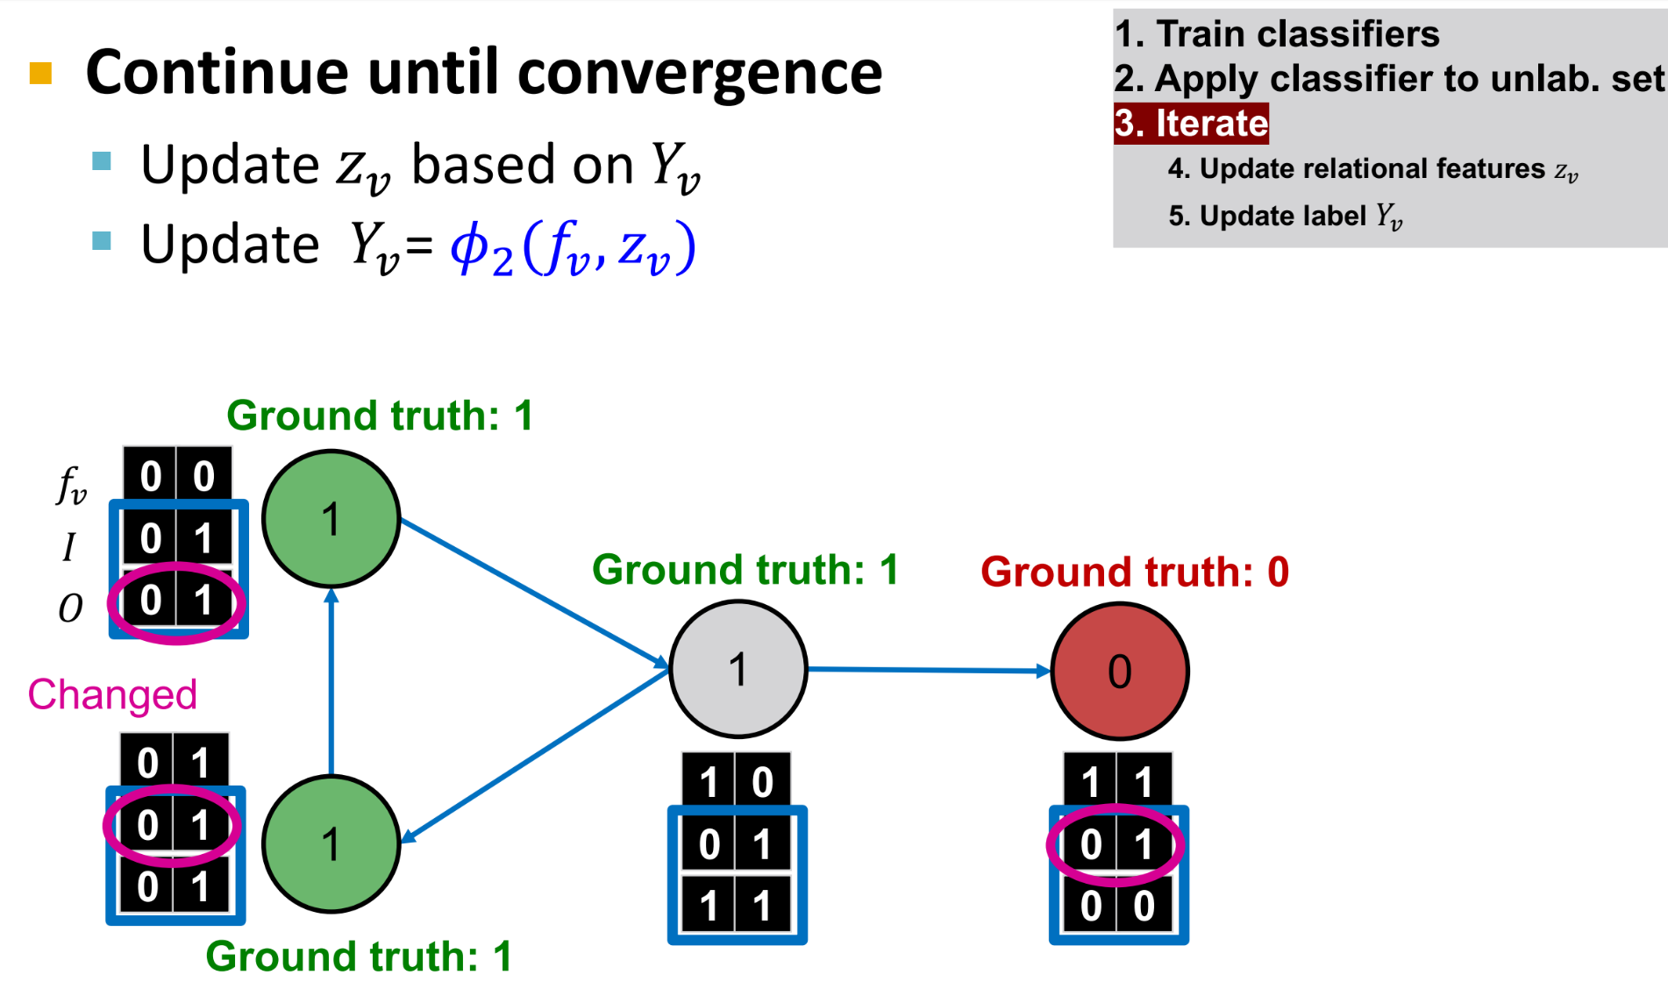
Iterative Classifier – Iterate

Slide 22
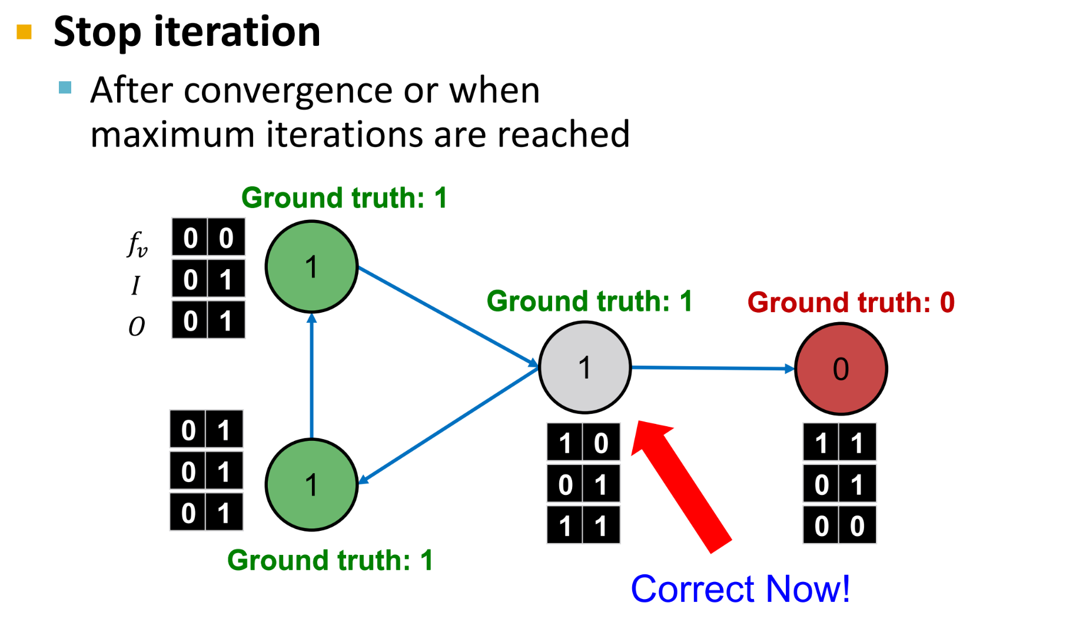
Iterative Classifier – Final Prediction

Slide 23
Relational, Iterative Classification Summary
Relational classification
Iteratively update probabilities of node belonging to a label class based on its neighbors.
Iterative classification
Improve over relational classification to handle attribute/feature information
Classify node v based on its features as well as labels of neighbors

Slide 24
Message Passing
Idea: Propagate node features by exchanging info between adjacent nodes.
Message
prepare message that will be passed to another nodes
Aggregate and Update
aggregate the coming messages
update node with the aggregated message
Notes:
Aggregate 整合，总计

Slide 25
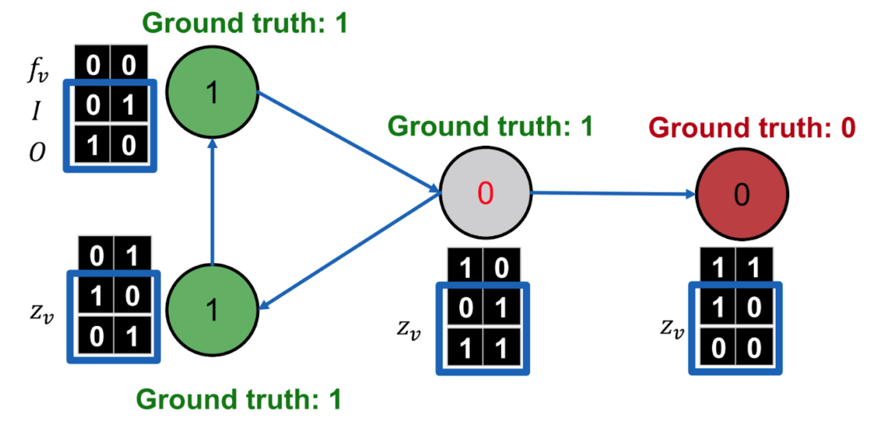
Message Passing
Message:
class prob.
Aggregate and Update:
average messages and replace original values
Relational Classsification
Message:
summary zv
Aggregate and Update:
use zv to update node label with φ2
Iterative Classsification
→ Graph neural networks use stacked, learnable MP layers to propagate node features
Notes:
GNN是一个更有利更弹性的工具，每个节点的message是可以叠加起来的，让每个node可以看到更远的距离，这就是我们之后要介绍的内容

