Slide 1

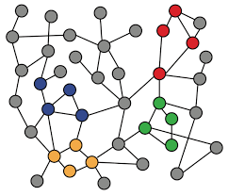
3-3. Applications and Limitations of Shallow Encoding
Machine Learning with Graphs
Application of Node Embeddings
Limitations of Shallow Encoding
Transductive, Inductive Learning
ref: Jure Leskovec – Stanford CS224W: Machine Learning with Graphs
周遠同 (Chou Yuan-Tung), ton731@gmail.com

Slide 2

What After Node Embeddings?
Once we have node embeddings (independent to task), we can continue to the downstream prediction.
downstream
Input
Graph
Node
Embeddings
Learning Algorithm
Prediction
Shallow Encoding
SVM
Random Forest
XGBoost
DNN
Node-level
Edge-level
Graph-level

Slide 3
How to Use these Node Embeddings?
Given a node i in a graph, we have it’s embedding Zi, we can do :
Clustering/community detection: Cluster Zi
Node classification: Predict label of node i based on Zi
Link prediction: Predict edge (i, j ) based on (Zi, Zj )
Concatenate: f(Zi, Zj) = g([Zi, Zj])
Hadamard: f(Zi, Zj) = g(Zi * Zj) (per position product)
Sum/Average: f(Zi, Zj) = g(Zi + Zj)
Distance: f(Zi, Zj) = g(|Zi - Zj|2)
Graph classification: aggregate node embeddings to form graph embedding Zg. Predict graph label based on graph embedding Zg.

Slide 4
Limitations of Shallow Encoders
Limitations of shallow embedding methods:
O(|V|) parameters are needed:
Every node has its own unique embedding
No shared parameters between nodes
Inherently “transductive”:
Cannot generate embedding for nodes that are not seen during training
Do not incorporate node features:
Nodes in many graphs have node features that we can and should leverage
Notes:
Transductive下一页会介绍

Slide 5
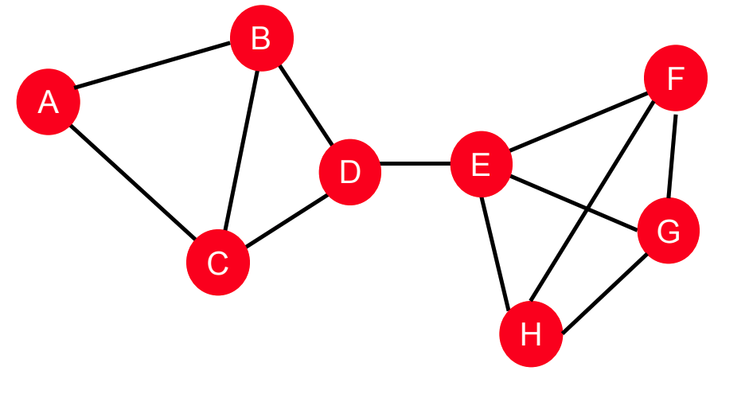
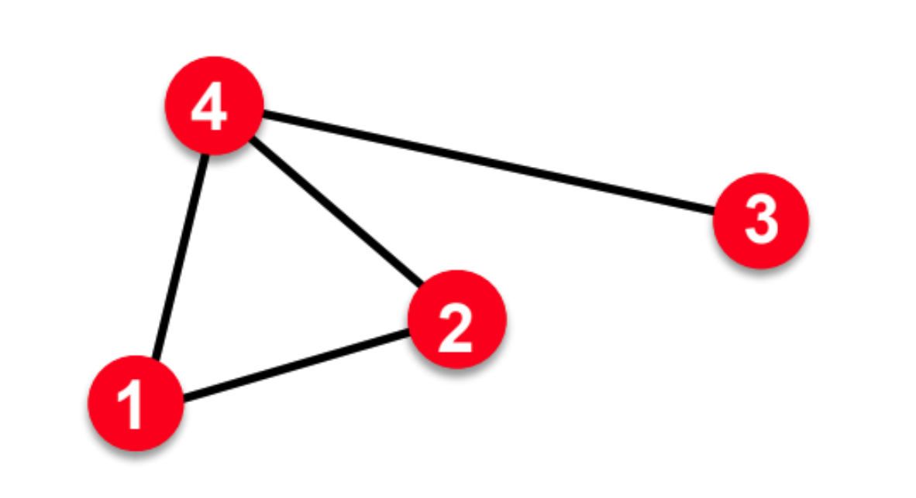
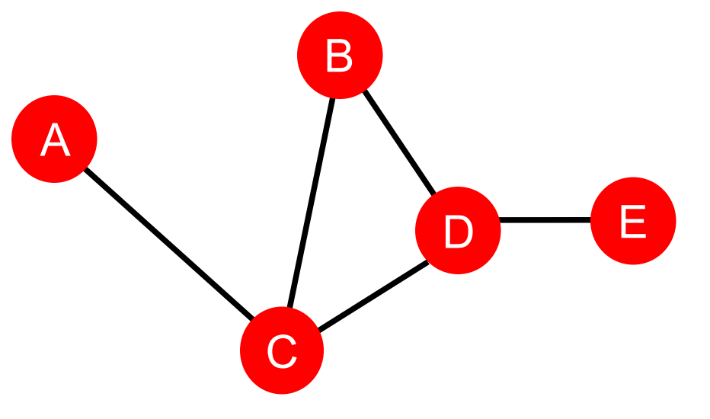
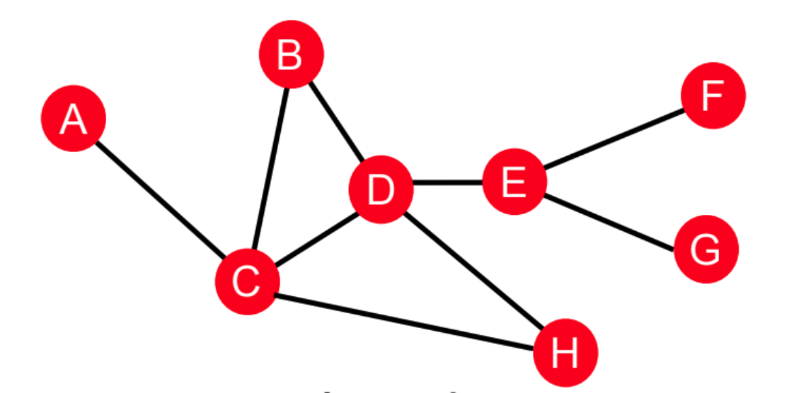
Transductive vs. Inductive Learning
Transductive: 直推式
Inductive: 歸納式
Training:
Testing:
In transductive learning, for new coming graphs, we have to train from scratch to get the embeddings. However in inductive learning, the way we create embeddings can be generalized to unseen graphs.
Inductive learning on graphs → Deep Encoder → Graph Neural Networks (GNNs)
Notes:
这段话指出了一些图嵌入方法的一个限制，即它们通常是“本质上的transductive”。这意味着这些方法在训练期间需要见到所有的节点，因此它们不能直接为训练过程中未见到的节点生成嵌入。
Transductive vs. Inductive Learning
在机器学习中，有两种不同的学习范式：transductive和inductive。
Transductive(转换的) learning 方法仅在训练时见过的数据上工作。在图嵌入的上下文中，这意味着方法仅为图中已存在的节点生成嵌入。如果在训练后添加新的节点，transductive方法不能为这些新节点生成嵌入，因为它们在学习过程中不可用。
Inductive(归纳的) learning 方法则能够推广到新的、未见过的数据。在图嵌入中，这意味着即使是训练时未见过的节点，方法也能为其生成嵌入。
例子
想象一下，你有一个社交网络，你使用了一种transductive图嵌入方法来学习每个用户的嵌入。如果社交网络在你训练模型后迎来了新用户，你的transductive模型将不能为这些新用户生成嵌入，因为它只学会了将嵌入分配给训练集中的用户。这就是为什么transductive模型通常需要重新训练或更新来处理新的节点。
相比之下，如果你使用了一种inductive图嵌入方法，比如图神经网络，这种方法可以根据用户的特征和他们在图中的位置来生成嵌入。因此，当新用户加入网络时，即使这些用户在模型训练期间未出现，inductive模型也能为他们生成嵌入。这种方法更加灵活和强大，因为它能够应对动态变化的图。

