Slide 1

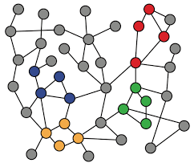
3-2. Random Walk Approaches for Node Embeddings
Machine Learning with Graphs
Random Walk
Learning Objective & Method
node2vec
ref: Jure Leskovec – Stanford CS224W: Machine Learning with Graphs
周遠同 (Chou Yuan-Tung), ton731@gmail.com

Slide 2

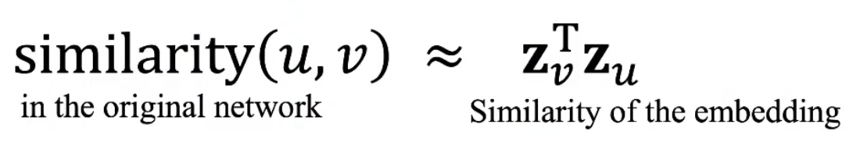
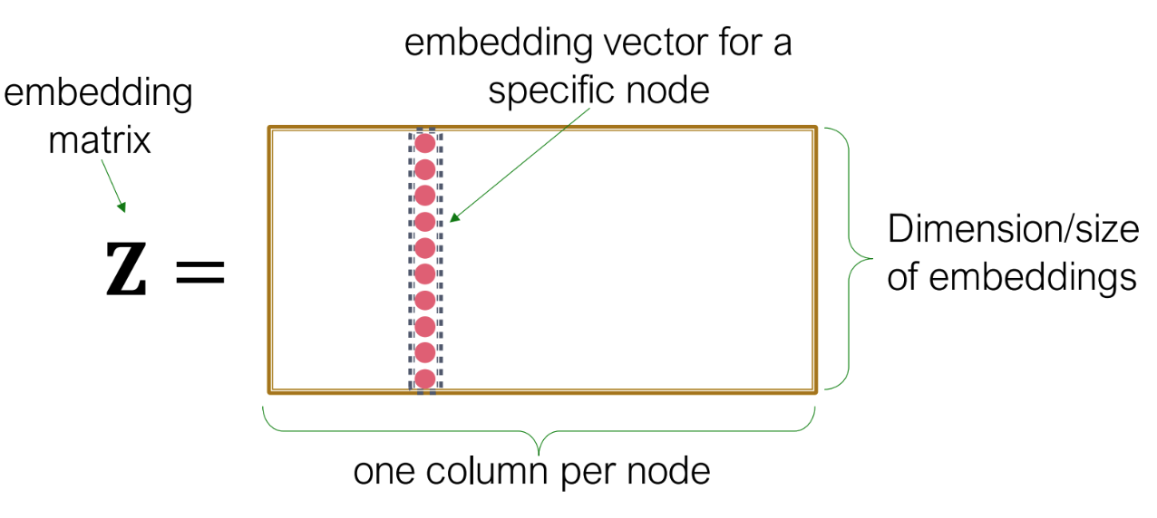
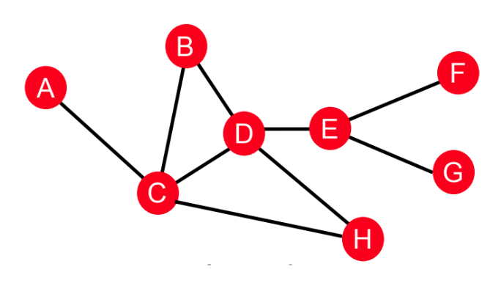
Review of Shallow Encoding
We want to learn the embedding for every node
such that
Notes:
“Shallow Encoding”指的是一种相对简单的节点嵌入方法，它使用浅层（也就是非深度）的学习框架来生成图中每个节点的向量表示。这里的“浅层”与“深度”相对，后者通常指的是深度学习方法，如深度神经网络，它们由许多层组成并能够学习数据的复杂表示。

Slide 3
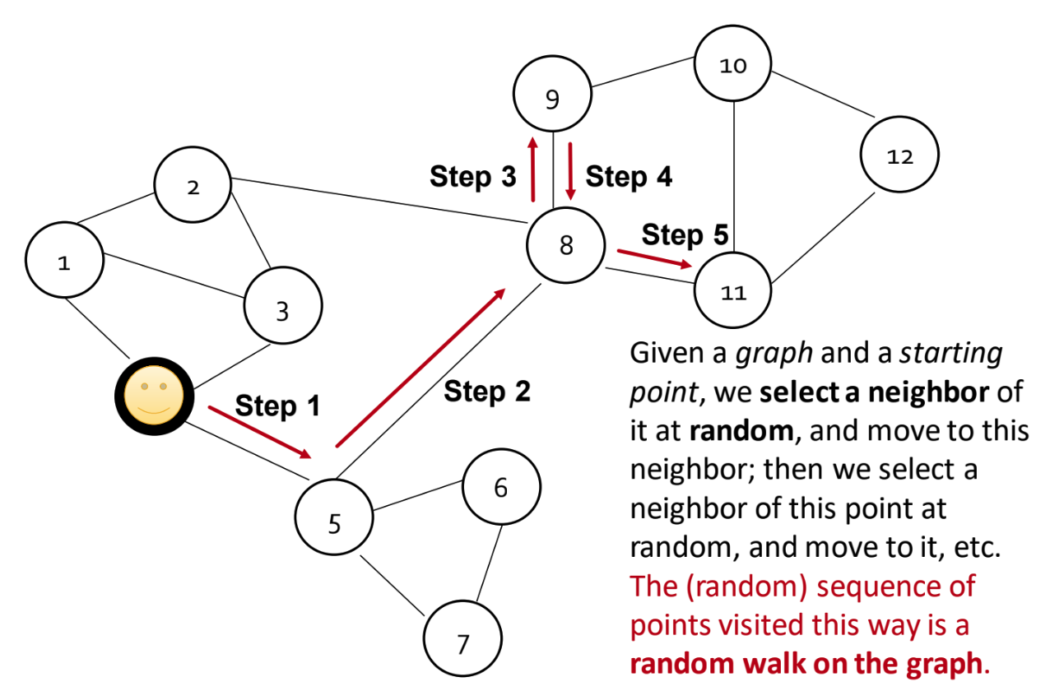
Random Walk
Notes:
但是我们其实还没有定义两个节点到底怎样才是相似，怎样是不相似，所以我们就提出了一个判断similarity的办法——random walk
其实一开始我有一个疑问，不应该是先转成向量（矩阵），再计算相似性吗，为什么现在不介绍转矩阵的方法反而先说第二步的random walk，其实这两步是相互作用一同发生的

Slide 4

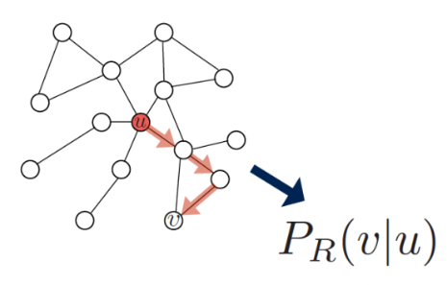
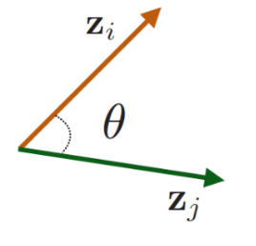
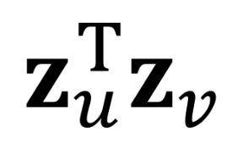

Random Walk Embedding
Estimate probability of visiting node v on a random walk starting from node u with strategy R :
Optimize node embeddings to learn the statistics from random walks

Slide 5
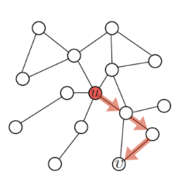
Why using Random Walks?
We can simply define nodes are similar if there are connected, why random walks?
Expressivity: Random walk incorporates both local and higher-order multi-hop nehgiborhood information
Efficiency: Don’t need to consider all node pairs at training state; only need to consider node pairs on the random walks

Slide 6
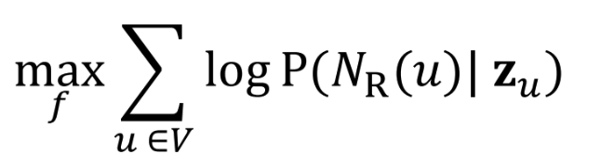

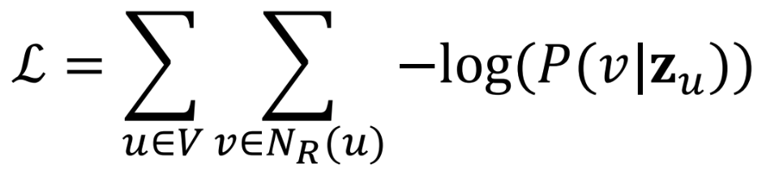
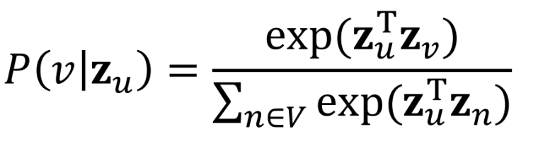


Feature Learning as Optimization
Log-likelihood objective:
is the neighborhood of node u by random walk strategy R
Equivalently, our loss function
where
Run short fixed-length random walks starting from each node u
For each node u, collect the visited node set
Find embeddings that minimizes L
Notes:
对数似然函数（Log-likelihood Objective）
在这个过程中，并没有一个“真实的随机游走得到的概率”去做比较。相反，随机游走用来生成训练数据，即每个节点的邻域N_R(u)，然后通过优化过程调整嵌入向量，使得我们的模型能够尽可能准确地反映这些邻域数据。
第一个公式的解释：![](https://lovexl-oss.oss-cn-beijing.aliyuncs.com/bed/202403031529881.png)
损失函数为什么有负号：最小化一个数的负对数等于最大化这个数本身
Softmax方法，为什么要加e，而不是直接算的解释：![](https://lovexl-oss.oss-cn-beijing.aliyuncs.com/bed/202403031557788.png)
为什么是从全局V上取而不是领域中取：![](https://lovexl-oss.oss-cn-beijing.aliyuncs.com/bed/202403031605340.png)
为什么只需要记录经过的点而不需要记录经过的次数等具体的信息：虽然记录每个节点被访问的次数可以提供额外的信息，但这可能导致模型过于复杂和难以优化。在某些方法中，比如Node2Vec或DeepWalk，重点是学习捕获图拓扑结构的节点嵌入，而不需要详细的访问次数信息。这些方法的目的是通过学习使得在随机游走中经常一起出现的节点在嵌入空间中彼此靠近，而不经常一起出现的节点在嵌入空间中彼此远离。这种方法简化了学习过程，同时仍能捕获图的关键特征。

Slide 7

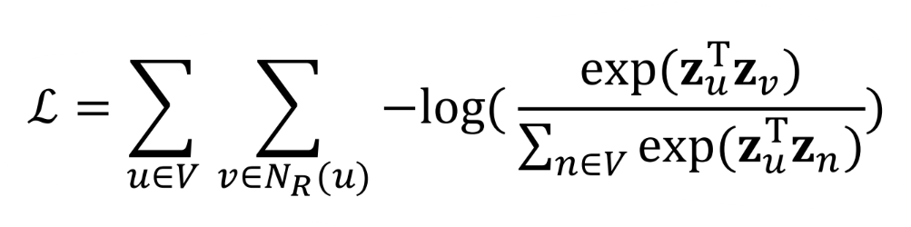
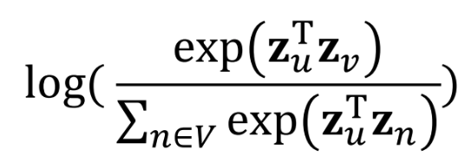
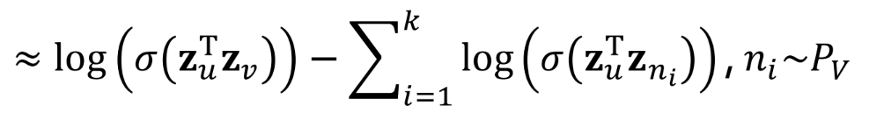
Negative Sampling in Optimzation
Problem: Expensive in summing over nodes ( )
random distribution over nodes
Solution: Negative Sampling (Softmax → Sigmoid)
Higher k gives more robust estimates. In practice k = 5-20.

Slide 8

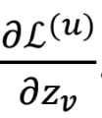
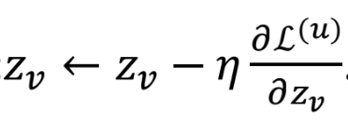
Stochastic Gradient Descent
Goal: Optimize
(Stochastic) Gradient Descent: a simple way to minimize L
SGD Algorithm:
Initialize at some randomized value for all nodes u.
Iterative until L converges:
Sample a node u, for all v calculate the derivative
For all v, update:

Slide 9
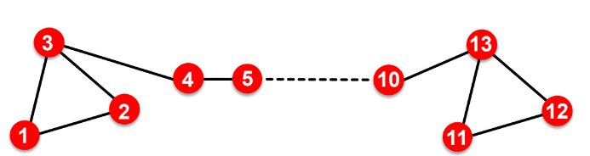
How should we randomly walk?
What strategies should we use to run the random walks?
Simplest idea: Just run fixed-length, unbiased random walks starting from each node (i.e., DeepWalk from Perozzi et al., 2013)
Issue: Not rich enough to embed nodes from same network community as well as nodes with similar structural roles

Slide 10
node2vec
Goal: Embed nodes with similar network neighborhoods close in the embedding space.
Key: Develop biased 2nd order random walk strategy R to generate richer node embeddings.
Learning method: Maximum likelihood optimization problem
hope to embed well on community networks and similar structural roles

Slide 11

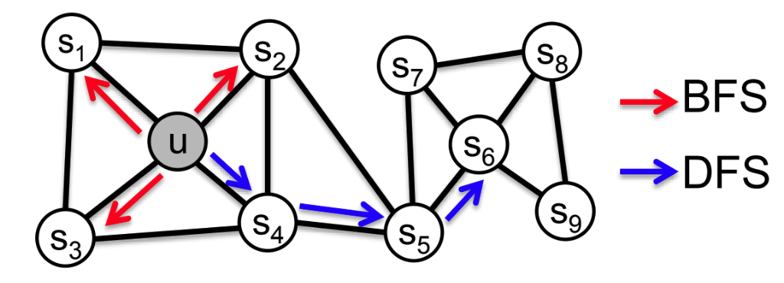
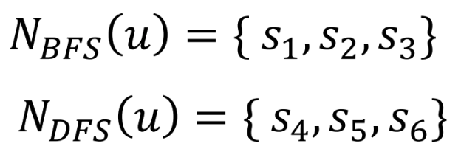
node2vec: Biased Walks
Idea: Use flexible, biased random walks that can trade off between local and global views of the network (Grover and Leskovec, 2016).
Two classic strategies to define a neighborhood of a given node u
(breadth-first search)
(depth-first search)
Walk of length ( of size 3):
Local view
Global view

Slide 12
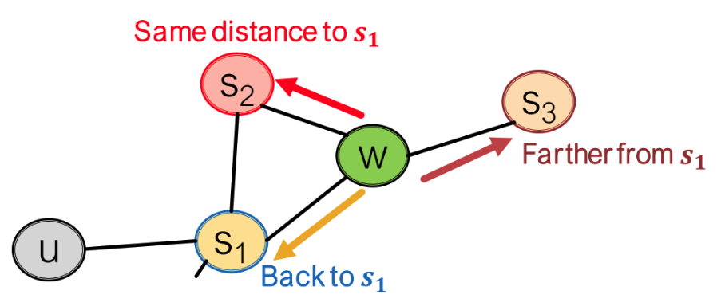
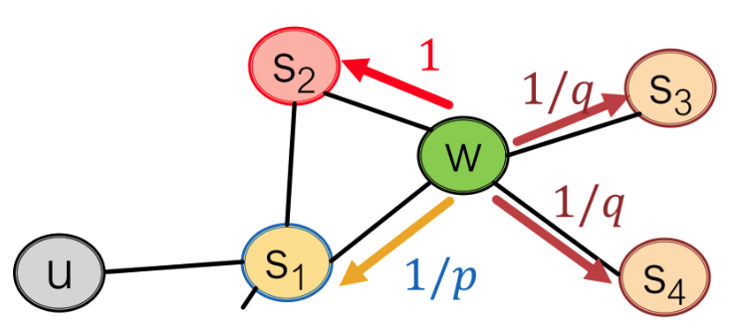
Biased Random Walk
Biased 2nd-order random walks explore network neighborhood:
Walker just traversed edge (s1, w) and is at w, now he can go:
1/p, 1, 1/q are unnormalized probs.
p: return parameter
q: “walk away” parameter
BFS-like walk: Low value of p
DFS-like walk: Low value of q
are the nodes visited by the biased walk.

Slide 13
node2vec algorithm
Compute random walk probabilities
Simulate r random walks of length l starting from each node u
Optimize the node2vec objective using stochastic gradient descent
→ The training process is same as DeepWalk, except the walking strategy

Slide 14
Summary of Random Walks
What can we do now? → We can get good node embeddings that distances in embedding space reflect node similarities in the original graph network.
Different method for node similarity:
Naive: similar if 2 nodes are connected
Local, global neighborhood overlap (Chap 2-2)
Random walk approaches
Which method should we use?
No one method wins in all cases
choose node similarity that matches your application

Slide 15
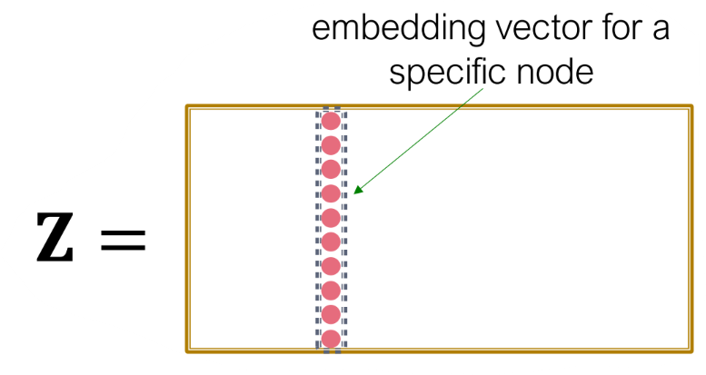

Random Walk Summary
Random Walks for Shallow Encoding:
Goal: Generate a lookup table for node embeddings
Run random walks for each node
Collect the set of visited nodes for each node on the walks
Optimize the embeddings using stochastic gradient descent

