Slide 1

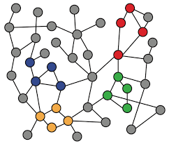
3-1. Node Embeddings Introduction
Machine Learning with Graphs
Graph Representation Learning
Node Embedding
Shallow Encoding
ref: Jure Leskovec – Stanford CS224W: Machine Learning with Graphs
周遠同 (Chou Yuan-Tung), ton731@gmail.com

Slide 2

Traditional ML for Graphs
We can extract node, edge, graph-level features from the graph, then learn a model to map the features to the desired labels.
Input
Graph
Structured Features
Learning Algorithm
Prediction
Feature Engineering
SVM
Random Forest
XGBoost
DNN
Node-level
Edge-level
Graph-level
Node feature
Edge feature
Graph feature

Slide 3

Graph Representation Learning
Graph Representation Learning aims to generate graph representation vectors that describe graph’s structure. So we don’t need to do feature engineering every single time.
Input
Graph
Structured Features
Learning Algorithm
Prediction
Feature Engineering
SVM
Random Forest
XGBoost
DNN
Node-level
Edge-level
Graph-level
Representation Learning
learn the features by itself

Slide 4
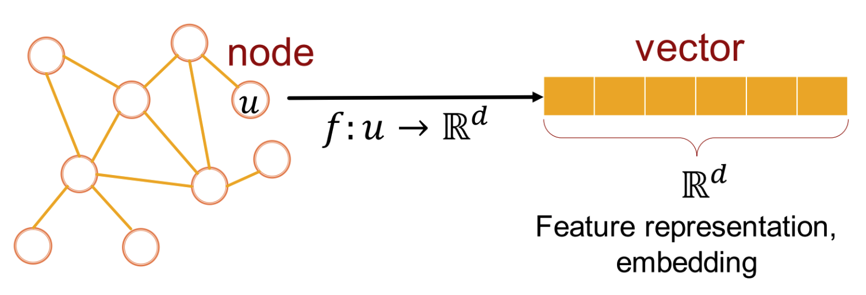

Why Embedding?
Graph Representation Learning: Learn efficient task-independent feature for machine learning with graphs. → Map nodes into an embedding space
Similarity of embeddings between nodes indicates their similarity in the network. (Similar to word embedding!)
For simplicity, no node features or extra information is used
Tasks
Node cls/reg
Edge prediction
Graph cls/reg
Clusternig
…

Slide 5
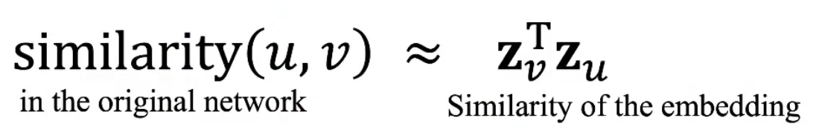
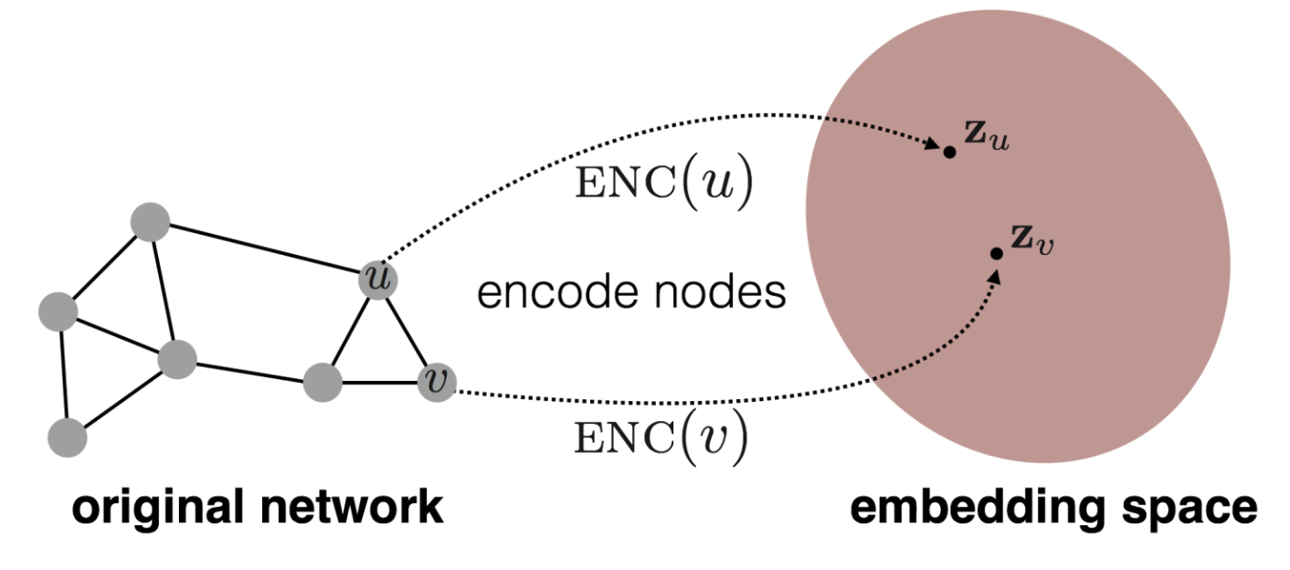
Node Embeddings
Goal: Encode nodes → similarity in embedding space (dot product) ≈ similarity in the original graph
→
We need to define:
ENC(u)
similarity(u, v)
Notes:
ENC(u)"指的是节点u的嵌入编码函数（embedding encoding function）

Slide 6
Learning Node Embeddings
Encoder: node → embedding (d-dimensional vector, ENC(v) = z_v)
Decoder: embedding → similarity score (dot product)
Define a node similarity function: whether 2 nodes are close in the graph, and how close are they?
Optimize →

Slide 7

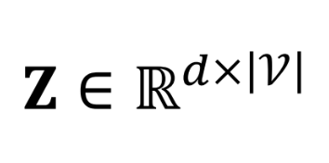
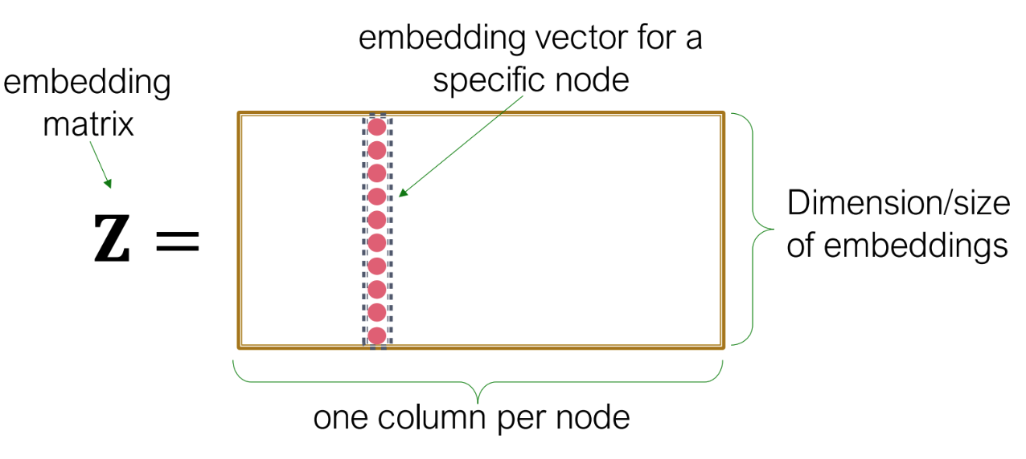
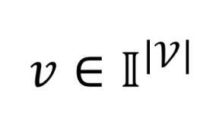
Shallow Encoding
Simplest encoding approach: Build a embedding lookup table
matrix, each column is a node embedding (this is what we want to learn)
indicator vector, all zeros except a one in column for node v
Notes:
节点嵌入仅仅是降维吗？也可以是升维

Slide 8

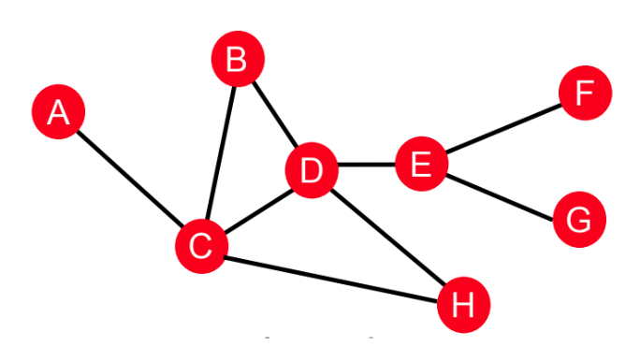
Shallow Encoding
Each node is assigned a unique embedding vector → we directly optimize the embedding of each node
Embedding is optimized to maximize for each similar node pairs (u, v)
Key choice: How to define node similarity? Should 2 nodes have similar embedding if they are linked? they share neighbors? they have similar structure roles? → Random Walks

Slide 9
Note on Node Embeddings
This is unsupervised/self-supervised way of learning node embeddings.
Not using node labels
Not using node features
Directly learn a set of coordinates (the embedding) of a node, so that some feature of the network is preserved.
These embeddings are task independent
They can be used in different downstream predictions.
Notes:
自监督学习的理解：自监督学习其实就是一种聪明的技巧，它可以在没有人工标签的情况下进行学习。在自监督学习中，数据本身就提供了学习的线索。想象一下，你有一本书，但是某些单词被遮住了。尽管这样，你通常还是能根据上下文猜出被遮住的单词是什么。这里，上下文就像是“输入数据的一部分”，而被遮住的单词就像是“数据的其他部分”。自监督学习的过程就像是用书中的其他单词来预测被遮住的单词。在自监督学习的机器学习模型中，我们同样会遮住（或者说移除）数据的一部分，然后让模型尝试预测它。例如，在自然语言处理中，我们可以随机遮住一句话中的某些单词，然后训练一个模型，去根据剩下的单词预测被遮住的单词。在这个过程中，模型学会了理解语言的结构和单词之间的关系。总的来说，自监督学习就是让模型在没有外部标签的帮助下，通过输入数据自身的信息来学习。这样，模型就能学到数据中的模式和结构，从而能在未来的任务中做出更好的决策。

