Slide 1

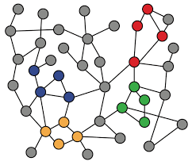
2-2. Traditaional Feature-based Methods: Edge
Machine Learning with Graphs
Distance-based Features
Local Neighborhood Overlap Feature
Global Neighborhood Overlap Feature
ref: Stanford CS224W: Machine Learning with Graphs
Notes:
局部邻域重叠特征
全局邻域重叠特征

Slide 2
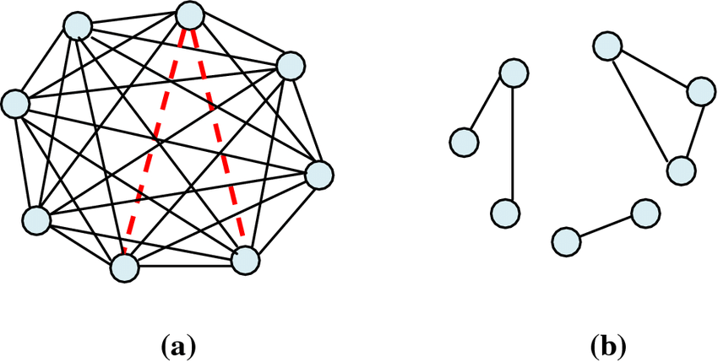
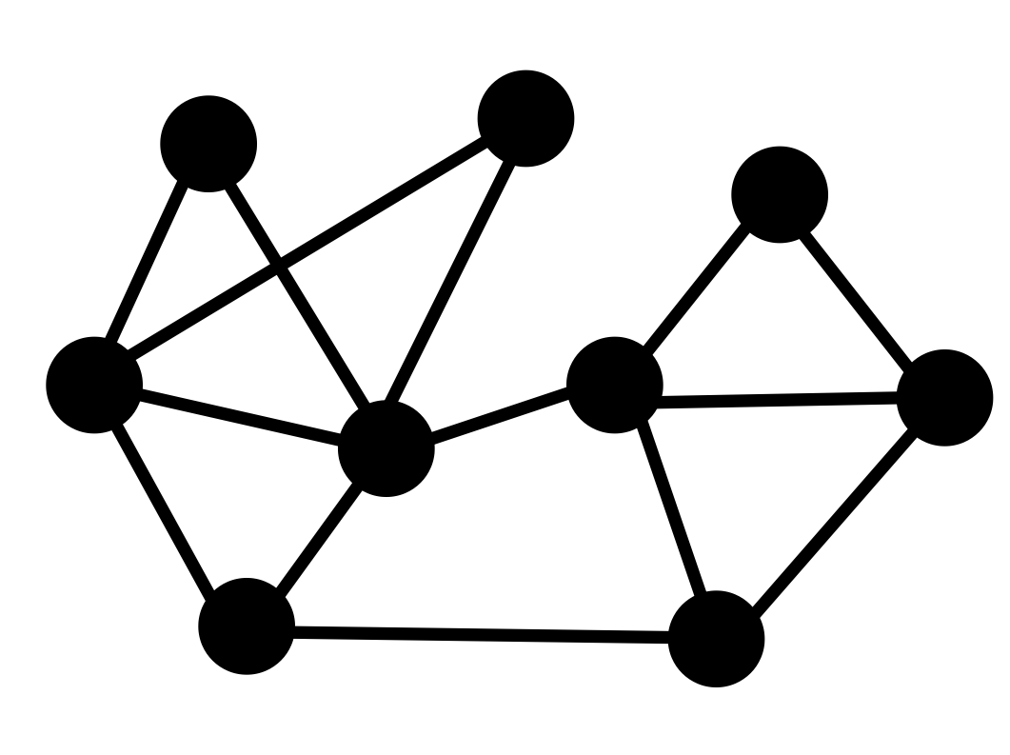

Edge(Link)-level Prediction Task
Predict new links based on existing links.
Predict edge-level features/labels
e1=5
e1=?
e2=3
e2=?
training
testing
t=0
t=1
Multi-moth flame optimization for solving the link prediction problem in complex networks

Slide 3
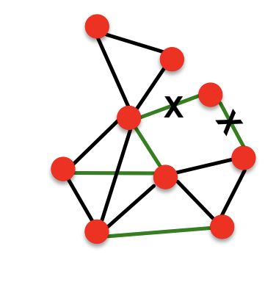
Edge Prediction from Neighborhood
High level idea: design features c(x, y) for each node pair (x, y)
for example, # of common neighbors
select top k pairs as new edges
edge_feature(x, y, e) → new edge_feature
Notes:
标题：邻域中的边缘预测
主要目标是基于网络中每对节点间的属性（特征）来预测网络中新的连接（边缘）。例如，节点对之间共同邻居的数量就是一个特征。
首先，选择具有最高分数的前k个节点对作为新的边缘。
然后，将边缘特征（x, y, e）转换为新的边缘特征值。
这种方法可以用于社交网络中预测可能形成的新友谊链接，或者在蛋白质交互网络中预测哪些蛋白质可能会相互作用。
在应用这种方法时，我们需要考虑如何选择和设计有效的特征，以及如何确定最合适的k值来预测边缘。

Slide 4
Edge-level Features: Overview
Goal: Characterize the structure and connectivity of nodes and edges in the network:
Distance-based features
Local neighborhood overlap
Global neighborhood overlap
Notes:
目标：通过我们表示出来的这个future，它可以描述出两个节点之间的连通性

Slide 5
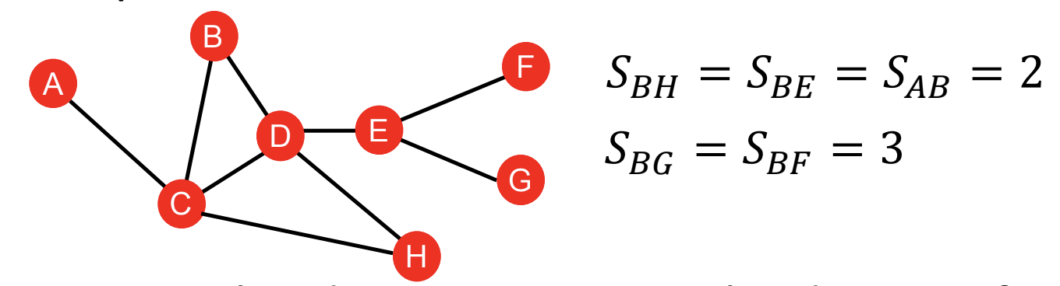
Distance-based Features
Shortest-path distance between two nodes
For exmaple:
However, this does not capture the degree of neighborhood overlap:
Node pair (B, H) has 2 shared neighboring nodes, while pairs (B, E) and (A, B) only have 1 such node.
Notes:
这个方法得到的BH、BE、AB都是二，这三条边是一样的，但是事实上，B与H、B与E直接的链接紧闭程度是不一样的

Slide 6

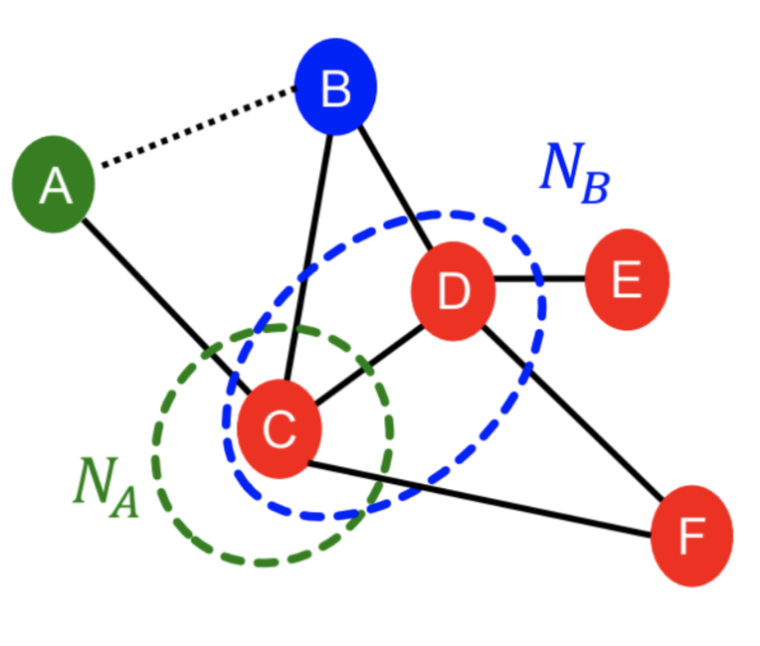
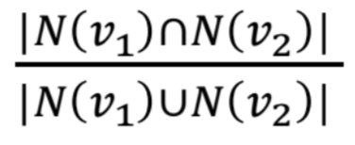
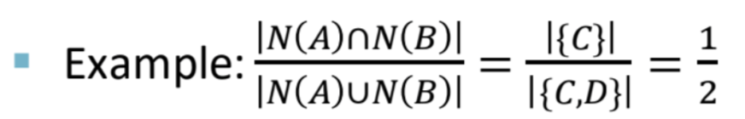
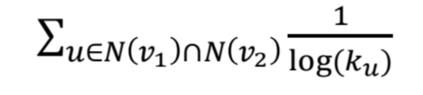
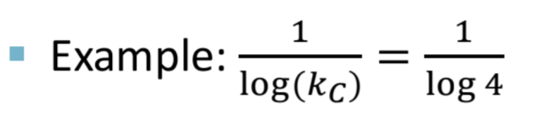
Local Neighborhood Overlap
Captures # neighboring nodes shared between two nodes v1 and v2:
Common neighbors:
Jaccard’s coefficient:
Adamic-Adar index:
Notes:
局部邻域重叠特征

Slide 7
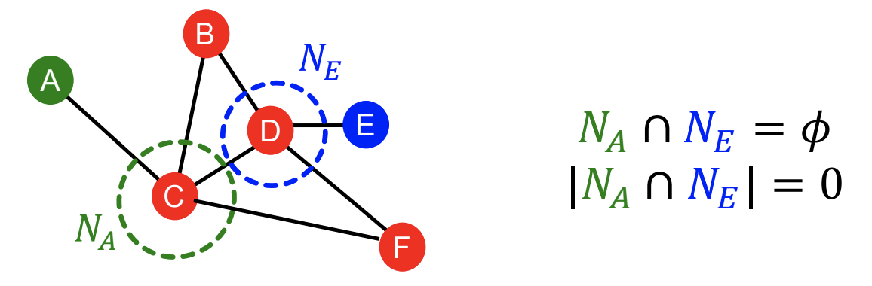
Global Neighborhood Overlap
Limitation of local neighborhood overlapping features:
Metric is always zero if the two nodes do not have any neighbors in common.
However, the two nodes may still potentially be connected in the future.
→ Global neighborhood overlap features resolve the limitation by considering the entire graph.
Notes:
全局邻域重叠特征

Slide 8
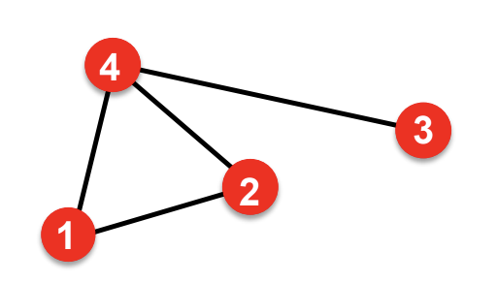
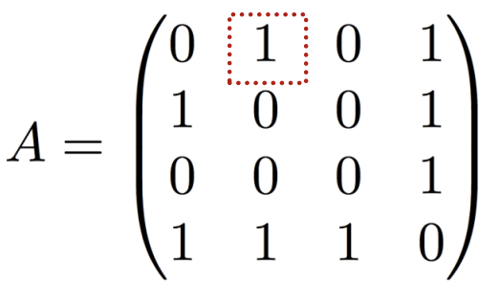
Global Neighborhood Overlap: Katz Index
Katz index: count the number of walks of all lengths between a given pair of nodes.
How to compute number of walks?
→ Powers of the graph adjacency matrix
Ai,j = 1 if node i, j are connected

Slide 9
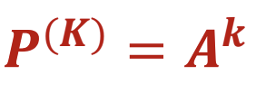
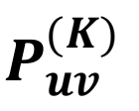
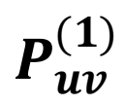

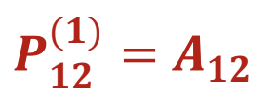
Katz Index
So, what is number of walks?
We want to show:
where = #walks of length K between u and v
= #walks of length 1 (direct neighborhood) between u and v =

Slide 10
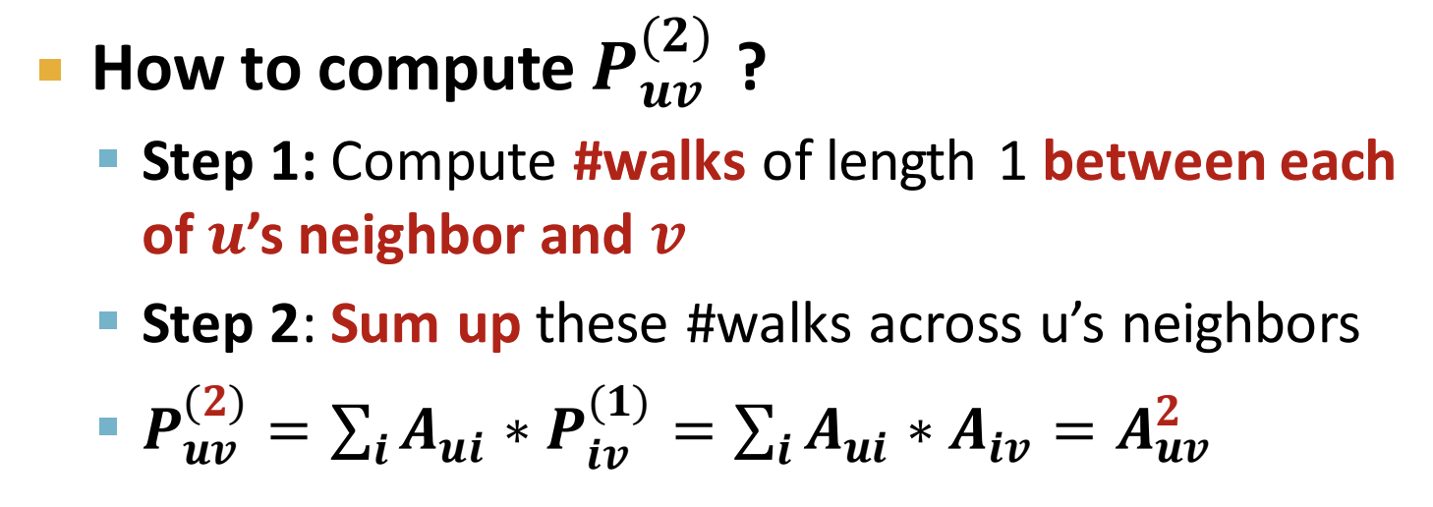
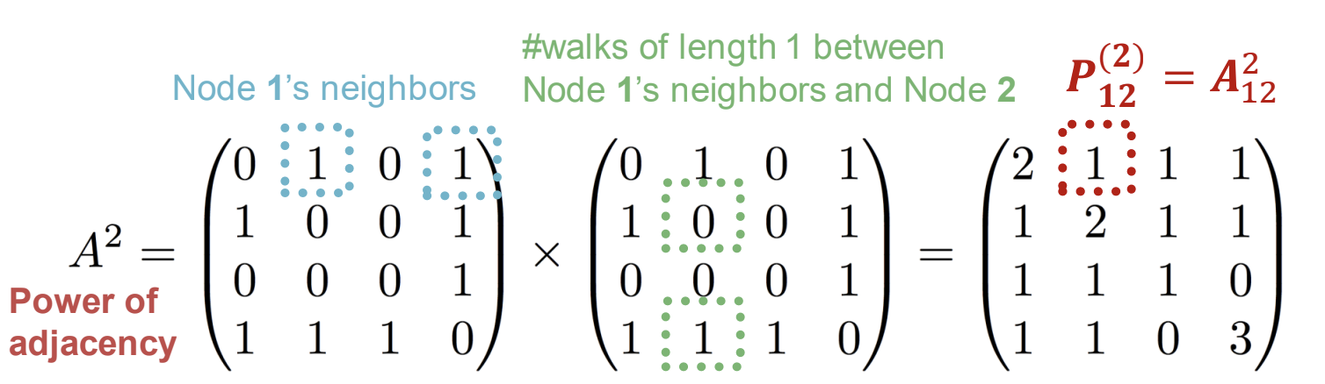
Katz Index

Slide 11



Katz Index
Using powers of adjacency matrix, we can calculate number of walks of all lengths between a pair of nodes.
specifies #walks of length 1 (direct neighborhood) between u and v.
specifies #walks of length 2 (neighbor of neighbor) between u and v.
specifies #walks of length l.

Slide 12
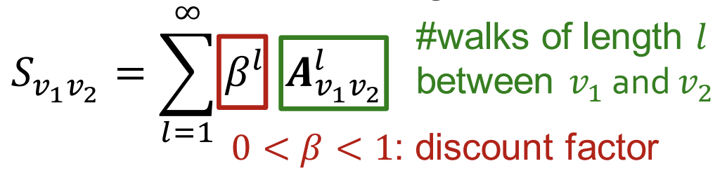
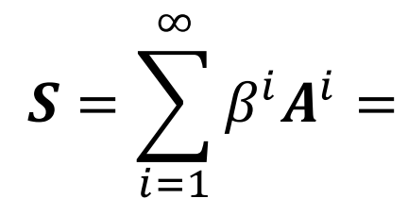
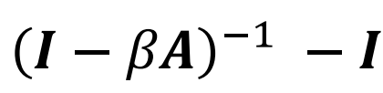
Katz Index
Katz index between v1 and v2 is calculated as sum over all walk lengths.
Katz index matrix is computed in closed-form:
Notes:
类比无穷级数1/1-x

Slide 13
Summary: Ways to Obtain Edge Features
Distance-based features:
Calculates shortest path between 2 nodes, but cannot capture overlapping neighboods.
Local neighborhood overlap:
Captures number of sharing neighborhoods between 2 nodes. Only focuses nodes within 2-hop.
Global neighborhood overlap:
Katz index uses entire graph structure to score 2 nodes. It can capture the structure globally.

