Slide 1

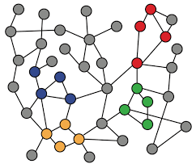
2-1. Traditaional Feature-based Methods: Node
Machine Learning with Graphs
Graph Prediction in Traditional ML
Importance-based Node Features
Structure-based Node Features
ref: Stanford CS224W: Machine Learning with Graphs

Slide 2
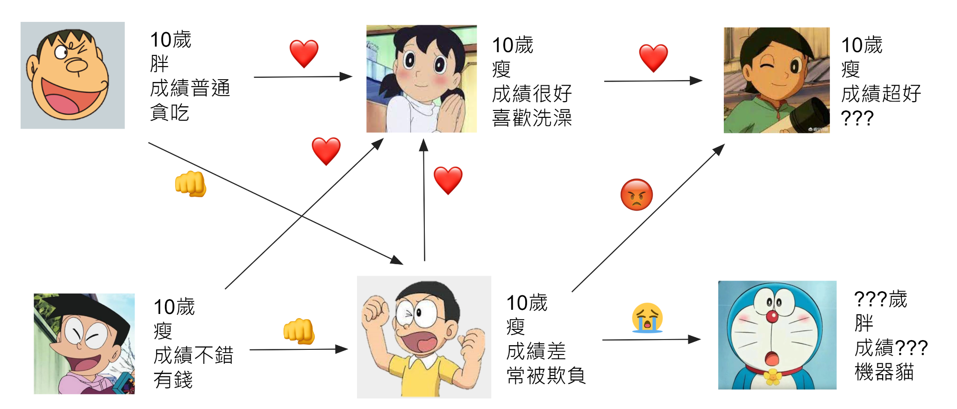
Machine Learning Tasks
Node-level, Edge-level, Graph-level prediction
Graph-level
Edge-level
?
Node-level

Slide 3
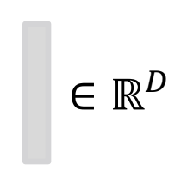
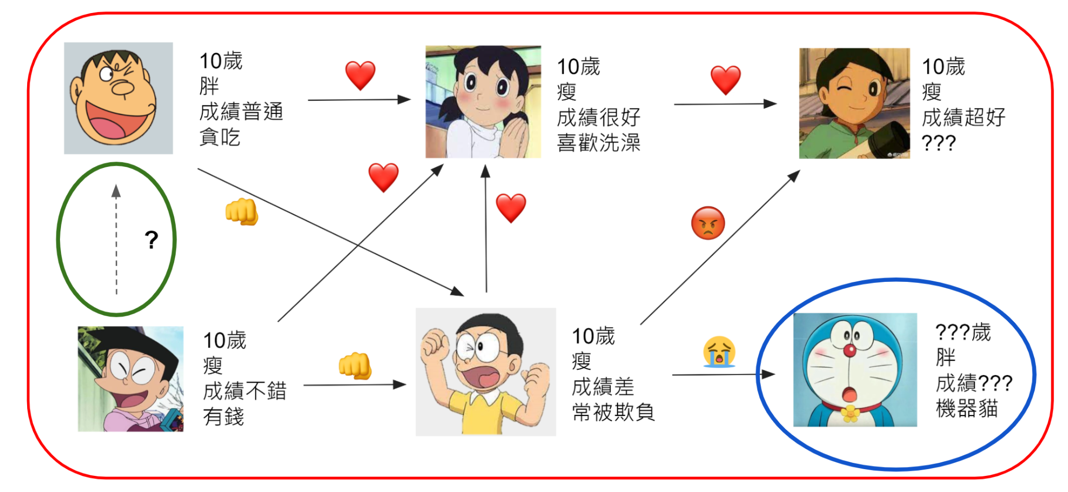
Traditional ML Pipeline
First, design features for nodes/edges/graphs
Graph features
Edge features
Node features

Slide 4

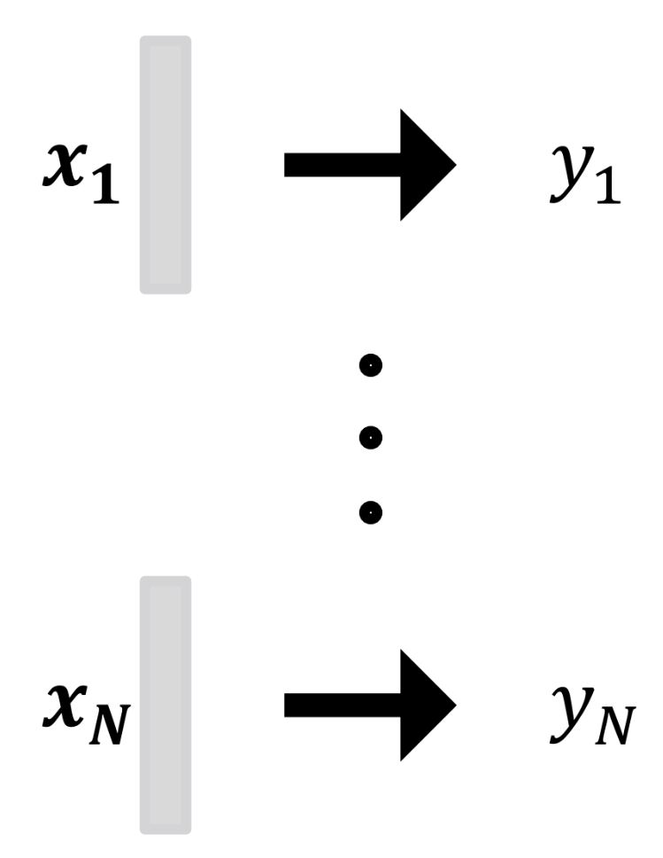

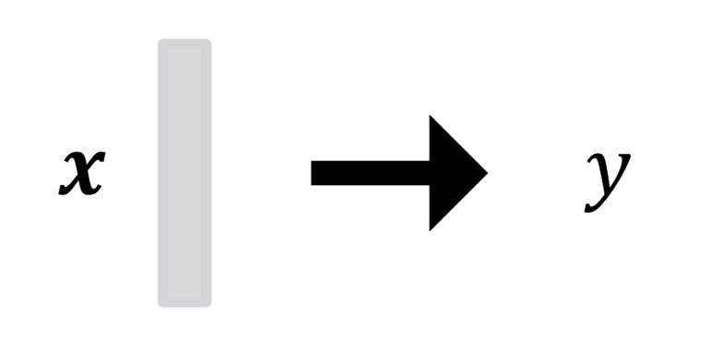

Traditional ML Pipeline
1. Feature extraction
  Node feature
  Edge feature
  Graph feature
2. Train ML model
  Random Forest
  XGBoost
  DNN
3. Apply the ML model
  Given a new node/edge/graph, obtain its features and make a prediction
Node features
Edge features
Graph features
Notes:
特征提取：这是模型训练前的准备工作，涉及到获取和构造输入数据的特征。这里列举了三种类型的特征：
节点特征（Node feature）
边特征（Edge feature）
图特征（Graph feature）
每种特征都表示为 RD，这意味着它们是在D维的实数空间中表示的。
训练ML模型：一旦特征被提取和准备好，接下来的步骤是选择并训练一个机器学习模型。PPT中提到了三种常见的机器学习模型：
随机森林（Random Forest）
极端梯度提升（XGBoost）
深度神经网络（DNN）
训练过程包括使用大量已知输出的示例来训练模型，使其能够识别输入数据和输出结果之间的关系。
应用ML模型：这是将训练好的模型应用于新数据的过程，以进行预测。当给定一个新的节点、边或图时，模型会提取其特征，并基于这些特征做出预测。PPT展示了模型针对不同输入（代表不同实例）生成不同的预测

Slide 5
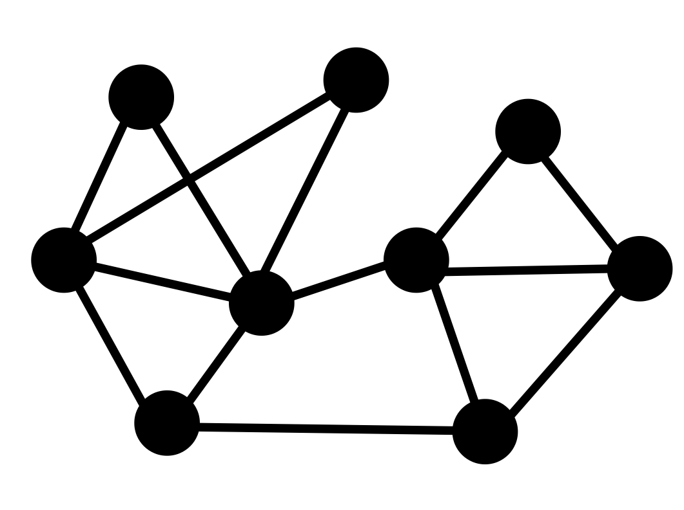
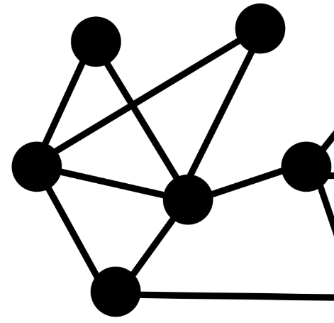

Feature Design
Using effective features over graphs is the key to achieving good model performance.
Besides the original node/edge/graph features, can we embed topology structure into node/edge/graph features?
Graph
Node Prediction
With neighboring topology
Notes:
如果中间的跟上面的有着一样的节点特征，那么他们输入到模型中时候就会有一样的输出？

Slide 6
Node-level Features: Overview
Goal: Characterize the structure and position of a node in the network:
Importance-based features
  Node degree
  Node centrality
Structure-based features
  Node degree
  Clustering coefficient
  Graphlets

Slide 7
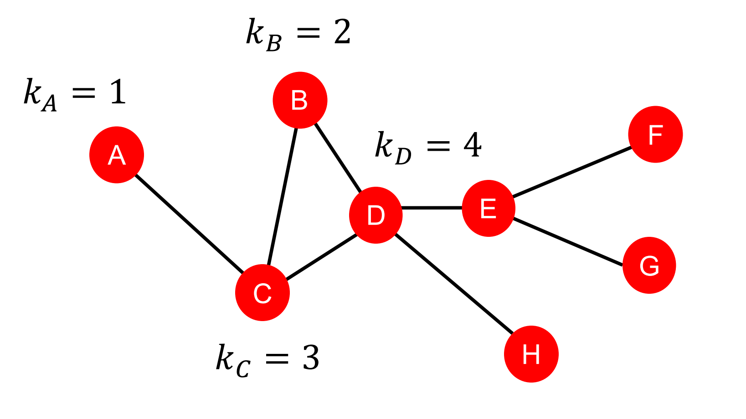
Node Features: Degree
The degree kv of node v is the number of edges (neighboring nodes) the node has.
Treats all neighboring nodes equally.

Slide 8
Node Features: Node Centrality
Node degree counts the neighboring nodes without capturing their importance.
Node centrality cv takes the node importance in a graph into account.
Different ways to evaluate importance:
  Eigenvector centrality
  Betweenness centrality
  Closeness centrality
  and many others….
Notes:
节点度对相邻节点进行计数，但不捕捉它们的重要性。

Slide 9
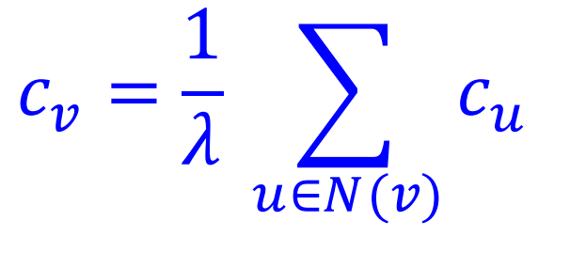
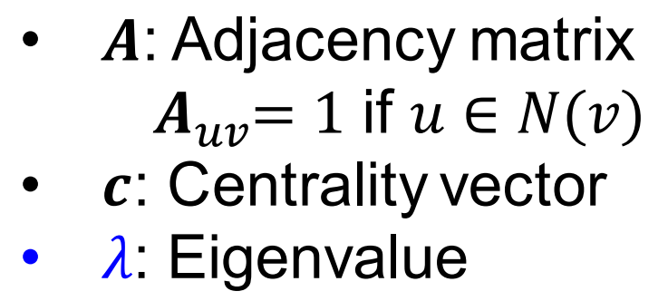

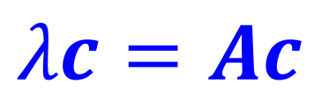
Node Features: Node Centrality (1)
Eigenvector Centrality
A node v is important if surrounded by important neighboring nodes u ∈ N(v).
We model the centrality of node v as the sum of the centrality of neighboring nodes recursively:
We can see that centrality c is the eigenvector fo A
Notes:
非常棒的一个公式，根据特征值与特征向量巧妙的解决了递归计算的问题
Eigenvector 特征向量
Recursively递归

Slide 10
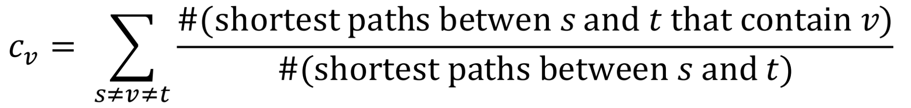
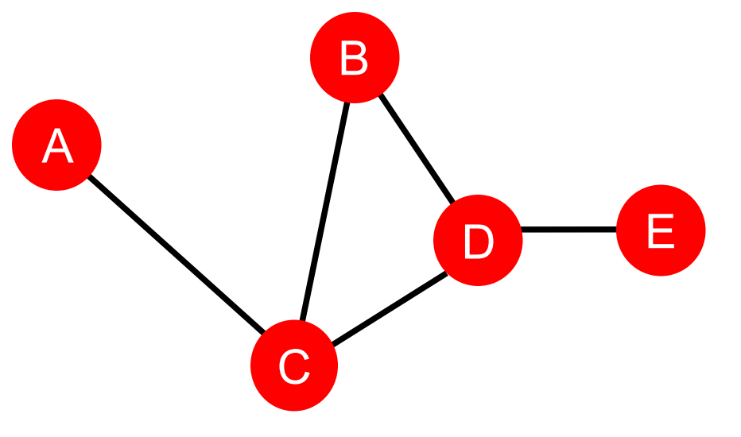
Node Features: Node Centrality (2)
Betweenness Centrality
A node is important if it lies on many shortest paths between other nodes.
For example:
C_A = C_B = C_E = 0
C_C = 3 (A-C-B, A-C-D, A-C-D-E)
C_D = 3 (A-C-D-E, B-D-E, C-D-E)
Notes:
Betweenness Centrality介数中心性
#表示它的个数

Slide 11
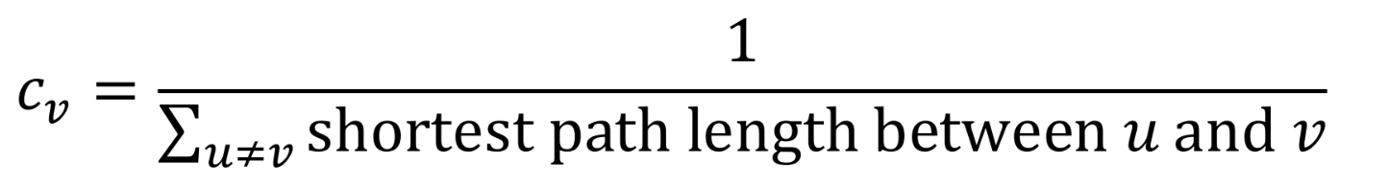
Node Features: Node Centrality (3)
Closeness Centrality
A node is important if it has small shortest path lengths to all other nodes.
For example:
C_A = 1/(2 + 1 + 2 + 3) = 1/8
(A-C-B, A-C, A-C-D, A-C-D-E)
C_D = 1/(2 + 1 + 1 + 1) = 1/5
(D-C-A, D-B, D-C, D-E)
Notes:
接近中心性

Slide 12
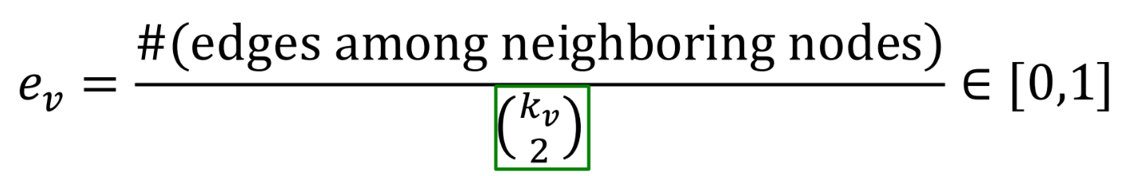
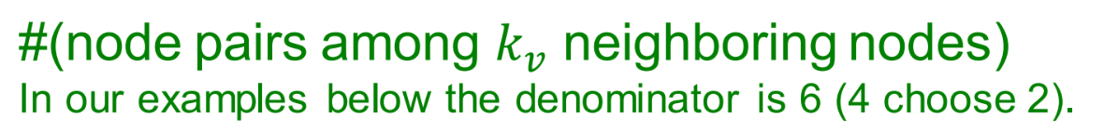
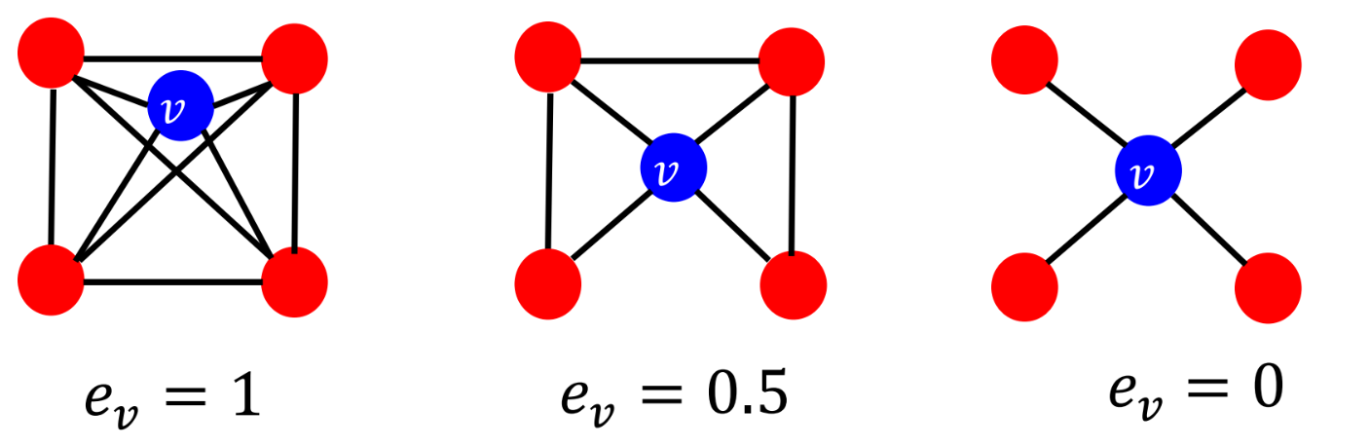
Node Features: Clustering Coefficient
Measures how connected v′s neighboring nodes are:
For example:
6/6
3/6
0/6

Slide 13
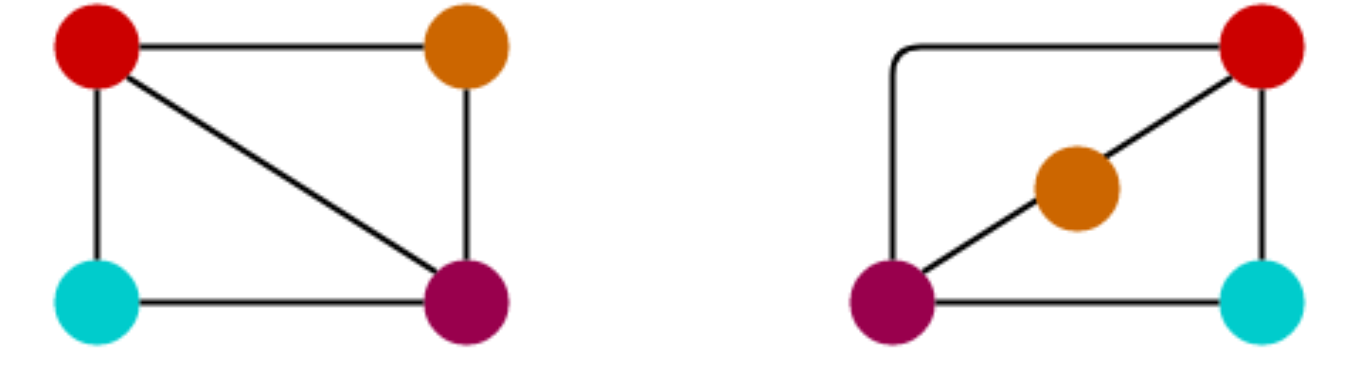
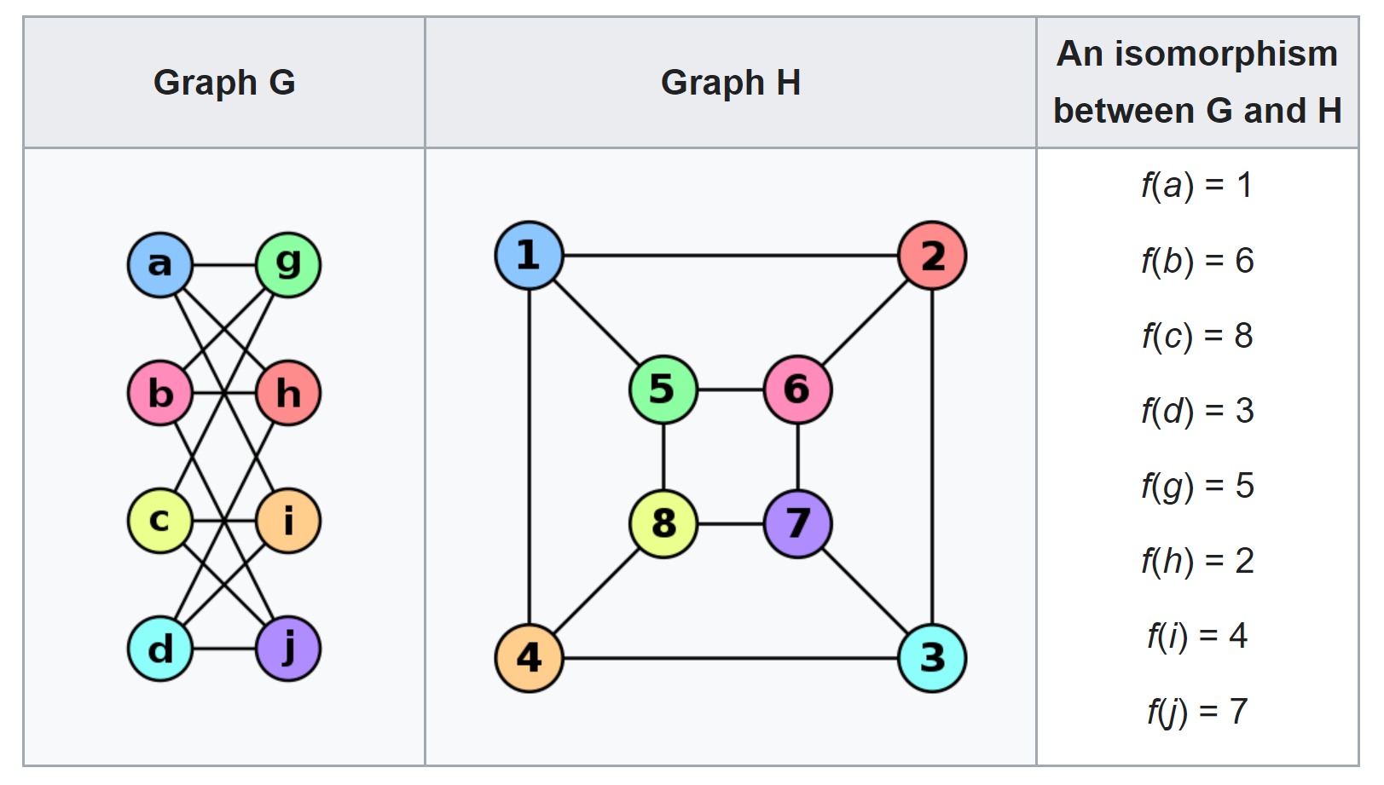
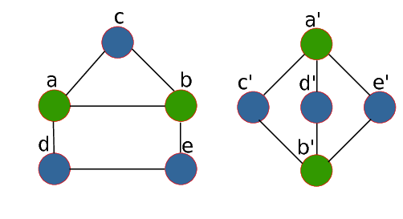
Graph Isomorphism
Isomorphic graphs having the same number of vertices, edges, and also the same edge connectivity.
isomorphic
source: wiki
non-isomorphic
Notes:
Graph Isomorphism 图的同构

Slide 14
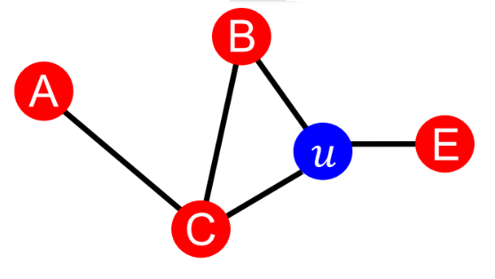
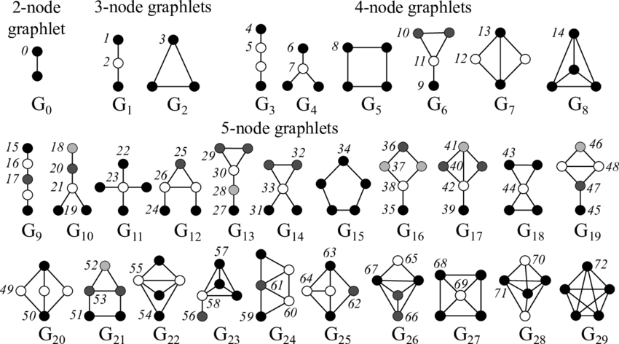
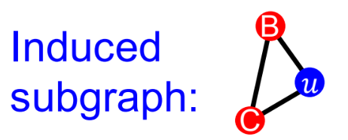
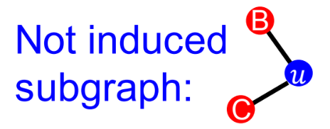
Node Features: Graphlet
Graphlets are induced, non-isomorphic subgraphs that describe the structure of node u’s network neighborhood.
u has graphlets:
[0, 1, 2, 3, 5, 10, 11]

Slide 15
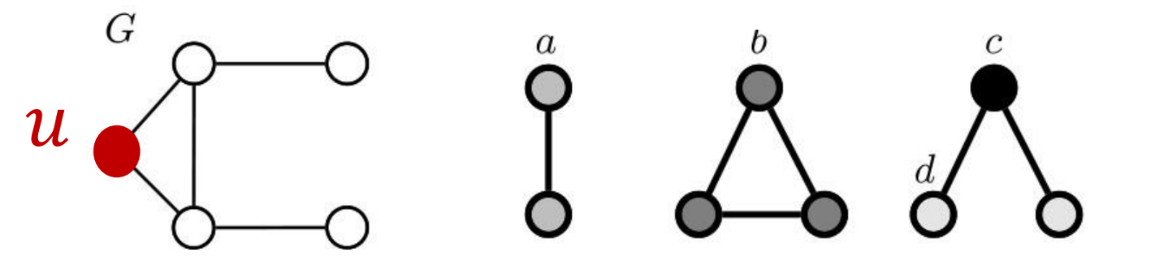
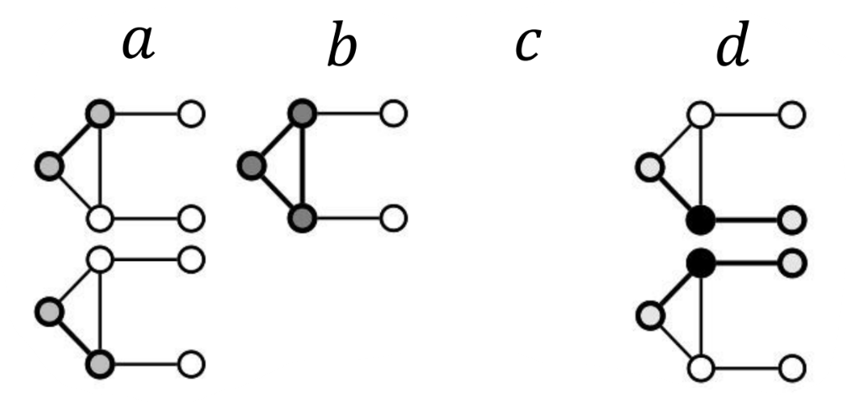
Graphlet Degree Vector (GDV): A count vector of graphlets rooted at a given node.
Graphlet degree vector provides a measure of a node’s local network topology (more detail than node degrees or clustering coefficient.).
select graphlets up to 3 nodes
Using 5-node graphlets we can derive a 73 dim vector
Graphlet instances for node u
GDV for node u:
[a, b, c, d] = [2, 1, 0, 2]

Slide 16
Summary: Ways to Obtain Node Features
Importance-based features: capture the importance of a node in a graph, useful for predicting influential nodes in a graph
  Node degree
  Node centrality (Eigenvector, Betweenness, Closeness Centrality)
Structure-based features: capture topological properties of local neighborhood around a node, useful for predicting a particular role a node plays in a graph
  Node degree
  Clustering coefficient
  Graphlets

